Slide 1
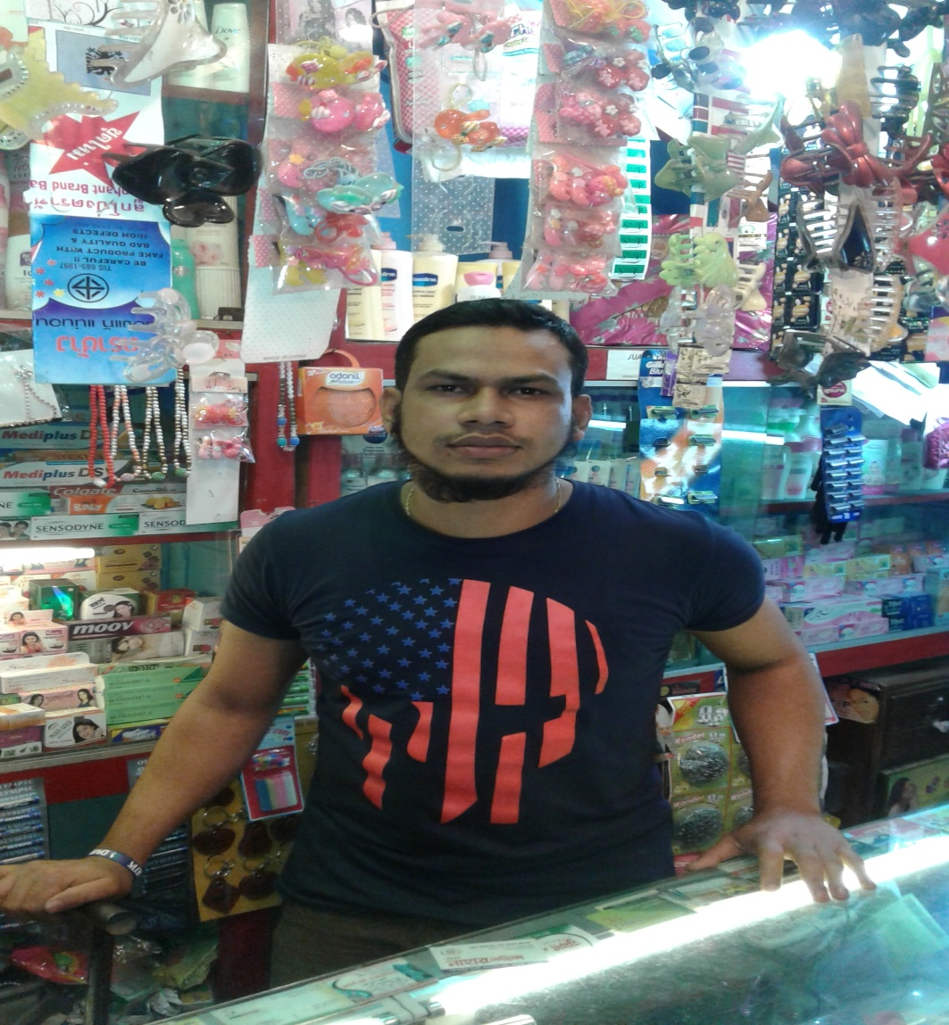

Juyena Cosmetics
Project by: Md. Mohsin
Identified by: Md. Billal Hossain
Verified By : Md. Zahidul Kabir
Noakhali Unit
Region -2
GRAMEEN TRUST

Slide 2
Brief Bio of the PROPOSED Nobin Udyokta
Name | : | Md. Mohsin
Permanent Address | : | Amanotpur, Begumgonj, Noakhali-3822
Age | : | 01-Jan-1992 (24Years)
Marital status | : | Married
Children | : | 01 Children
No. of siblings: | : | 05 Brothers, 03 Sisters
Parent’s and GB related Info (i) Who is GB member (ii) Mother’s name (iii) Father’s name (iv) GB member’s info Further Information: (v) Who pays GB loan installment (vi) Mobile lady (vii) Grameen Education Loan Any other loan like GCCN, GKF | : : : : : : : : | Mother Father Late. Umme Kulsum Md. Golam Sarwar Branch: Jirtoli, Begomgonj, Centre :0, Group no : 0, Loanee no.: 0, Member since: 2002 Drop Out: 2008, First loan: 5,000/-, Existing loan: 20,000/-, Outstanding: Nil. N/A N/A N/A N/A N/A
Education | : | Class Eight

Slide 3
Brief Bio of the PROPOSED Nobin Udyokta (cont…)
Present Occupation | : | Cosmetics Collect raw materials from Chowmohani Bazar. Local Consumer are the target customer group.
Initial Investment | : | 1,00,000/=
Trade License No |  | 367/2016-2017
Business Experience And Training Info | : : | 06 Years Received training from Chowmohani Bazar for 02years.
Other Own/Family Sources of Income | : | N/A
Other Own/Family Sources of Liabilities | : | N/A
NU Contact Info |  | +8801623-057371 (This number will be registered in SBMS System for Daily SMS)
NU Project Source/Reference | : | Noakhali Unit

Slide 4
brief history of GB loan utilization by Family
NU’s mother has been a member of Grameen Bank since 2002 to 2008 (06 Years). At first she took a loan of Taka 5,000/- from Grameen Bank. His father used GB loan in his business and repaired their own houses from his income. NU also built their own house from the income of GB loan. They also bought some land. NU’s mother gradually improved their life standard by using GB loan.

Slide 5
Proposed Nobin Udyokta business INFO
Business Name | : | Juyena Cosmetics.
Address/ Location | : | Bangla Bazar, Begumgonj, Noakhali-3822
Total Investment in BDT | : | 2,80,000/-
Financing | : | Self BDT 2,00,000 (from existing business) 71% Required Investment BDT 80,000/-(as equity) 29%
Present salary/drawings from business (estimates) | : | 7,000/-
Proposed Salary | : | 7,000/-
Proposed Business % of present gross profit margin (ii) Estimated % of proposed gross profit margin (iii) Agreed grace period | : : : | 20% 20% 02 Months

Slide 6
Present & Proposed Investment Breakdown
Particulars | Existing Business (BDT) | Proposed (BDT) | Total (BDT)
Investments in different categories: | (1) | (2) | (1+2)
Present Stock Items: Advance 70,000 Cosmetics Item 60,000 Bag 35,000 Decoration 30,000 Electric Items 5,000 | 2,00,000 |  | 2,00,000
Proposed items: Cosmetics Item 45,000 Bag 35,000 |  | 80,000 | 80,000
Total Capital | 2,00,000 | 80,000 | 2,80,000

Slide 7
Present & Proposed Investment Breakdown
Present Stock Items
Product name | Amount
Advance | 70,000
Cosmetics Item | 60,000
Bag | 35,000
Electric Items | 5,000
Decoration | 30,000
Total Present Stock | 2,00,000/-
Proposed Items
Product Name | Unit | Amount
Cosmetics | 200 | 20,000
Lotion | 150 | 7,500
Gold Plated Items | 150 | 17,500
School Bag | 80 | 20,000
Ladies Bag | 50 | 15,000
Total Proposed Stock |  | 80,000/-

Slide 8
INFO ON EXISTING BUSINESS OPERATIONS
Particulars | Existing Business (BDT)
 | Daily | Monthly | Yearly
Sales (A) | 2,800 | 84,000 | 10,08,000
Less: Cost of sales (B) | 2,240 | 67,200 | 8,06,400
Gross Profit (C) [C=(A-B)] | 560 | 16,800 | 2,01,600
Less: Operating Costs
Electricity bill |  | 400 | 4,800
Generator bill |  | 300 | 3,600
Shop Rent |  | 3,500 | 42,000
Night Guard bill |  | 100 | 1,200
Mobile bill |  | 600 | 7,200
Present salary/Drawings- self |  | 7,000 | 84,000
Conveyance or Transport] |  | 800 | 9,600
Others (fees, Entertainment, TL renew) |  | 500 | 6,000
Non Cash Item:
Depreciation Expenses (30,000*10%+5,000*20% ) |  | 333 | 3,996
Total Operating Cost (F) |  | 13,533 | 1,62,396
Net Profit (E-F): |  | 3,267 | 39,204

Slide 9
Financial Projection of NU Business plan
Particulars | Year 1 (BDT) |  |  | Year 2 (BDT) |  |  | Year 3 (BDT)
 | Daily | Monthly | Yearly | Daily | Monthly | Yearly | Daily | Monthly | Yearly
Sales (A) | 3,000 | 90,000 | 10,80,000 | 3,200 | 96,000 | 11,52,000 | 3,400 | 1,02,000 | 12,24,000
Less: Cost of Sale (B) | 2,400 | 72,000 | 8,64,000 | 2,560 | 76,800 | 9,21,600 | 2,720 | 81,600 | 9,79,200
Gross Profit (A-B)=(C) | 600 | 18,000 | 2,16000 | 640 | 19,200 | 2,30,400 | 680 | 20,400 | 2,44,800
Less: Operating Costs
Electricity bill |  | 400 | 4,800 |  | 400 | 4,800 |  | 400 | 4,800
Generator bill |  | 300 | 3,600 |  | 300 | 3,600 |  | 300 | 3,600
Shop Rent |  | 3,500 | 42,000 |  | 3,500 | 42,000 |  | 3,500 | 42,000
Night Guard bill |  | 100 | 1,200 |  | 100 | 1,200 |  | 100 | 1,200
Mobile bill |  | 600 | 7,200 |  | 600 | 7,200 |  | 600 | 7,200
Present salary/Drawings- self |  | 7,000 | 84,000 |  | 7,000 | 84,000 |  | 7,000 | 84,000
Conveyance or Transport |  | 800 | 9,600 |  | 800 | 9,600 |  | 800 | 9,600
Others (fees, Entertainment, TL renew) |  | 500 | 6,000 |  | 500 | 6,000 |  | 500 | 6,000
Non Cash Item:
Depreciation Expenses |  | 333 | 3,996 |  | 333 | 3,996 |  | 333 | 3,996
Total Operating Cost |  | 13,533 | 1,62,396 |  | 13,533 | 1,62,396 |  | 13,533 | 1,62,396
Net Profit (C-D) = (E) |  | 4,467 | 53,604 |  | 5,667 | 68,004 |  | 6,867 | 82,404
GT payback | 32,000 |  |  | 32,000 |  |  | 32,000
Retained Income: | 21,604 |  |  | 36,004 |  |  | 50,404

Slide 10
Cash flow projection on business plan (Rec. & Pay.)
Sl # | Particulars | Year 1 (BDT) | Year 2 (BDT) | Year 3 (BDT)
1.0 | Cash Inflow
1.1 | Investment Infusion by Investor | 80,000
1.2 | Net Profit | 53,604 | 68,004 | 82,404
1.3 | Depreciation (Non cash item) | 3,996 | 3,996 | 3,996
1.4 | Opening Balance of Cash Surplus |  | 25,000 | 65,000
 | Total Cash Inflow | 1,37,600 | 97,000 | 1,51,400
2.0 | Cash Outflow
2.1 | Purchase of Product | 80,000
2.2 | Payment of GB Loan
2.3 | Investment Pay Back Including ownership Tr. Fee | 32,000 | 32,000 | 32,000
 | Total Cash Outflow | 1,12,000 | 32,000 | 32,000
3.0 | Net Cash Surplus | 25,000 | 65,000 | 1,19,400

Slide 11
SWOT Analysis
STRENGTH Skilled & experienced Well known in locality. Quality services. | WEAKNESS Less Capital
OPPORTUNITIES Shop position is in the center point of business area. Beside main road. | THREATS Fire . Theft.

Slide 12
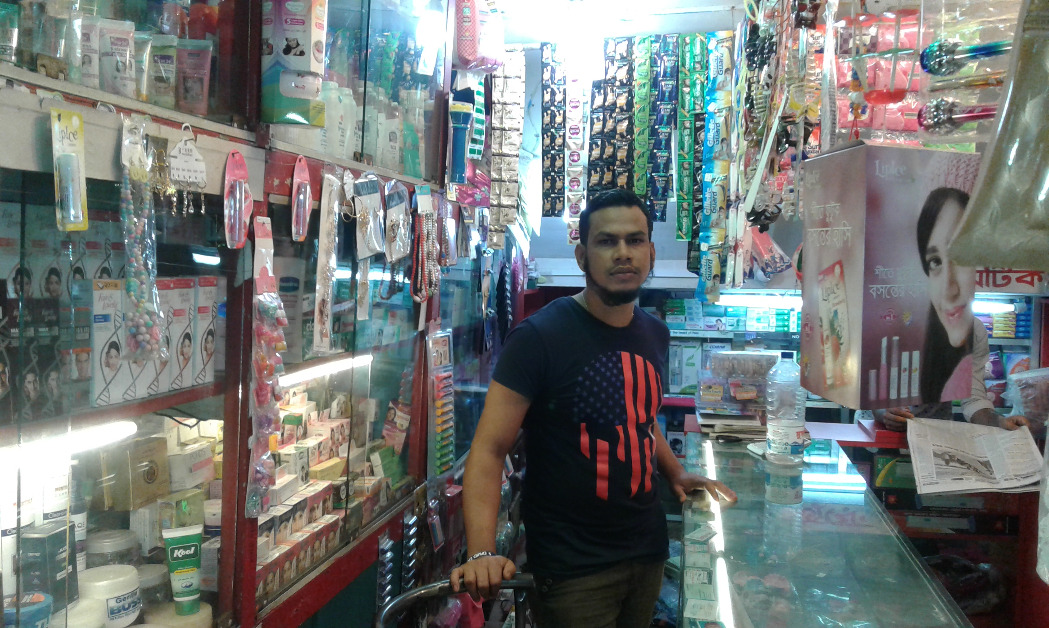

Slide 13
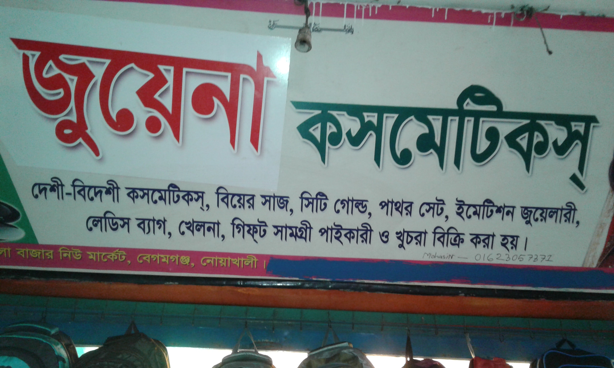

Slide 14
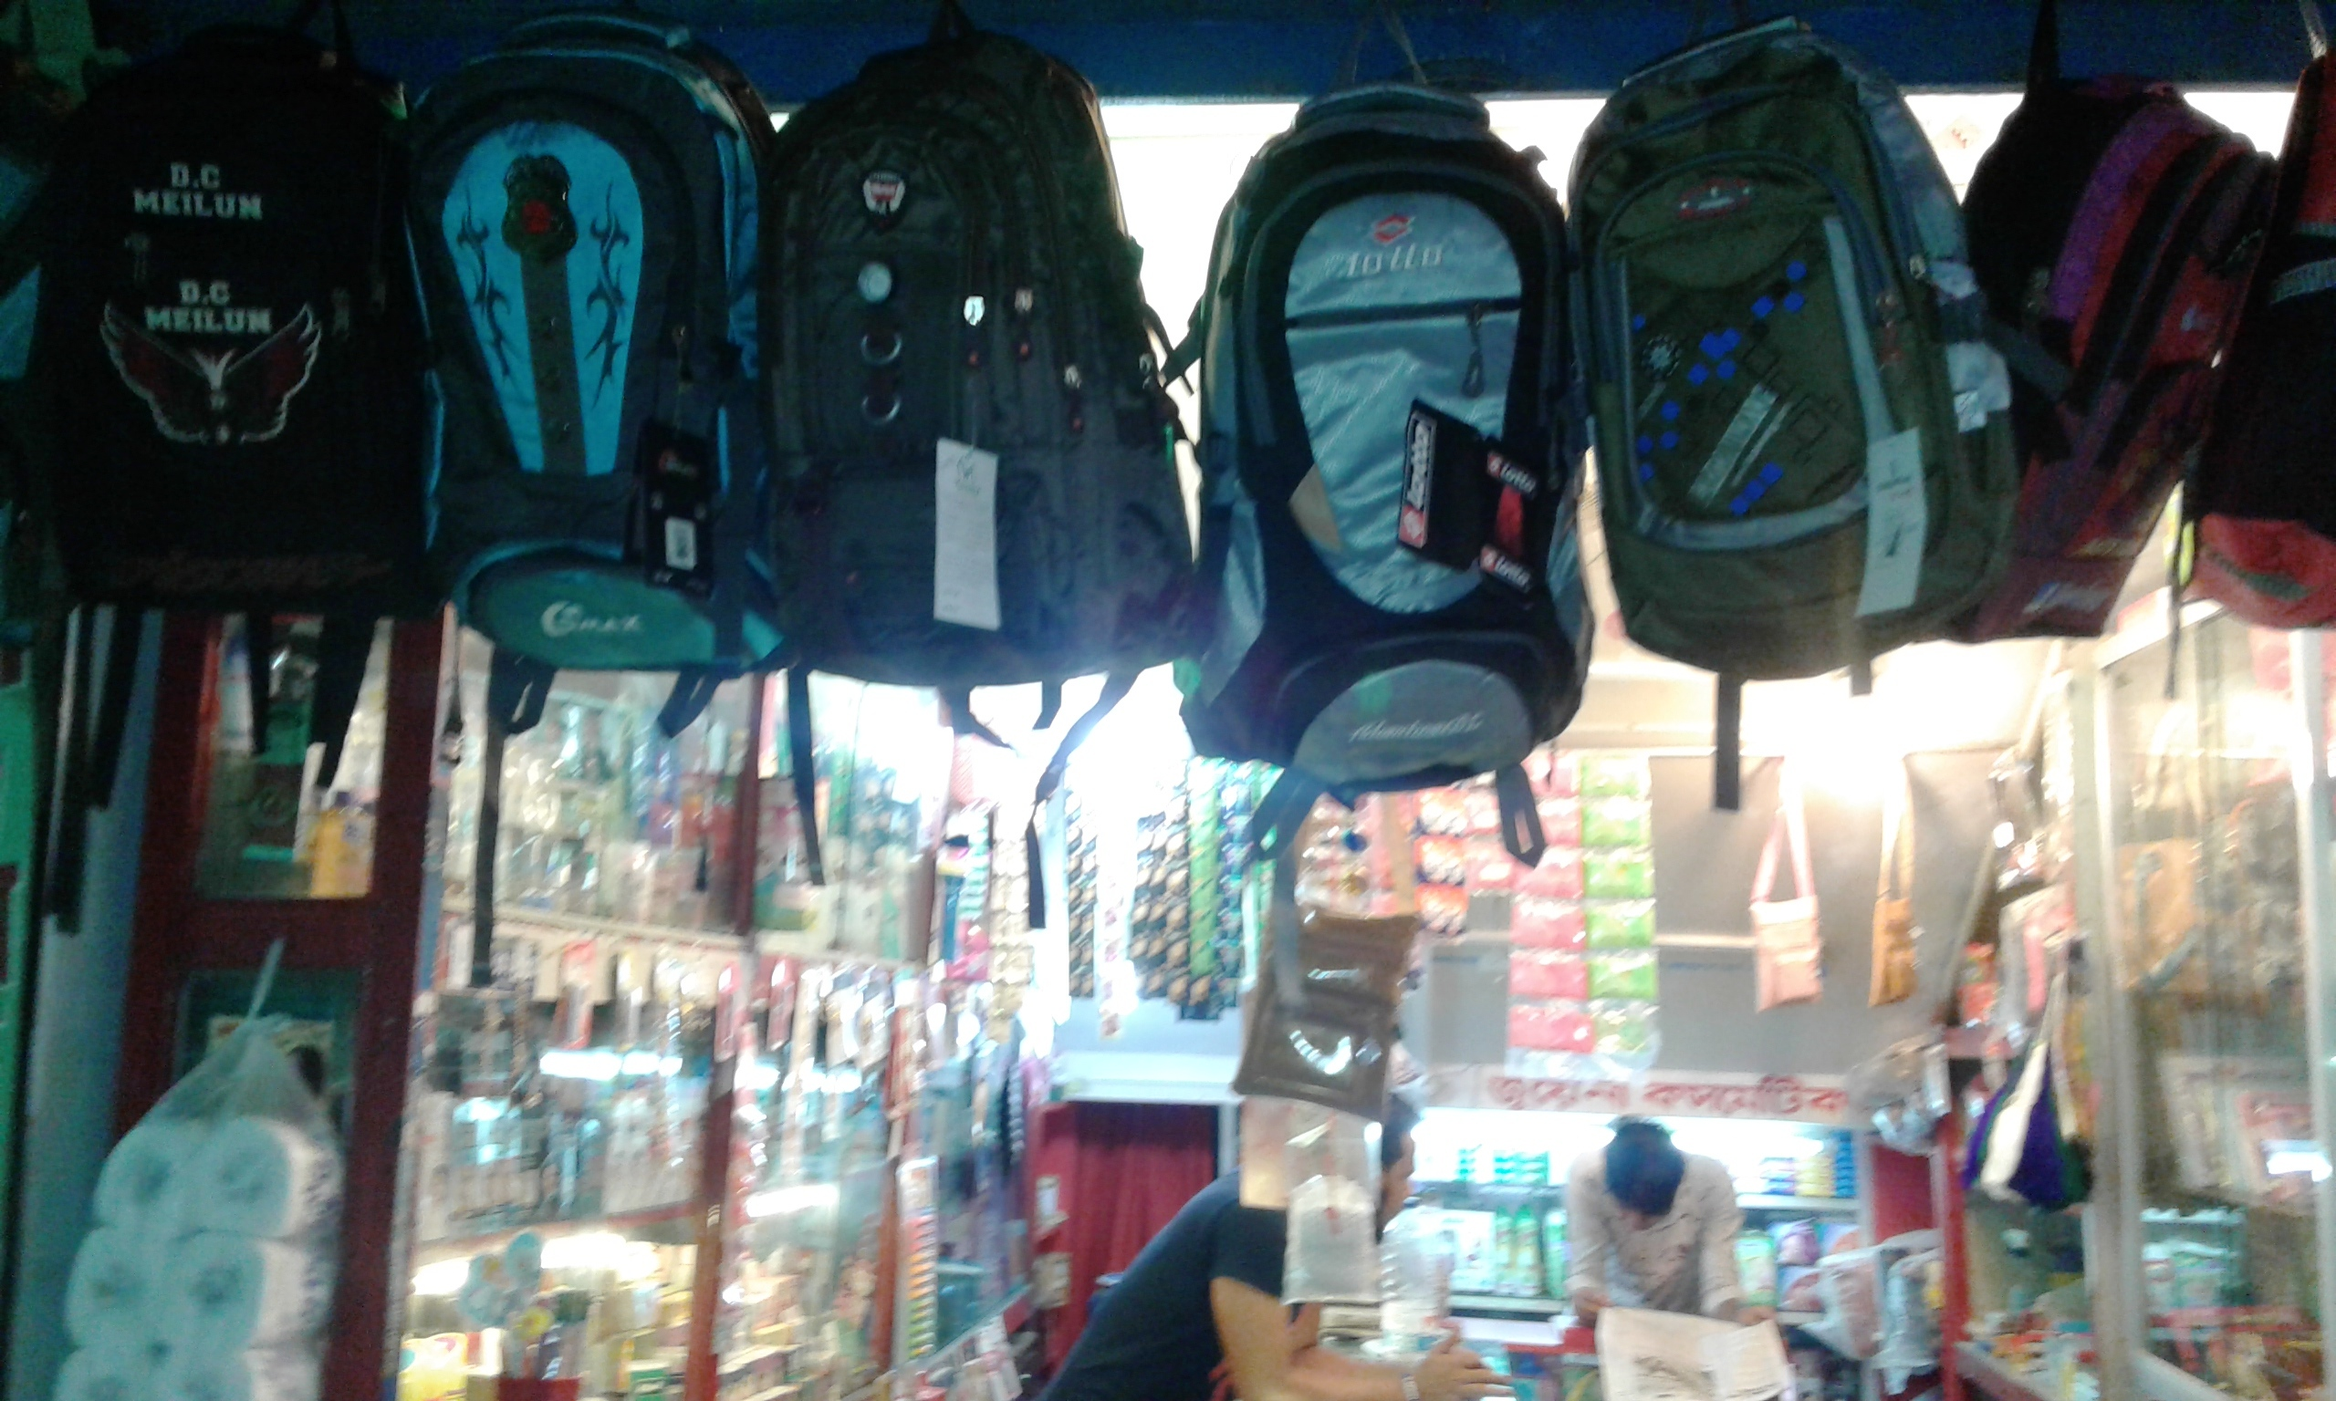

Slide 15
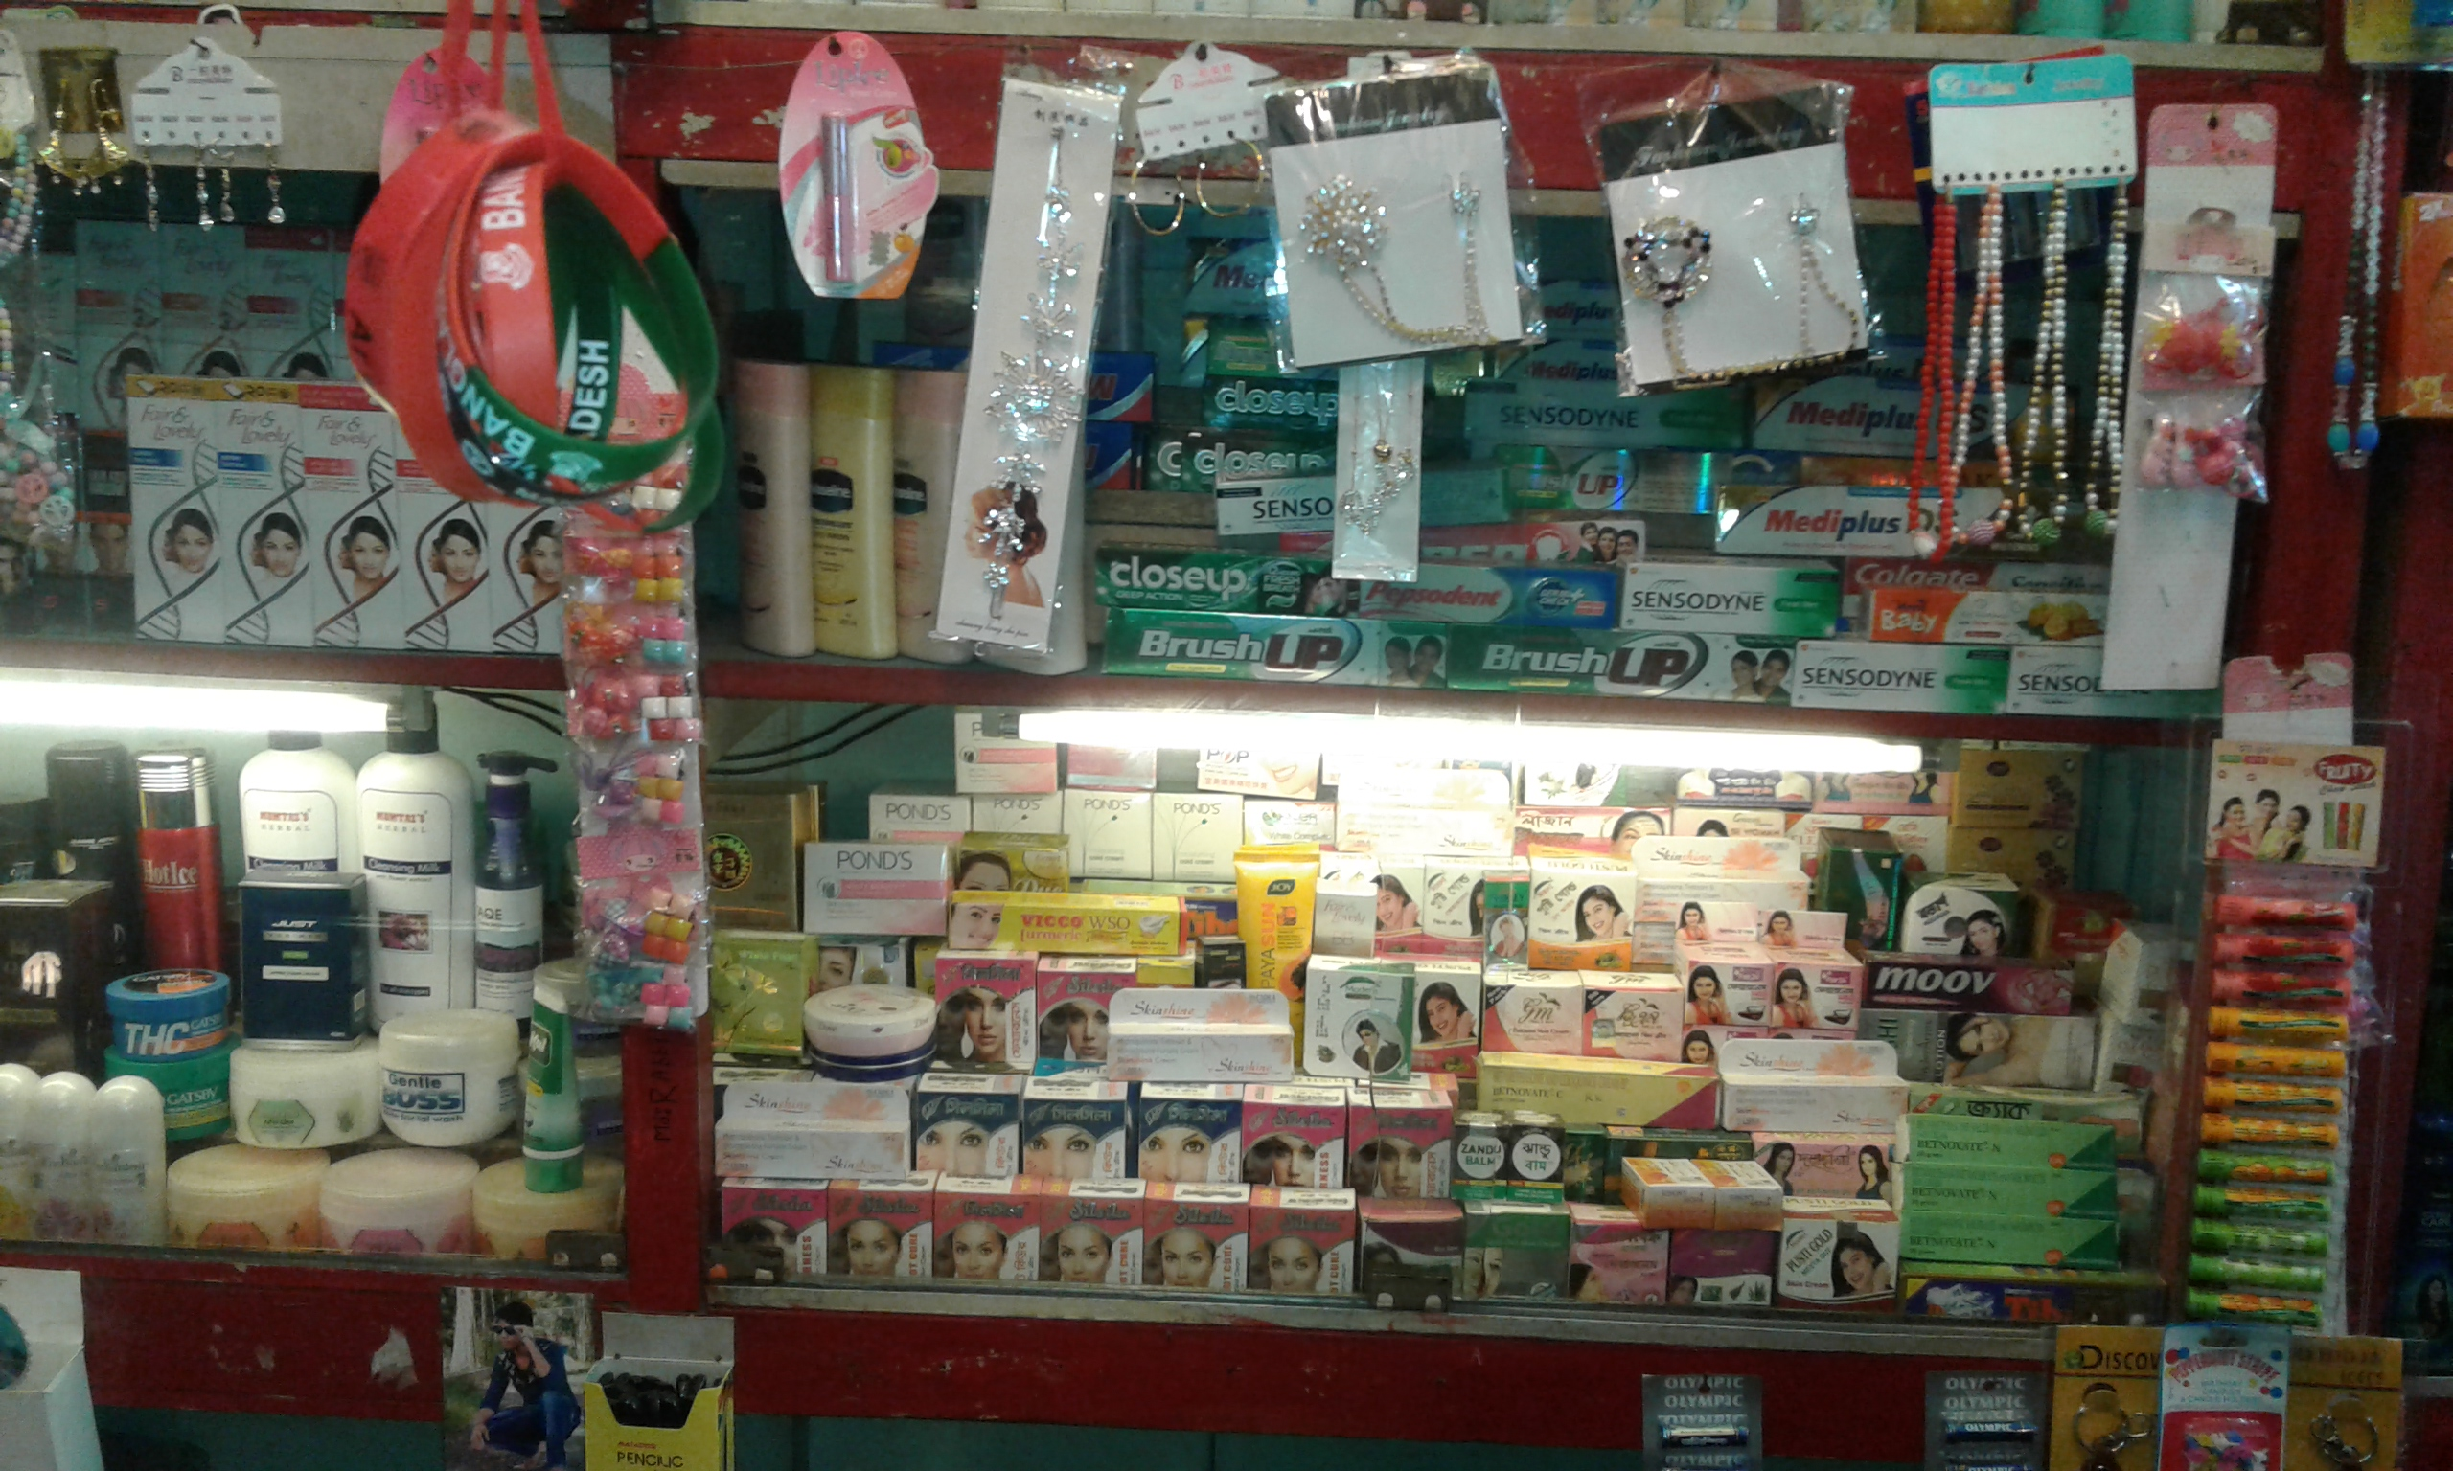

Slide 16
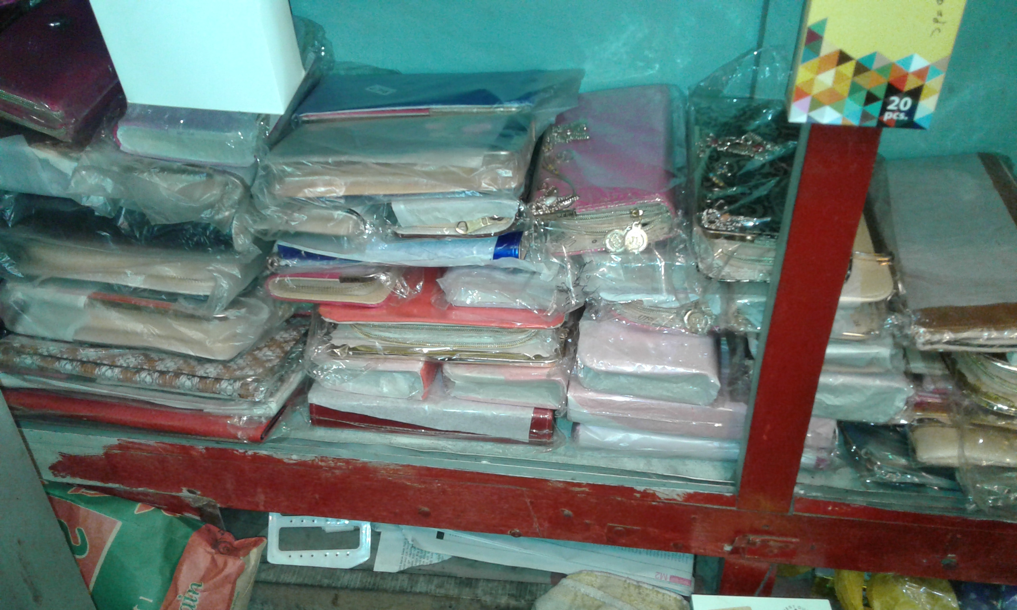

Slide 17
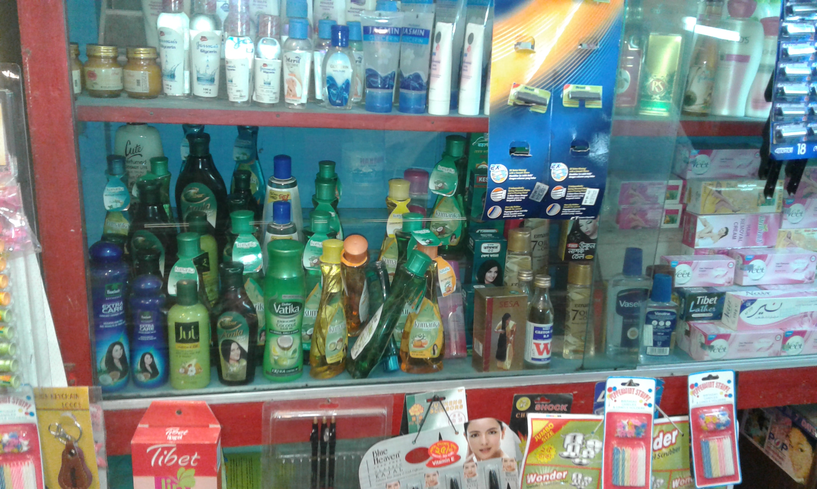

Slide 18
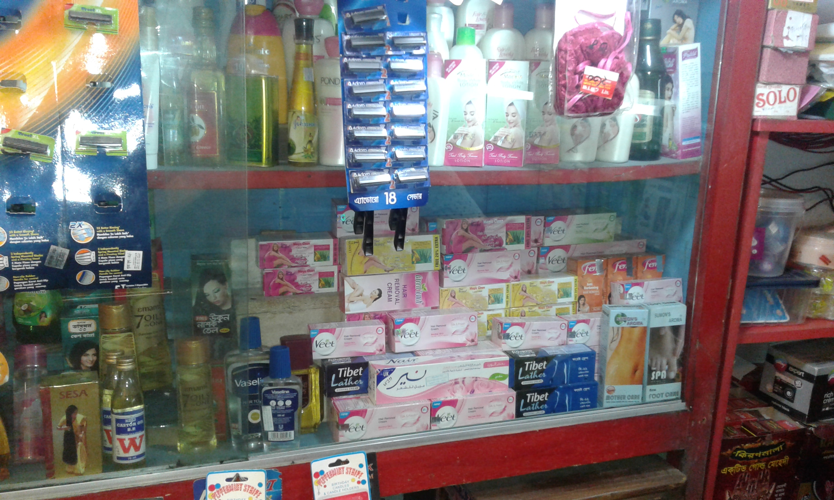

Slide 19
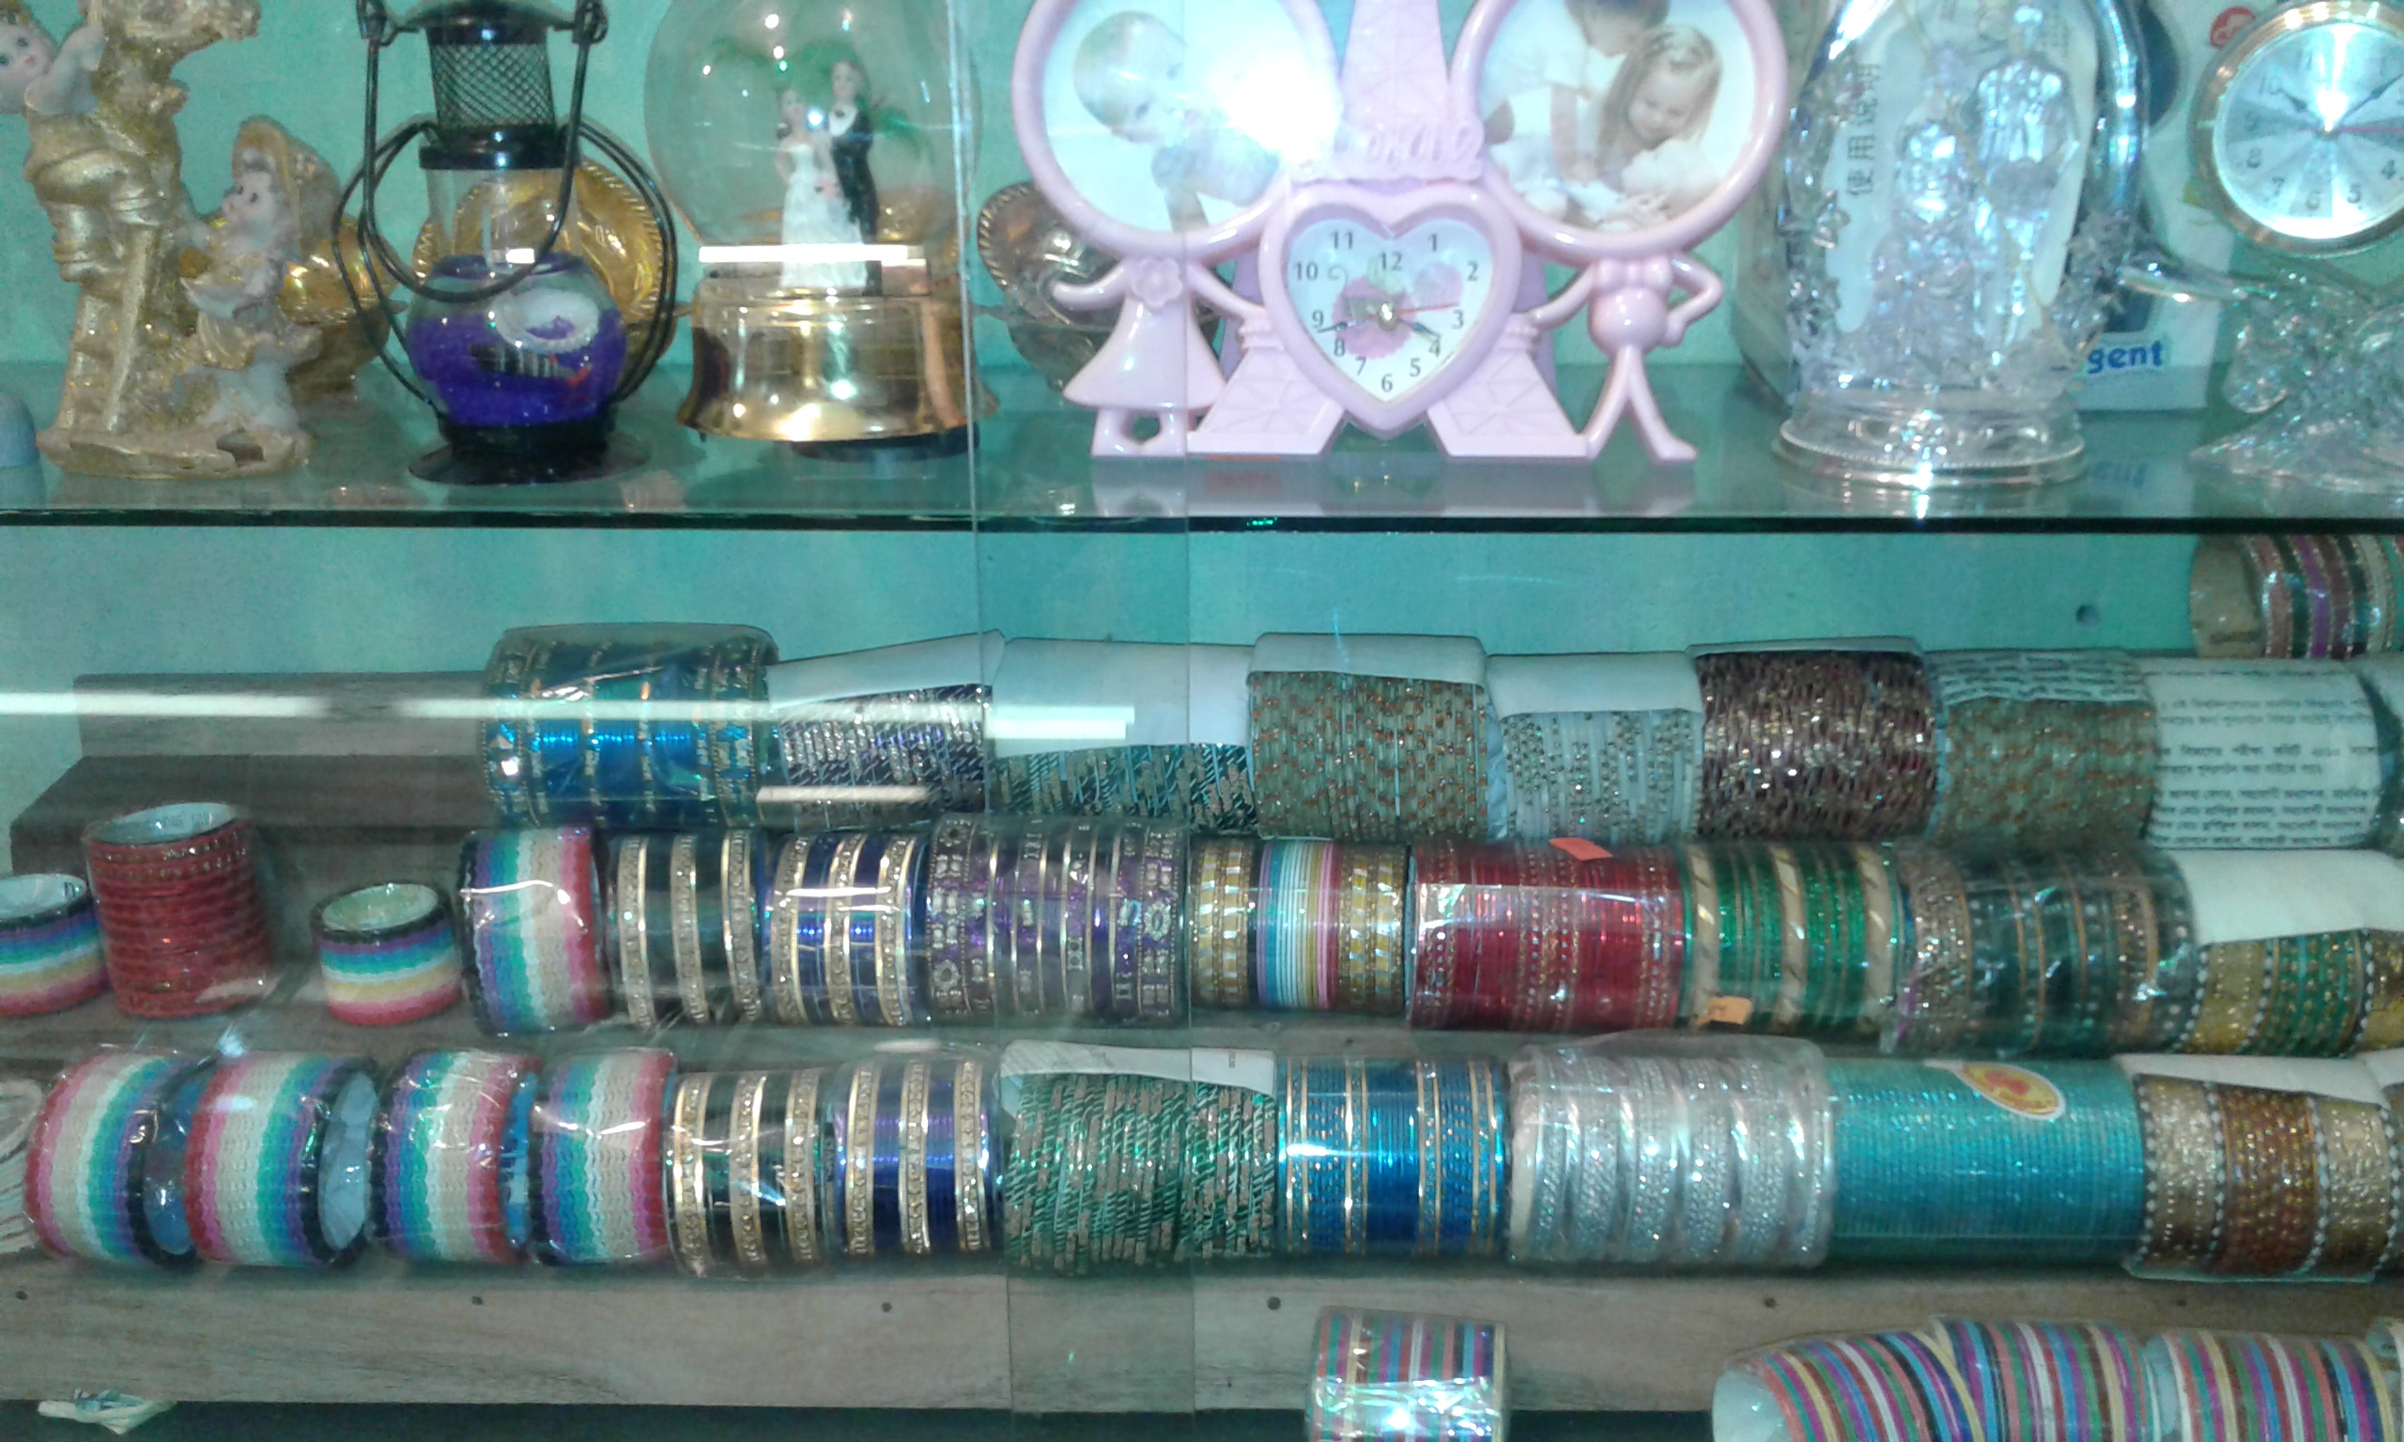

Slide 20
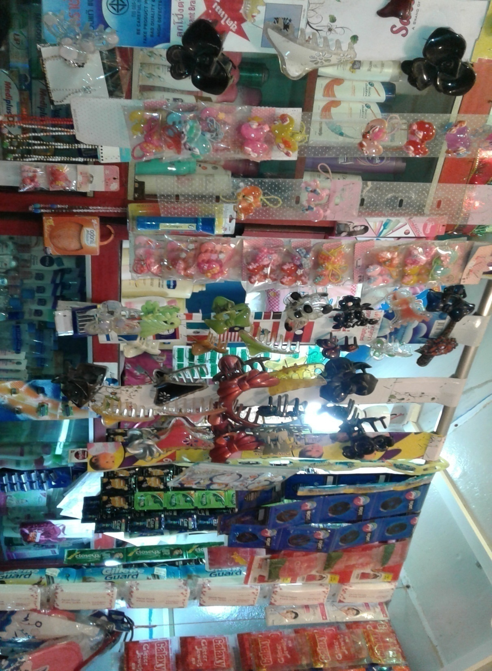

Slide 21
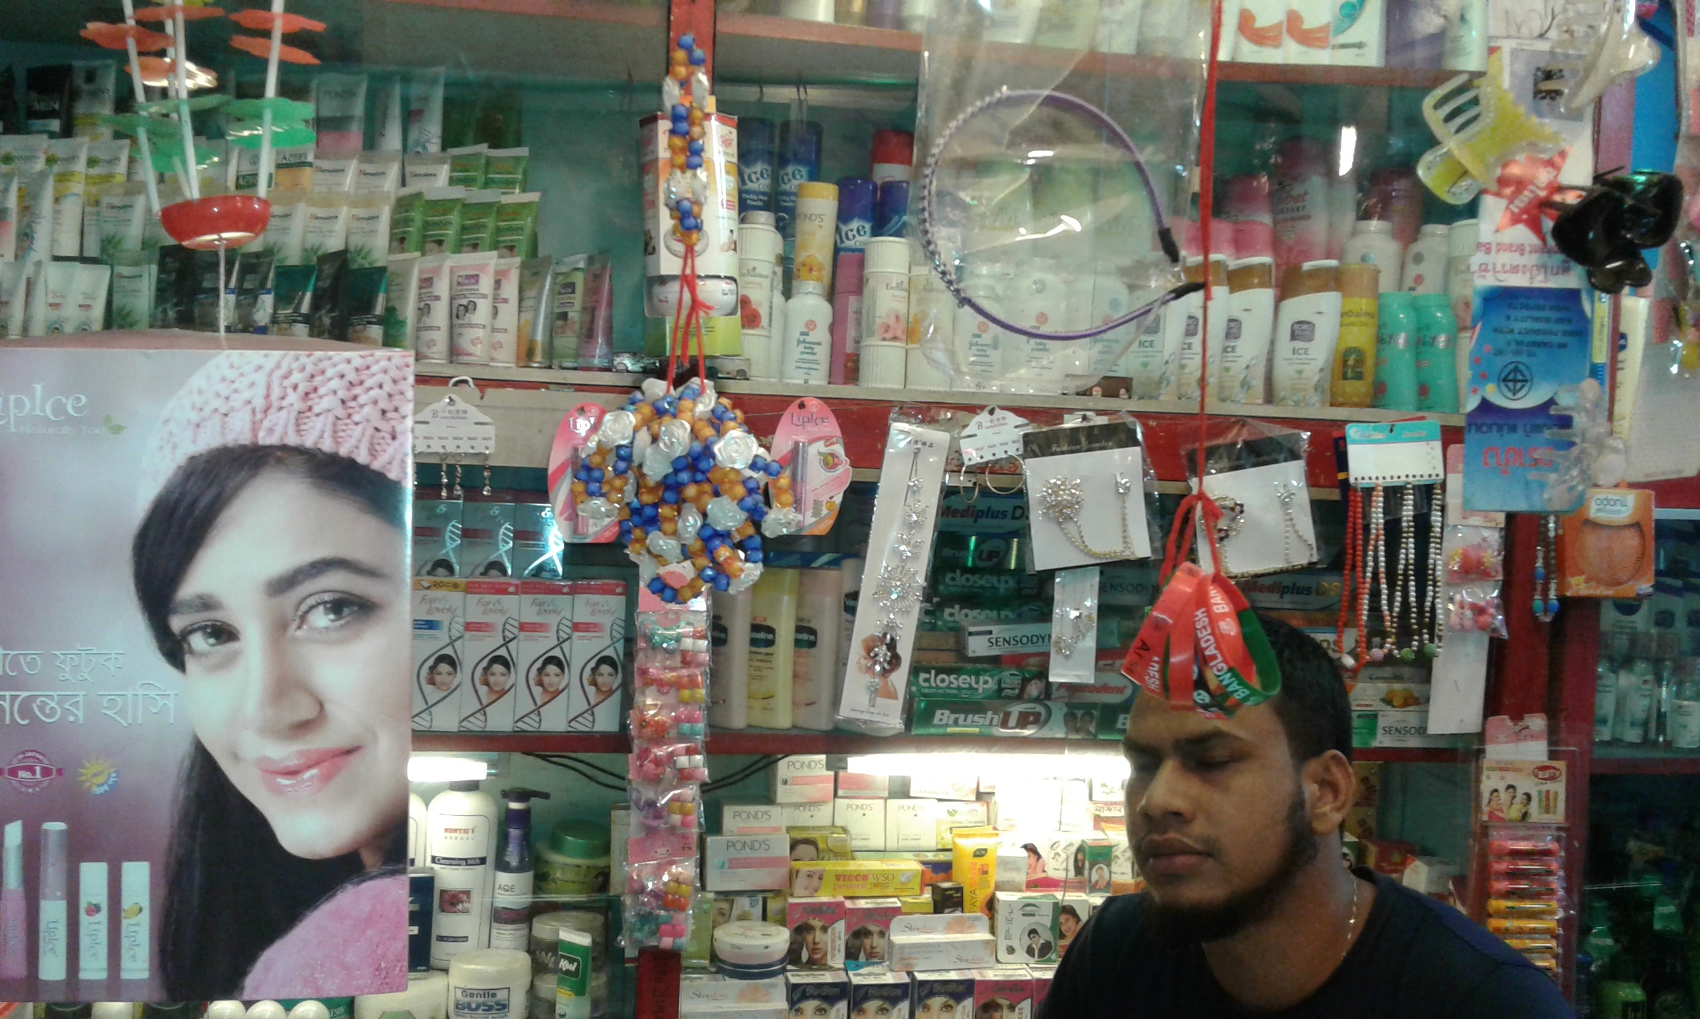

Slide 22
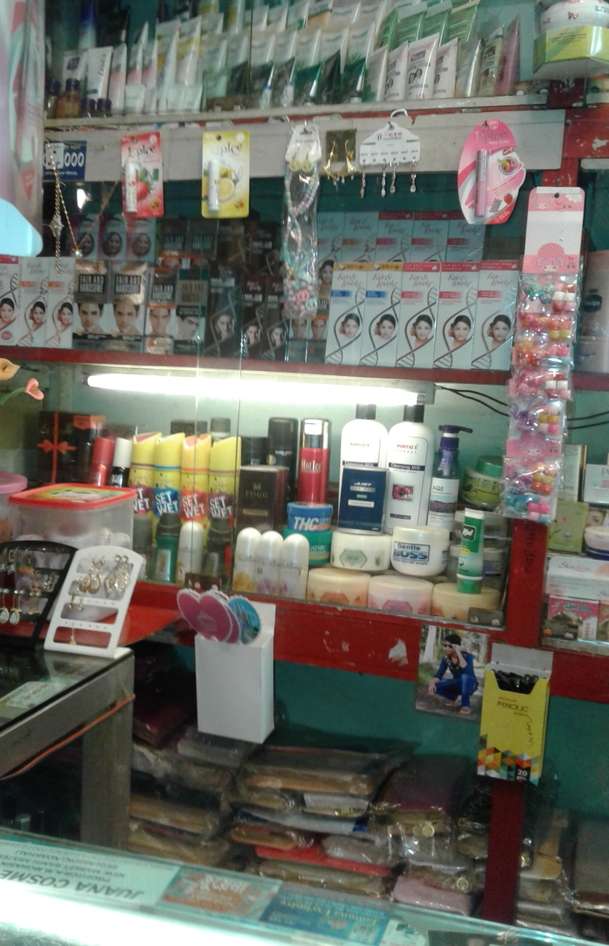
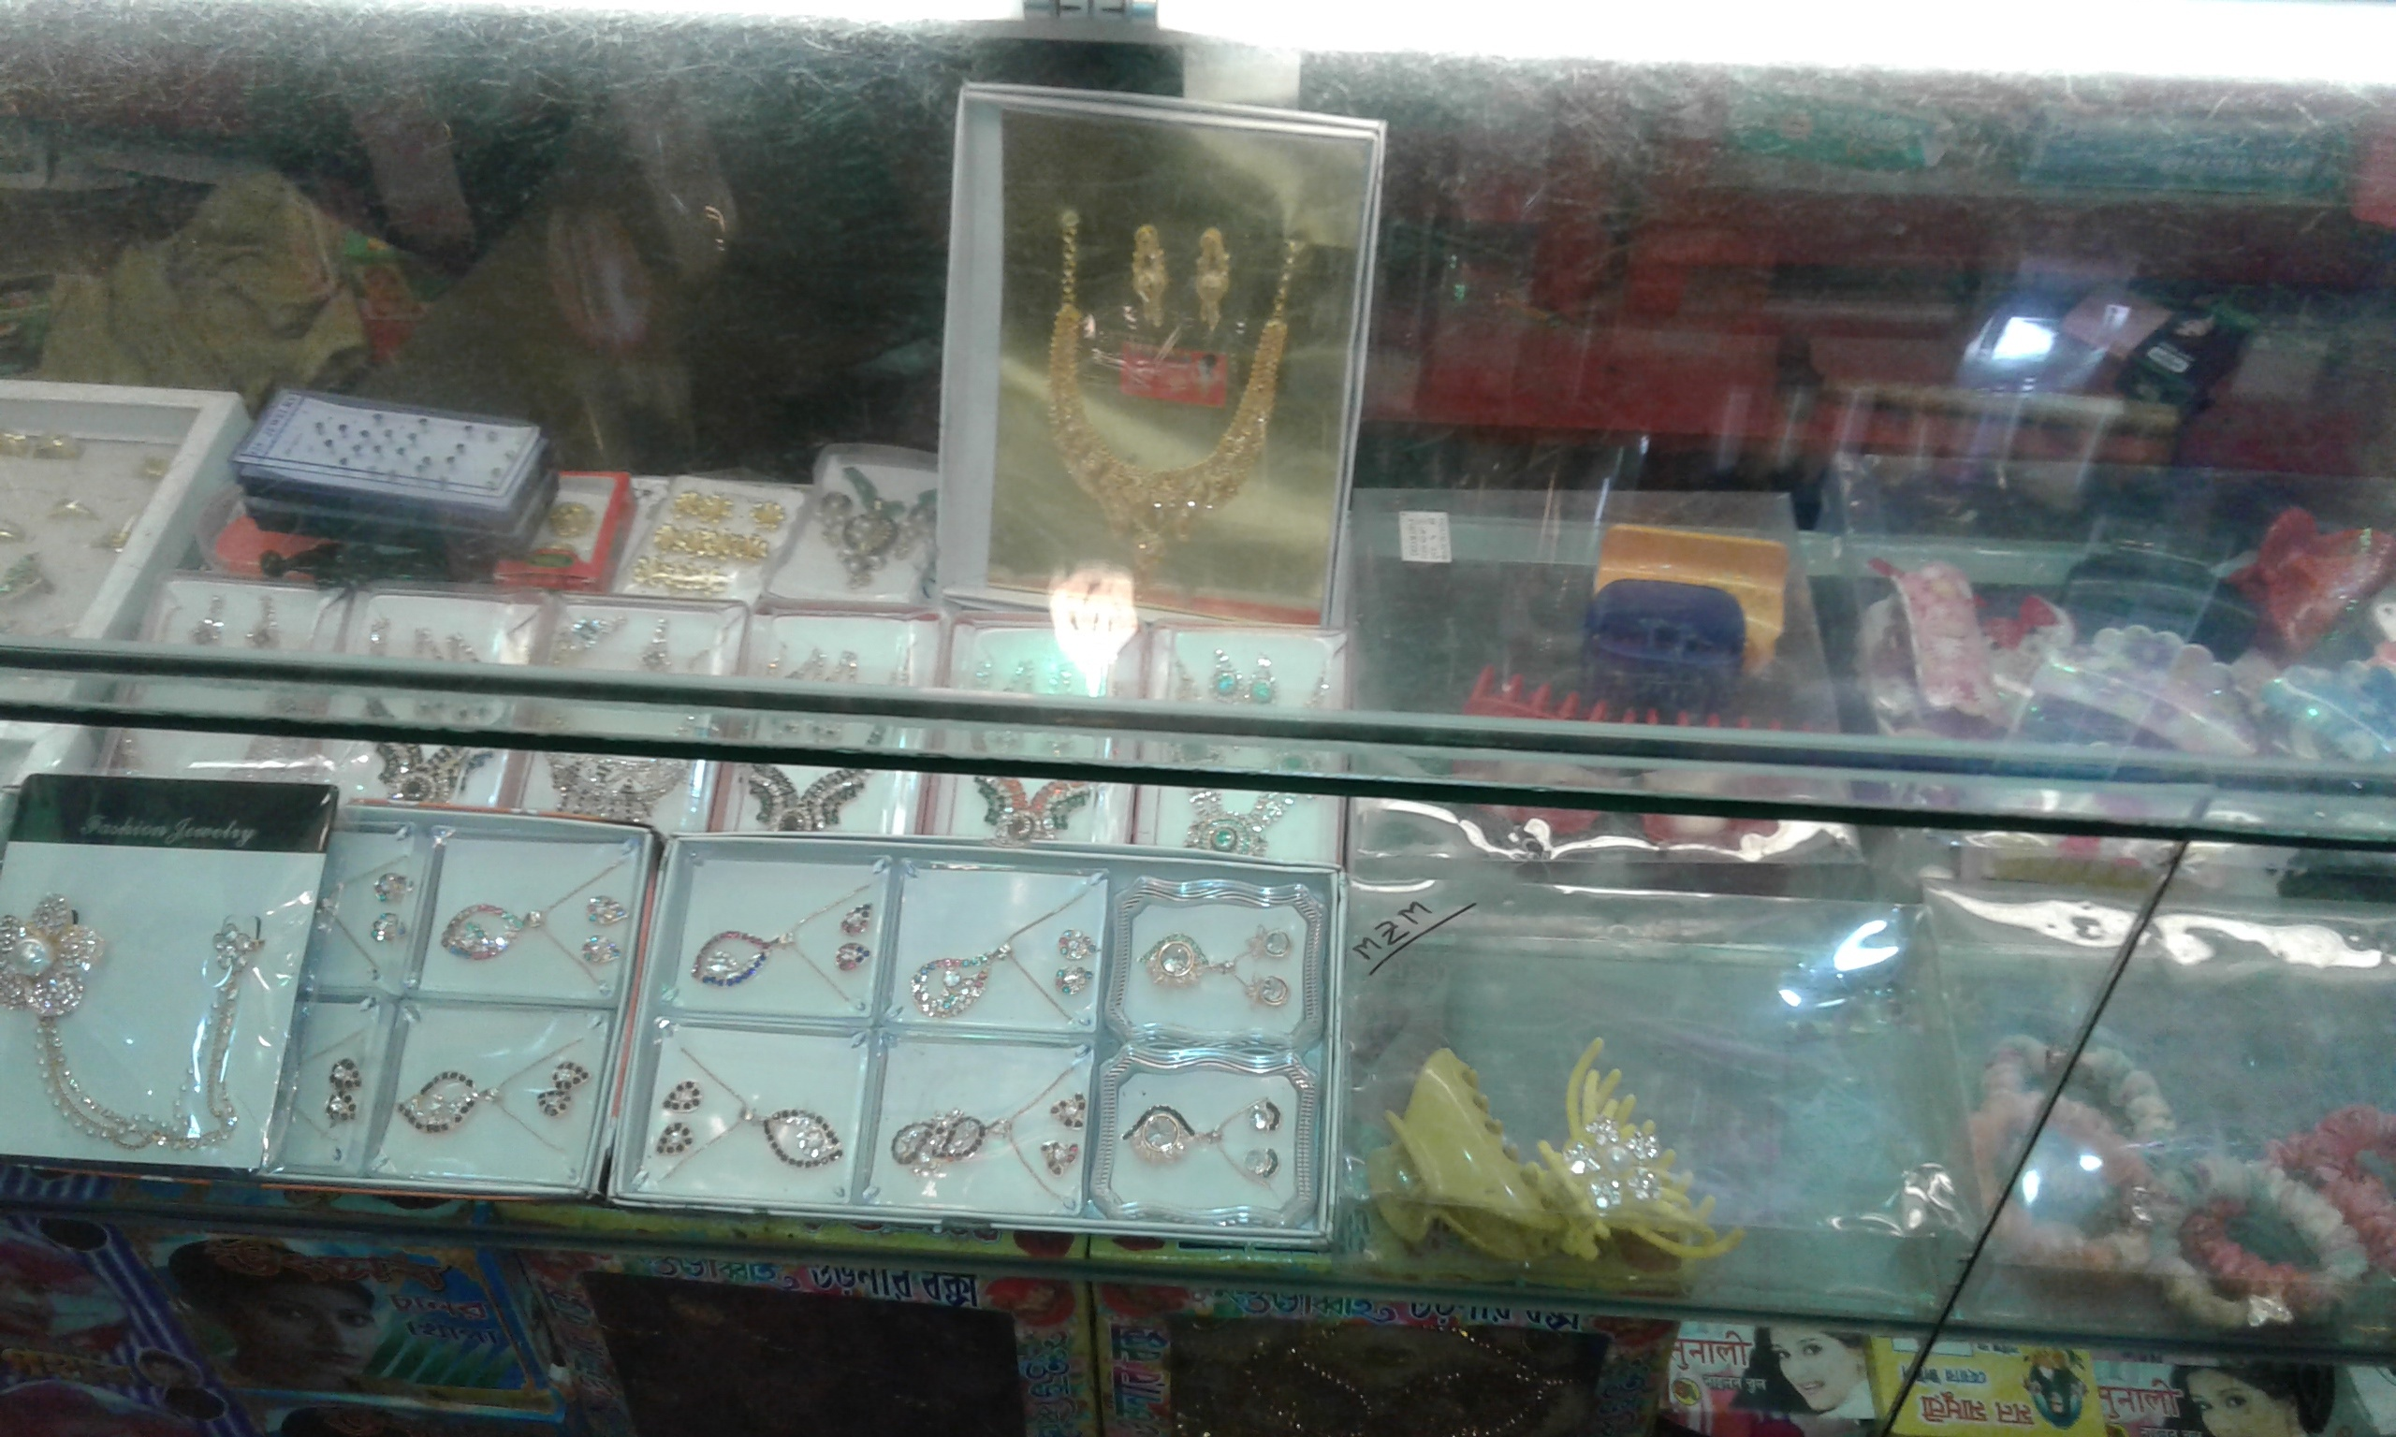

Slide 23
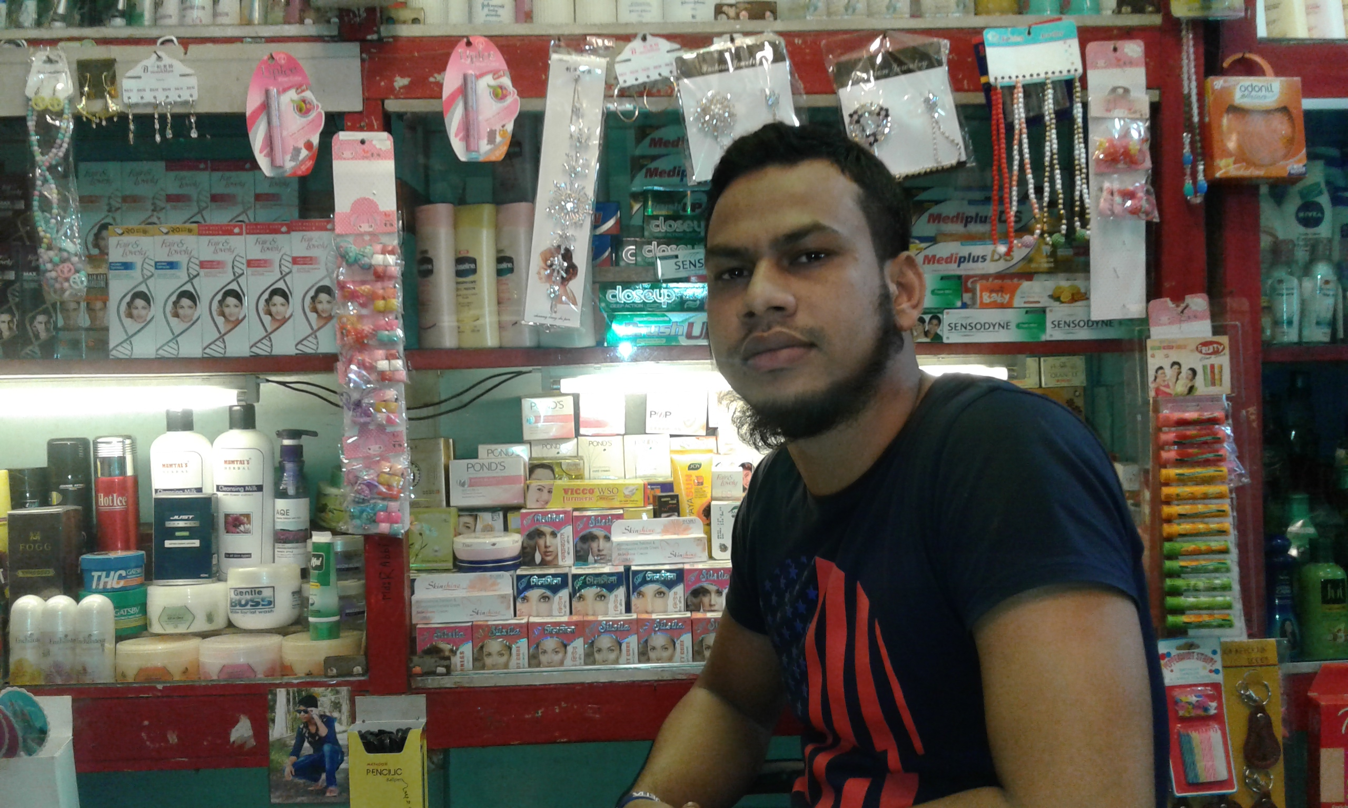

Slide 24
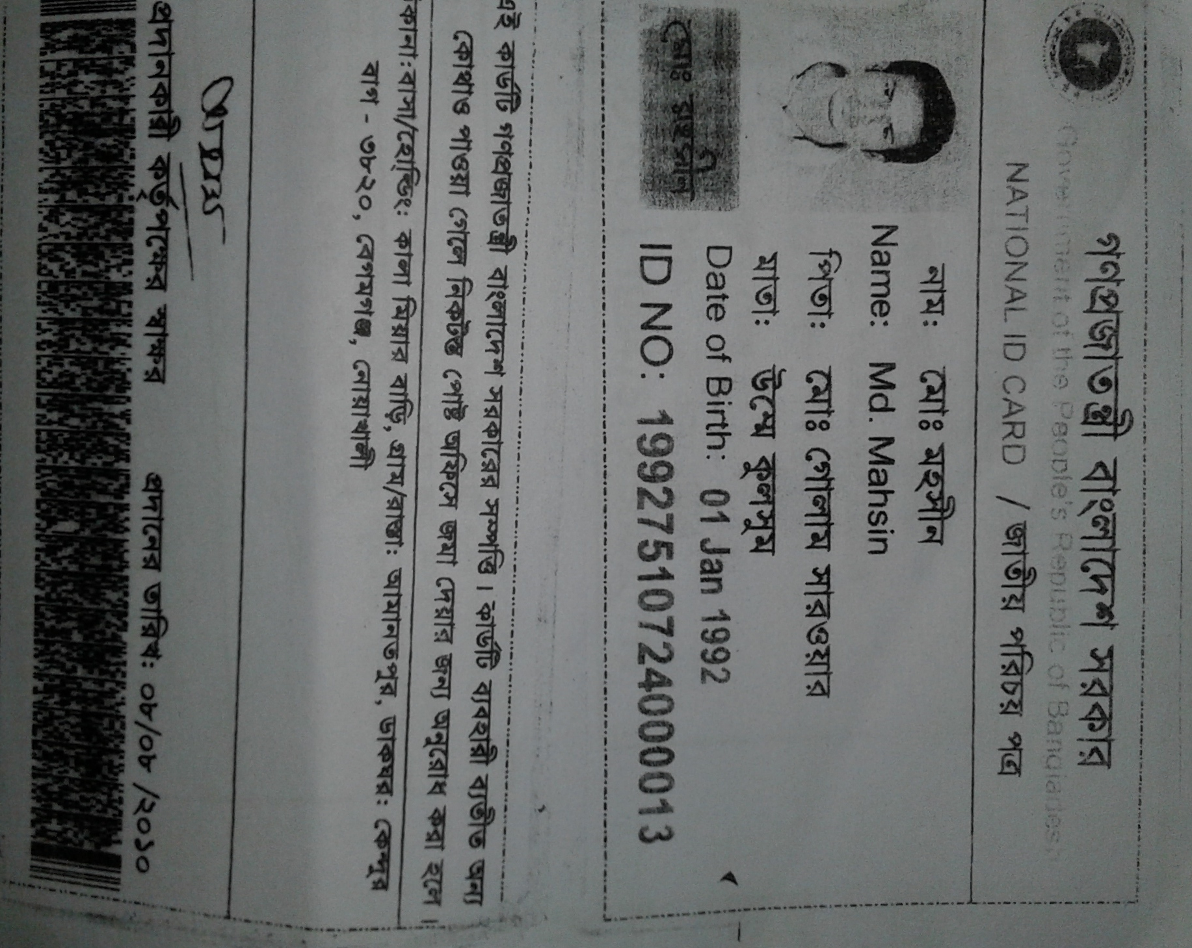

Slide 25
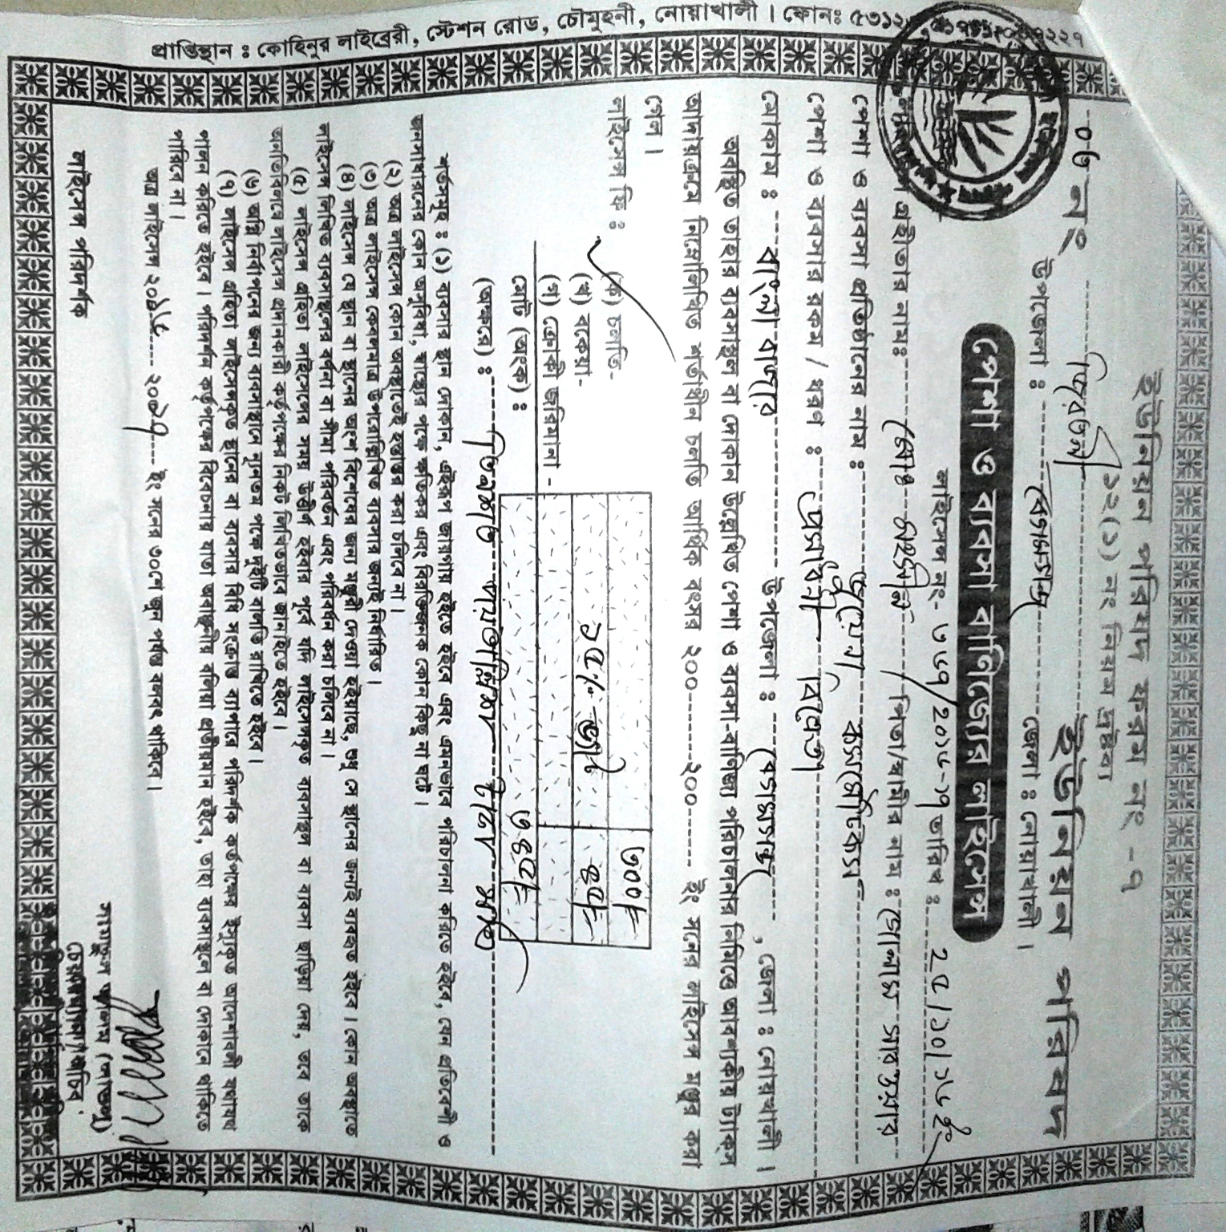

Slide 26
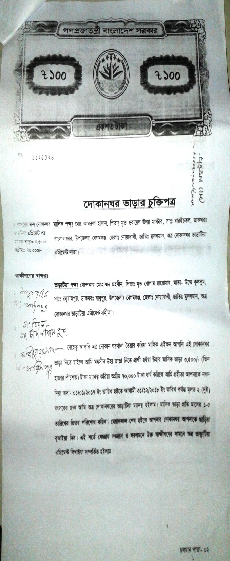
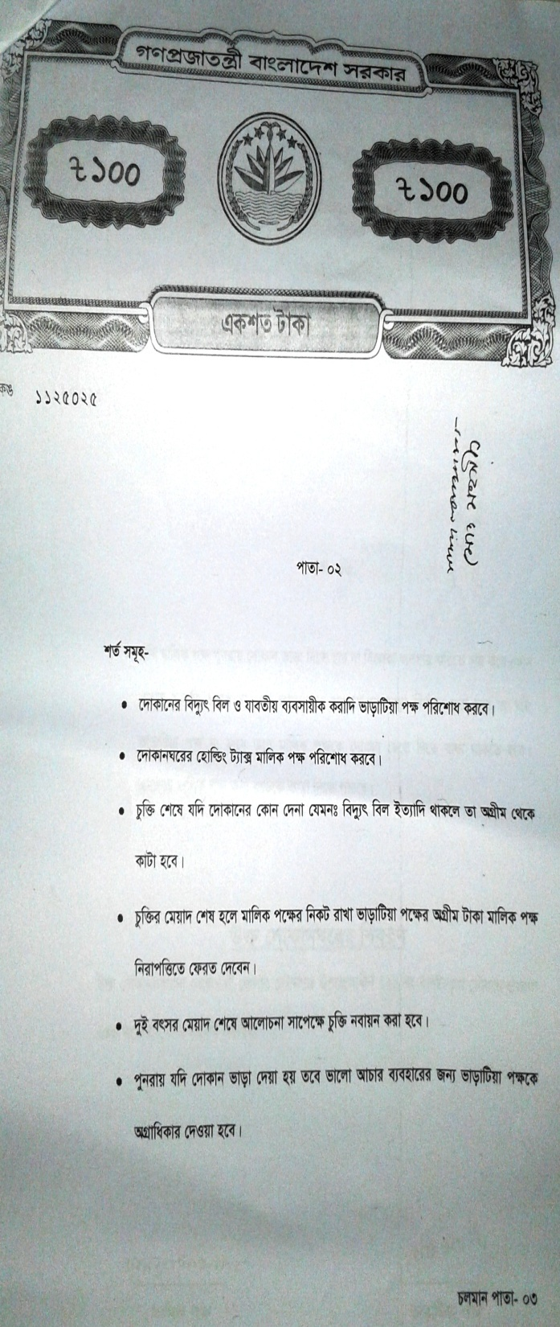
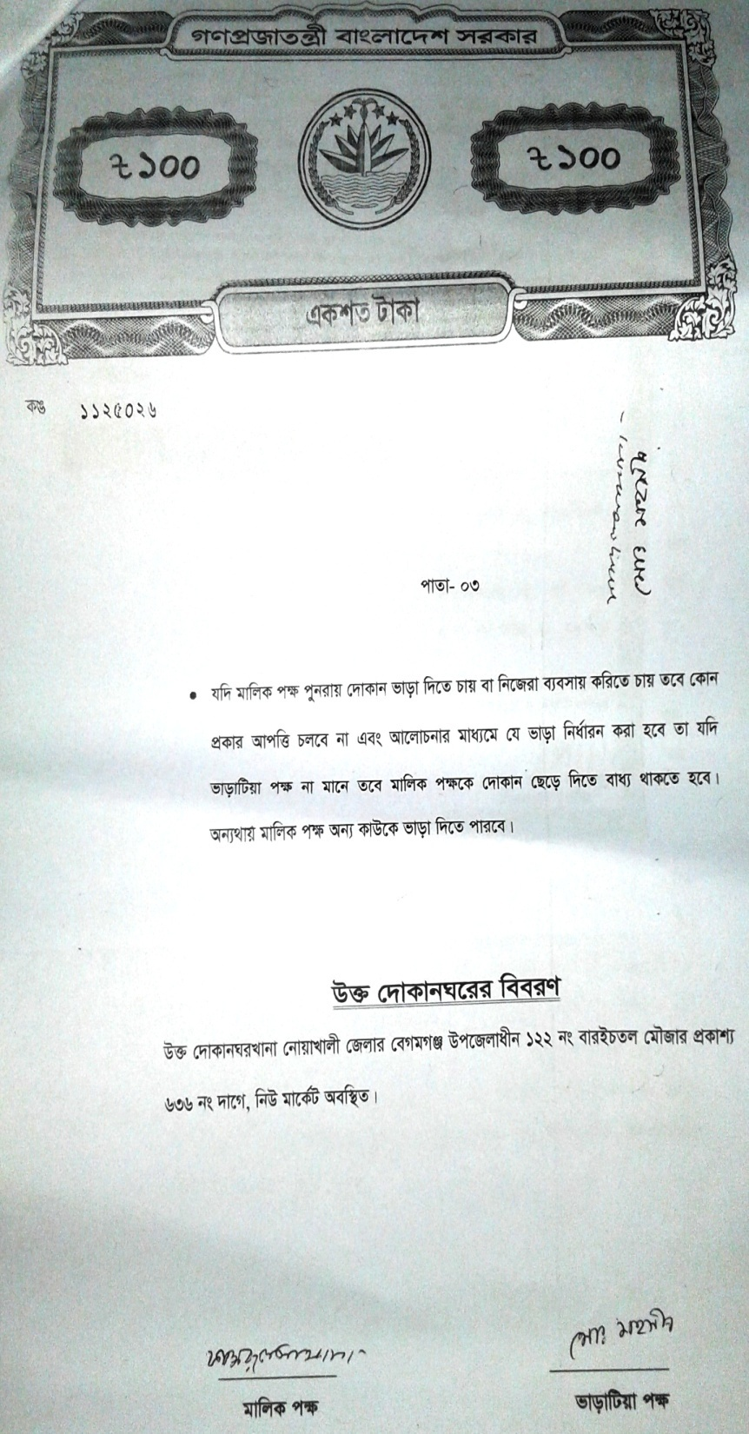

Slide 27
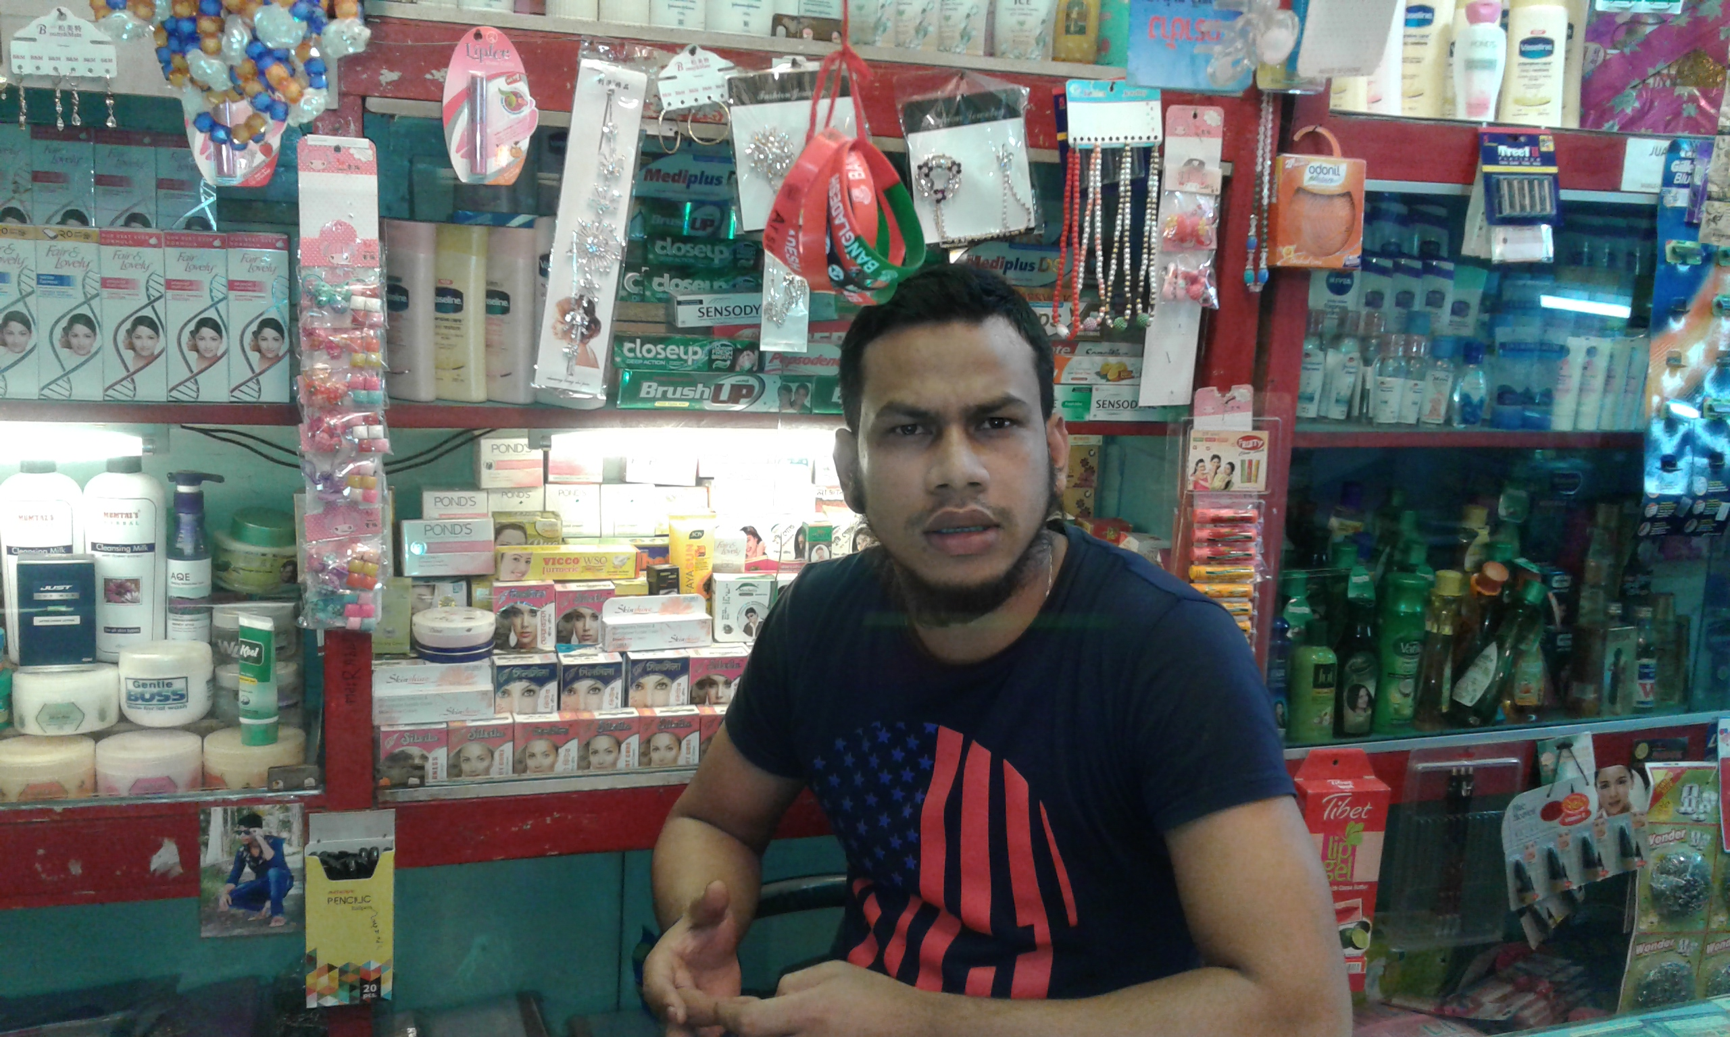

Slide 28

Presented at
SB Internal Design Lab
On January, 2017
For more information
Grameen Trust
Phone No : 9017038
Md. Mohsin
Cell No: - 01623-057371

