Slide 1
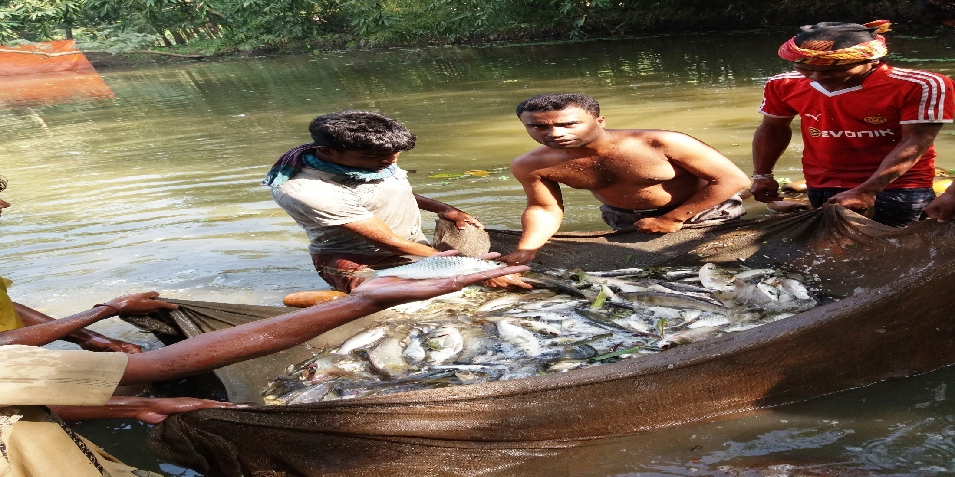

Adorsho Motsho Khamar
Project by: Ahasan Ullah Sohan
Identified by: Abdul Mannan
Verified By : Mir Hossian Chowdhury
Noakhali Unit
Region -2
GRAMEEN TRUST

Slide 2
Brief Bio of the PROPOSED Nobin Udyokta
Name | : | Ahasan Ullah Sohan
Permanent Address | : | Kotobpur, Begumgonj, Noakhali-3825
Age | : | 15-May-1984 (32 Years)
Marital status | : | Unmarried
Children | : | N/A
No. of siblings: | : | 04 Brothers, 01 Sister
Parent’s and GB related Info (i) Who is GB member (ii) Mother’s name (iii) Father’s name (iv) GB member’s info Further Information: (v) Who pays GB loan installment (vi) Mobile lady (vii) Grameen Education Loan Any other loan like GCCN, GKF | : : : : : : : : | Mother Father Bibi Aysha Abdul Gofran Branch: Rosulpur , Begumgonj, Centre :0 Group no: 0, Loanee no.0, Member since: 2001, Drop Out: 2006 First loan: 5,000/-, Existing loan: 20,000/-, Outstanding: Nil. N/A N/A N/A N/A N/A
Education | : | Class Five

Slide 3
Brief Bio of the PROPOSED Nobin Udyokta (cont…)
Present Occupation | : | Motsho Khamar Collect raw materials from Chowmohani Bazar. Local Consumer are the target customer group.
Initial Investment | : | 50,000/=
Trade License No |  | 33/2016-2017
Business Experience And Training Info | : : | 10 Years Received training from Chowmohani Bazar for 02years.
Other Own/Family Sources of Income | : | N/A
Other Own/Family Sources of Liabilities | : | N/A
NU Contact Info |  | +8801814-896272 (This number will be registered in SBMS System for Daily SMS)
NU Project Source/Reference | : | Noakhali Unit

Slide 4
brief history of GB loan utilization by Family
NU’s mother has been a member of Grameen Bank since 2001 to 2006 (6 years). At first she took a loan of Taka 5,000/- from Grameen Bank. His father used GB loan in his business and repaired their own houses from the income. NU also built their own house from the income of GB loan. They also bought some land. NU’s mother gradually improved their life standard by using GB loan.

Slide 5
Proposed Nobin Udyokta business INFO
Business Name | : | Adorsho Motsho Khamar
Address/ Location | : | Bottola Bazar, Begumgonj, Noakhali-3825
Total Investment in BDT | : | 2,80,000/-
Financing | : | Self BDT 2,00,000/- (from existing business) 71% Required Investment BDT 80,000/-(as equity) 29%
Present salary/drawings from business (estimates) | : | 7,000/-
Proposed Salary | : | 7,000/-
Proposed Business % of present gross profit margin (ii) Estimated % of proposed gross profit margin (iii) Agreed grace period | : : : | 30% 30% 2 Months

Slide 6
Present & Proposed Investment Breakdown
Particulars | Existing Business (BDT) | Proposed (BDT) | Total (BDT)
Investments in different categories: | (1) | (2) | (1+2)
Present Stock Items: Advance- 1,20,000 Different Kinds of Fish 50,000 Feeds 15,000 Pesticides 5,000 Medicine 5,000 Electrical Material 5,000 | 2,00,000 |  | 2,00,000
Proposed items: Fides 35,000 Medicine 10,000 Pesticides 5,000 Different Kinds of Fish Kids 30,000 |  | 80,000 | 80,000
Total Capital | 2,00,000 | 80,000 | 2,80,000

Slide 7
Present & Proposed Investment Breakdown
Present Stock Items
Product name | Amount
Advance | 1,20,000
Different Kinds of Pona Fish | 50,000
Fish Feed | 15,000
Medicine | 5,000
Pesticides | 5,000
Electrical Materials | 5,000
Total Present Stock | 2,00,000
Proposed Items
Product Name | Unit | Amount
Fish Feed | 30 Bags | 35,000
Pona Fish |  | 30,000
Medicine |  | 10,000
Pesticides |  | 5,000
Total Proposed Stock |  | 80,000

Slide 8
INFO ON EXISTING BUSINESS OPERATIONS
Particulars | Existing Business (BDT)
 | Monthly | Yearly
Sales (A) | 52,000 | 6,24,000
Less: Cost of sales (B) | 36,400 | 4,36,800
Gross Profit (C) [C=(A-B)] | 15,600 | 1,87,200
Less: Operating Costs
Electricity bill | 400 | 4,800
Generator bill | 150 | 1,800
Pond Rent | 2,000 | 24,000
Night Guard bill | 100 | 1,200
Mobile bill | 700 | 8,400
Present salary/Drawings- self | 6,000 | 72,000
Conveyance or Transport] | 400 | 4,800
Others (fees, Entertainment, TL renew) | 500 | 6,000
Non Cash Item:
Depreciation Expenses(5,000*20% ) | 83 | 996
Total Operating Cost (F) | 10,333 | 1,23,996
Net Profit (E-F): | 5,267 | 63,204

Slide 9
Financial Projection of NU Business plan
Particulars | Year 1 (BDT) |  | Year 2 (BDT) |  | Year 3 (BDT)
 | Monthly | Yearly | Monthly | Yearly | Monthly | Yearly
Sales (A) | 52,000 | 6,24,000 | 52,000 | 6,24,000 | 52,000 | 6,24,000
Less: Cost of Sale (B) | 36,400 | 4,36,800 | 36,400 | 4,36,800 | 36,400 | 4,36,800
Gross Profit (A-B)=(C) | 15,600 | 1,87,200 | 15,600 | 1,87,200 | 15,600 | 1,87,200
Less: Operating Costs
Electricity bill | 400 | 4,800 | 400 | 4,800 | 400 | 4,800
Generator bill | 150 | 1,800 | 150 | 1,800 | 150 | 1,800
Shop Rent | 2,000 | 24,000 | 2,000 | 24,000 | 2,000 | 24,000
Night Guard bill | 100 | 1,200 | 100 | 1,200 | 100 | 1,200
Mobile bill | 700 | 8,400 | 700 | 8,400 | 700 | 8,400
Present salary/Drawings- self | 6,000 | 72,000 | 6,000 | 72,000 | 6,000 | 72,000
Conveyance or Transport | 400 | 4,800 | 400 | 4,800 | 400 | 4,800
Others (fees, Entertainment, TL renew) | 500 | 6,000 | 500 | 6,000 | 500 | 6,000
Non Cash Item:
Depreciation Expenses | 83 | 996 | 83 | 996 | 83 | 996
Total Operating Cost | 10,333 | 1,23,996 | 10,333 | 1,23,996 | 10,333 | 1,23,996
Net Profit (C-D) = (E) | 5,267 | 63,204 | 5,267 | 63,204 | 5,267 | 63,204
GT payback | 32,000 |  | 32,000 |  | 32,000
Retained Income: | 31,204 |  | 31,204 |  | 31,204

Slide 10
Cash flow projection on business plan (Rec. & Pay.)
Sl # | Particulars | Year 1 (BDT) | Year 2 (BDT) | Year 3 (BDT)
1.0 | Cash Inflow
1.1 | Investment Infusion by Investor | 80,000
1.2 | Net Profit | 63,204 | 63,204 | 63,204
1.3 | Depreciation (Non cash item) | 996 | 996 | 996
1.4 | Opening Balance of Cash Surplus |  | 32,200 | 64,400
 | Total Cash Inflow | 1,44,200 | 96,400 | 1,28,600
2.0 | Cash Outflow
2.1 | Purchase of Product | 80,000
2.2 | Payment of GB Loan
2.3 | Investment Pay Back Including Ownership Tr. Fee | 32,000 | 32,000 | 32,000
 | Total Cash Outflow | 1,12,000 | 32,000 | 32,000
3.0 | Net Cash Surplus | 32,200 | 64,400 | 96,600

Slide 11
SWOT Analysis
STRENGTH Skilled & experienced Well known in locality. Quality services. | WEAKNESS Less Capital
OPPORTUNITIES Shop position is in the center point of business area. Beside main road. | THREATS Fire . Theft.

Slide 12
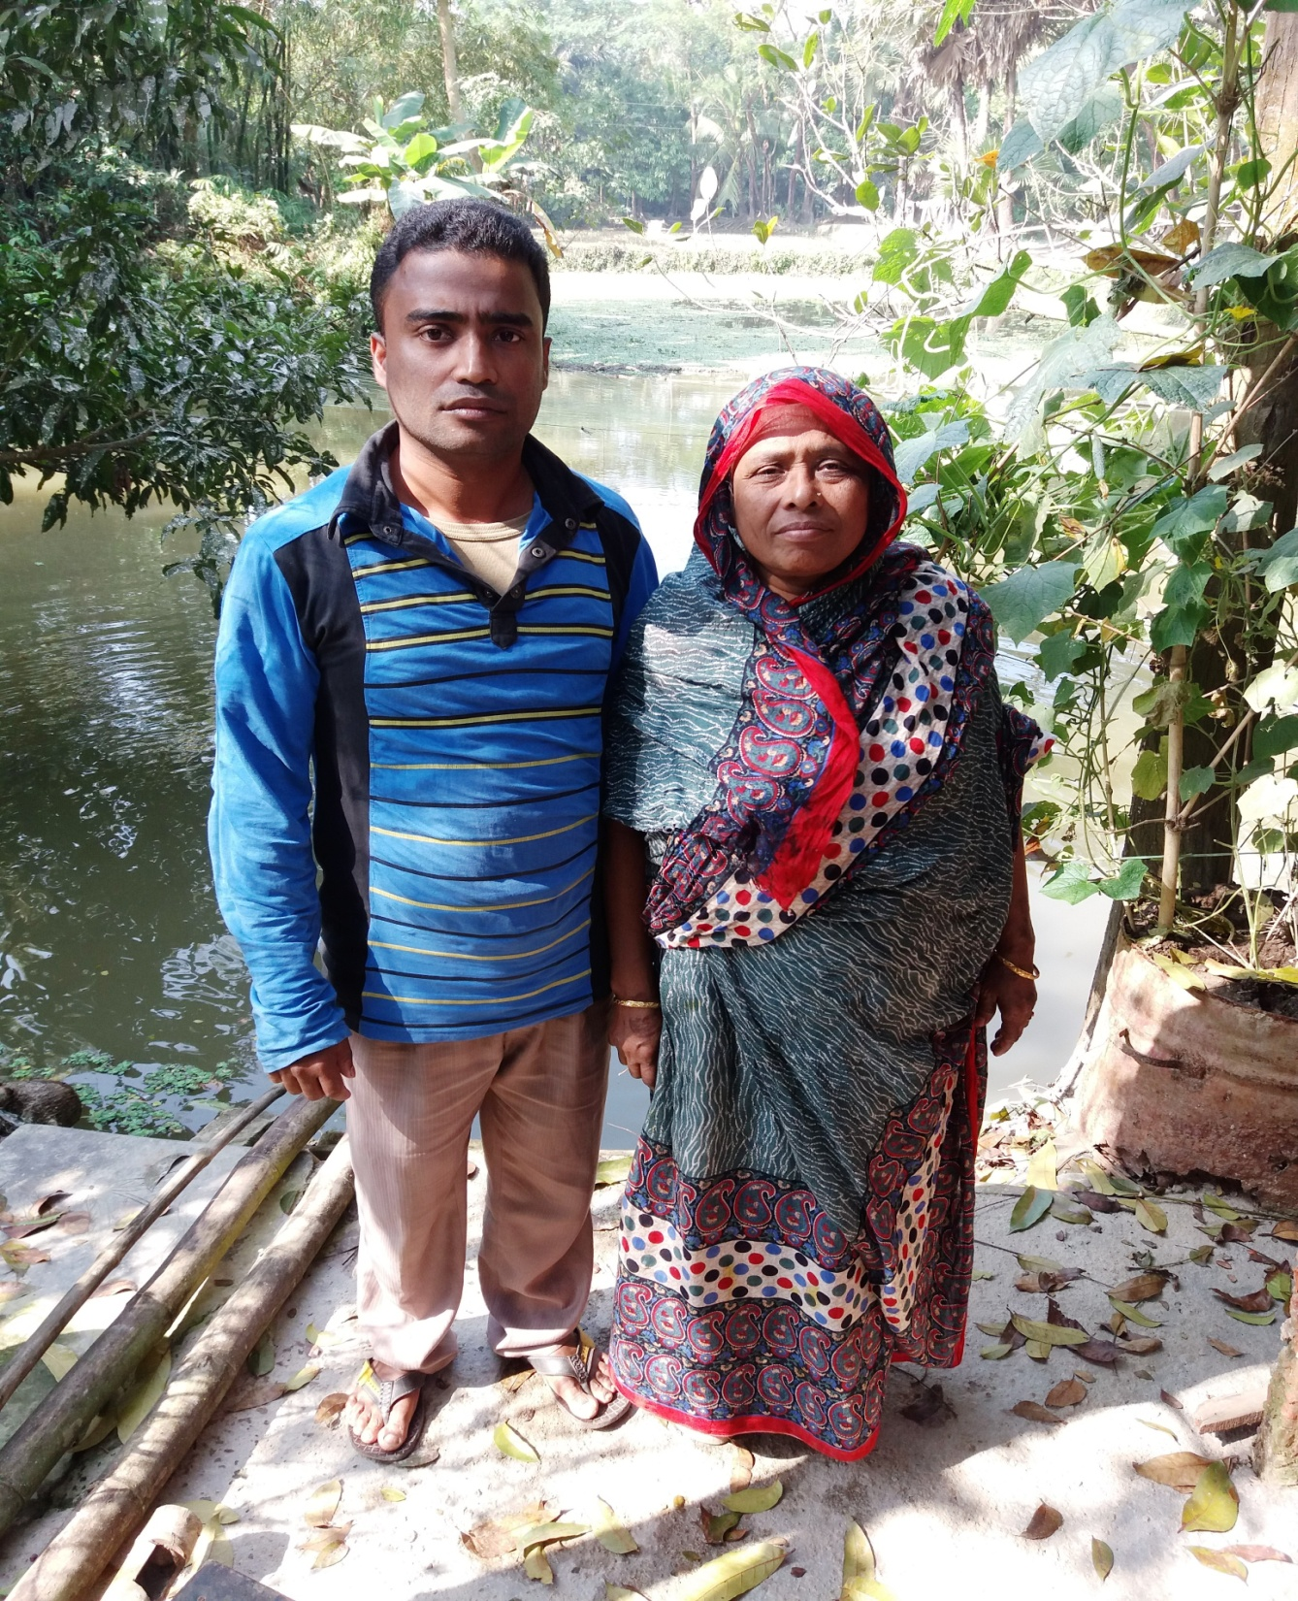

Slide 13
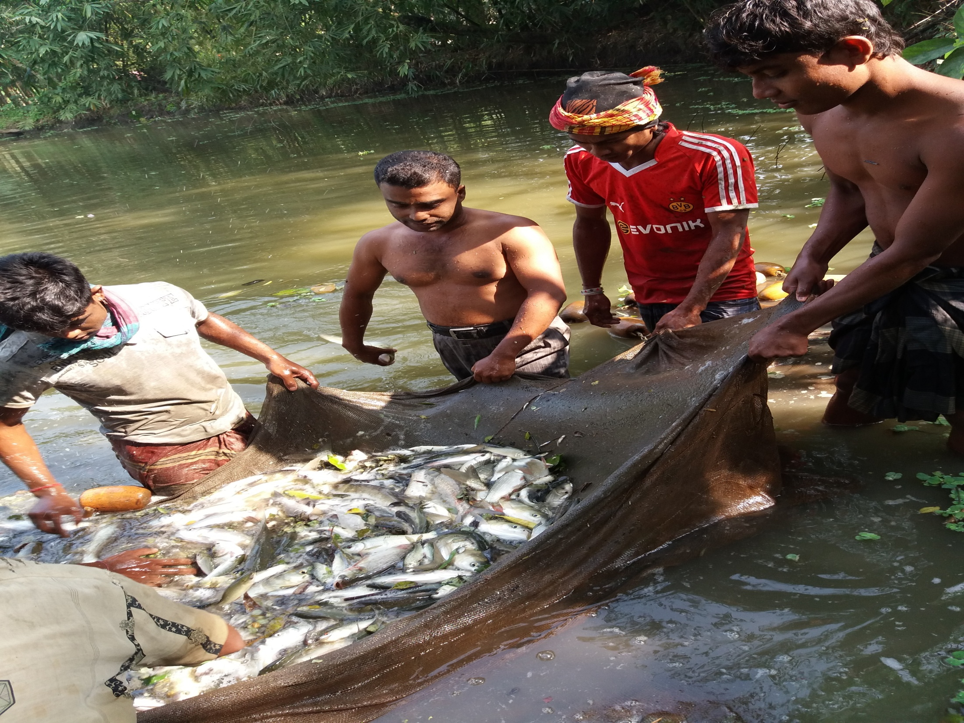

Slide 14
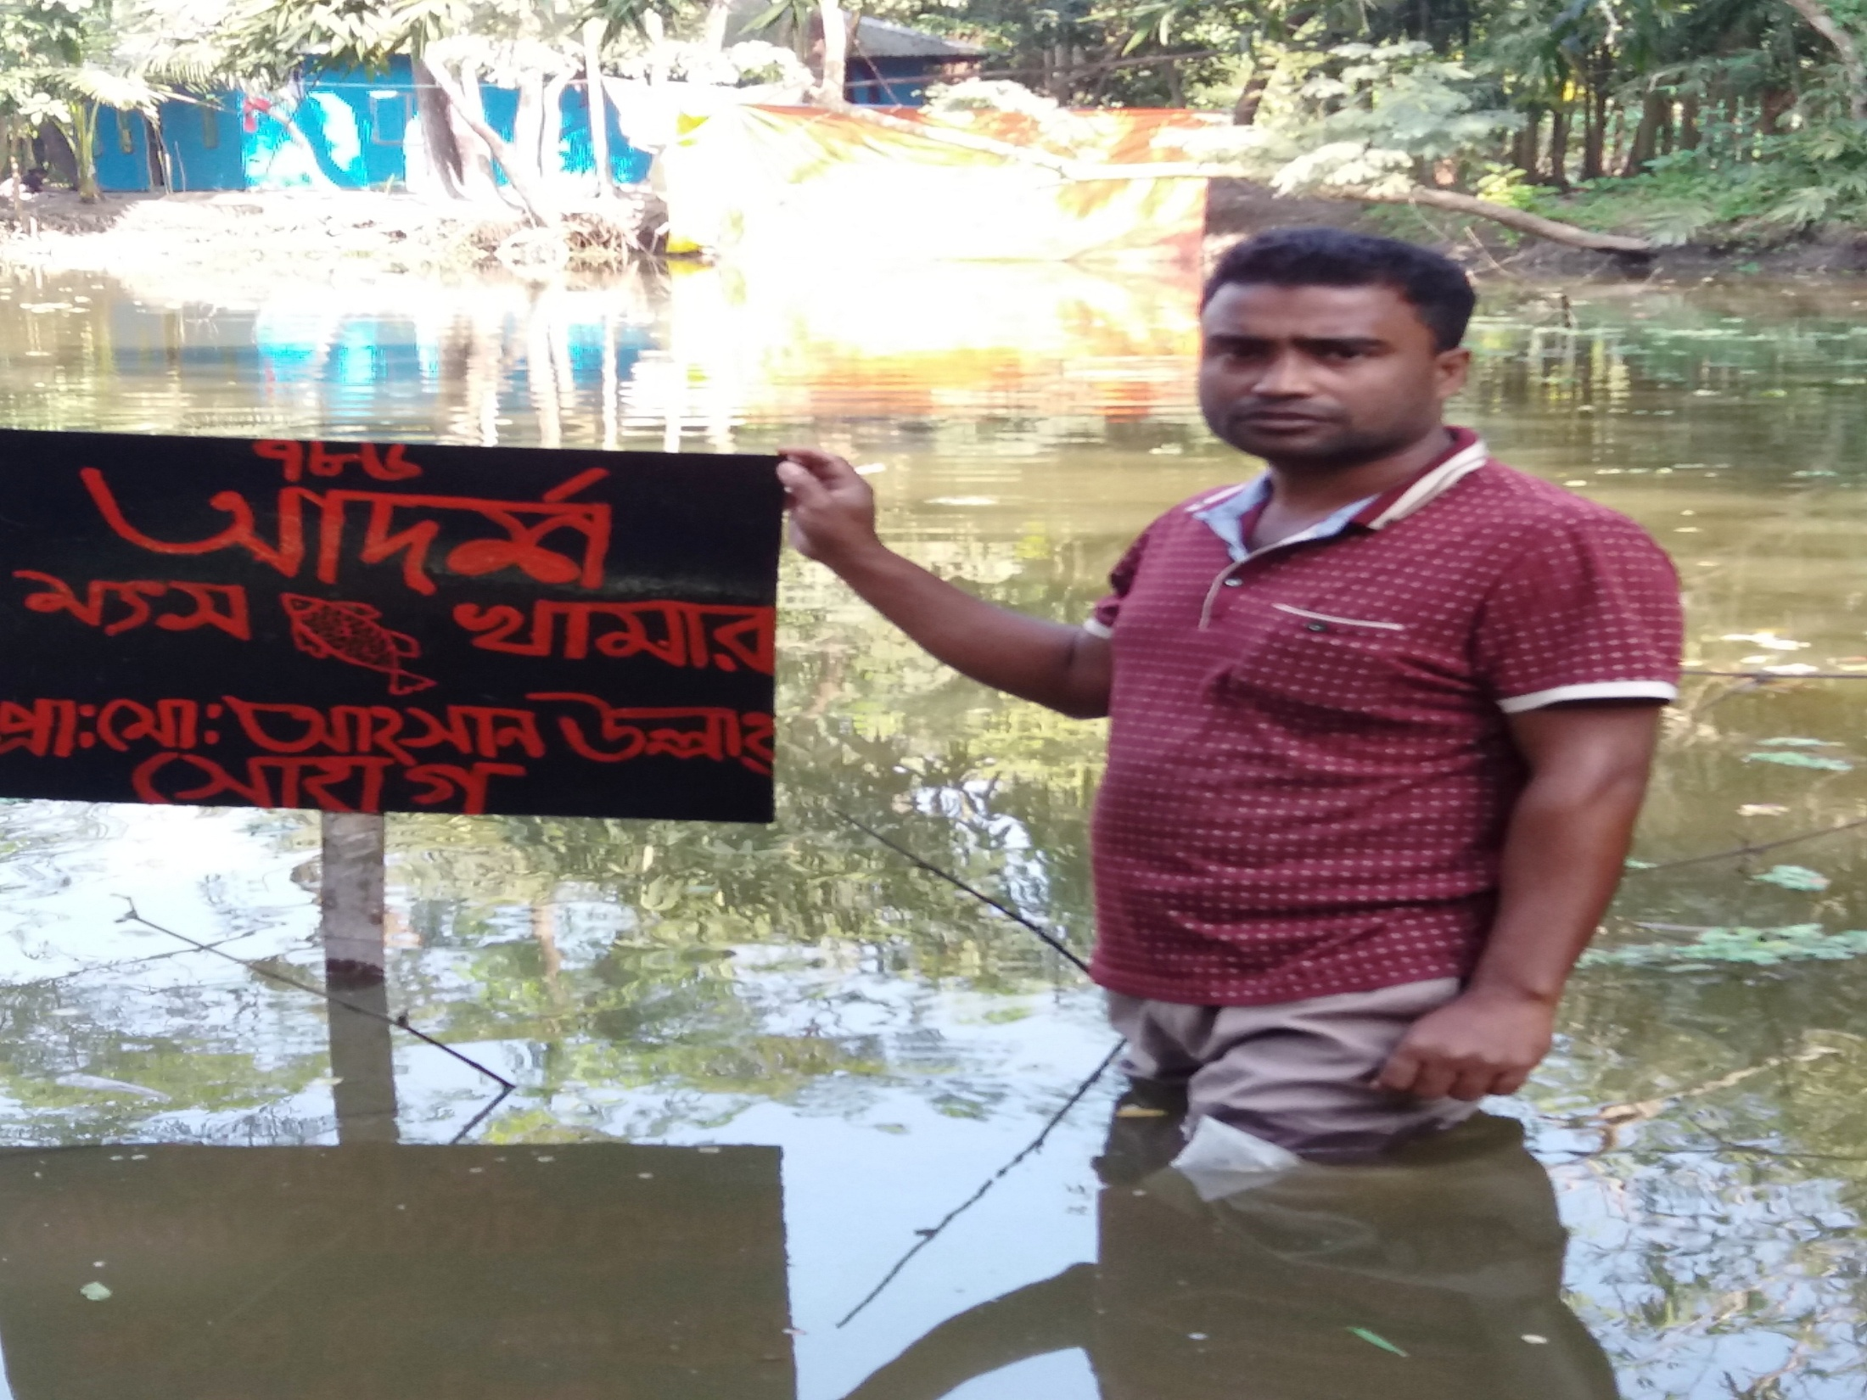

Slide 15
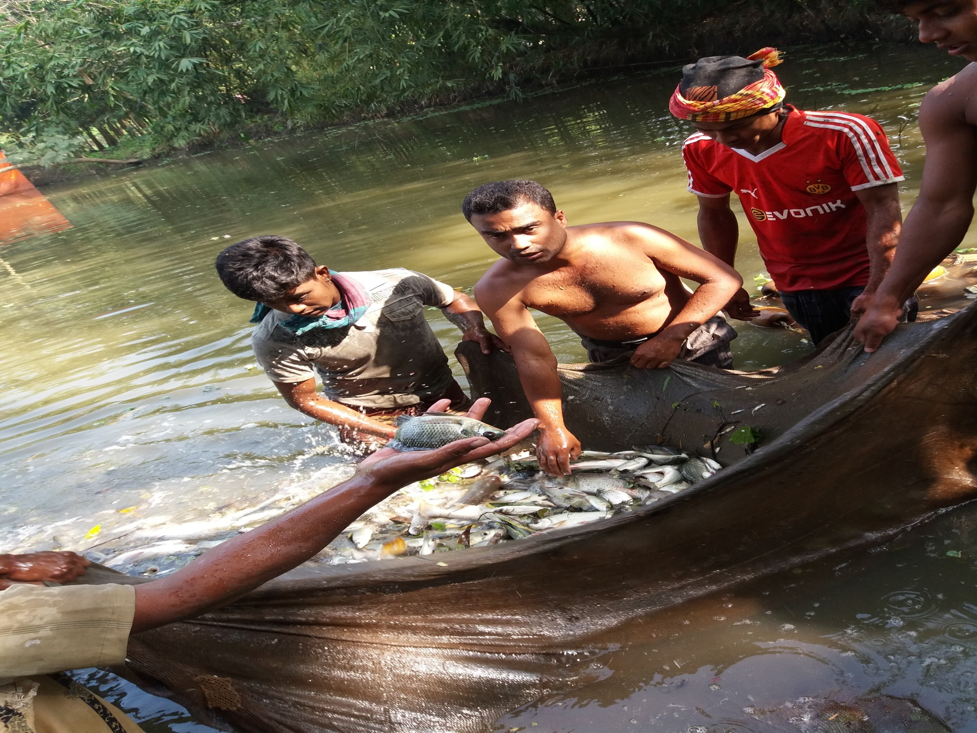

Slide 16


Slide 17
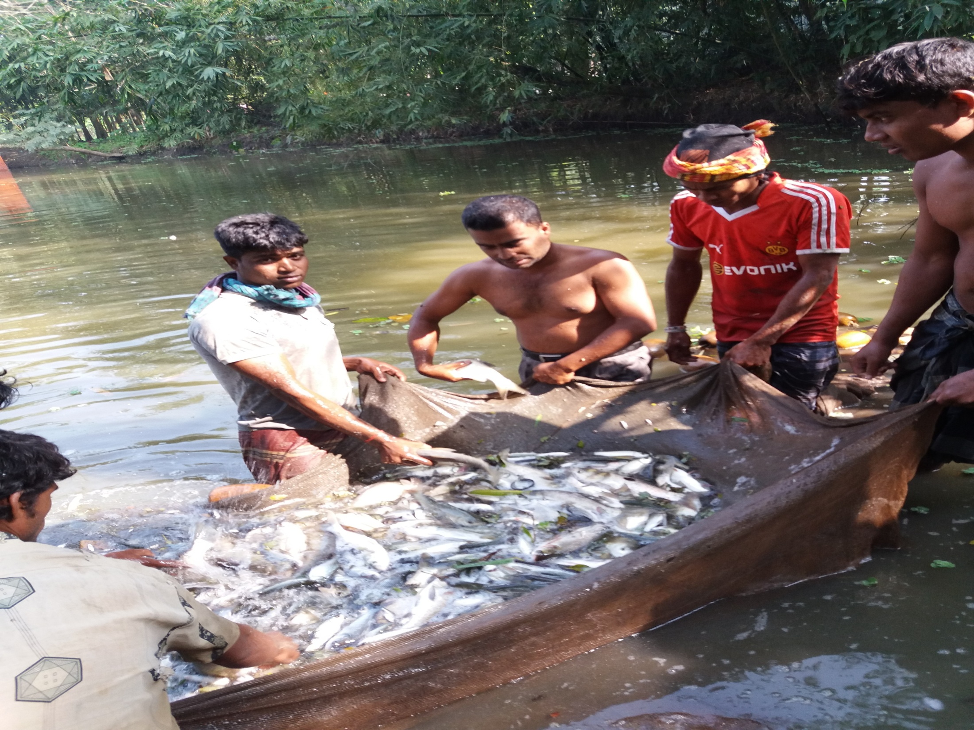

Slide 18
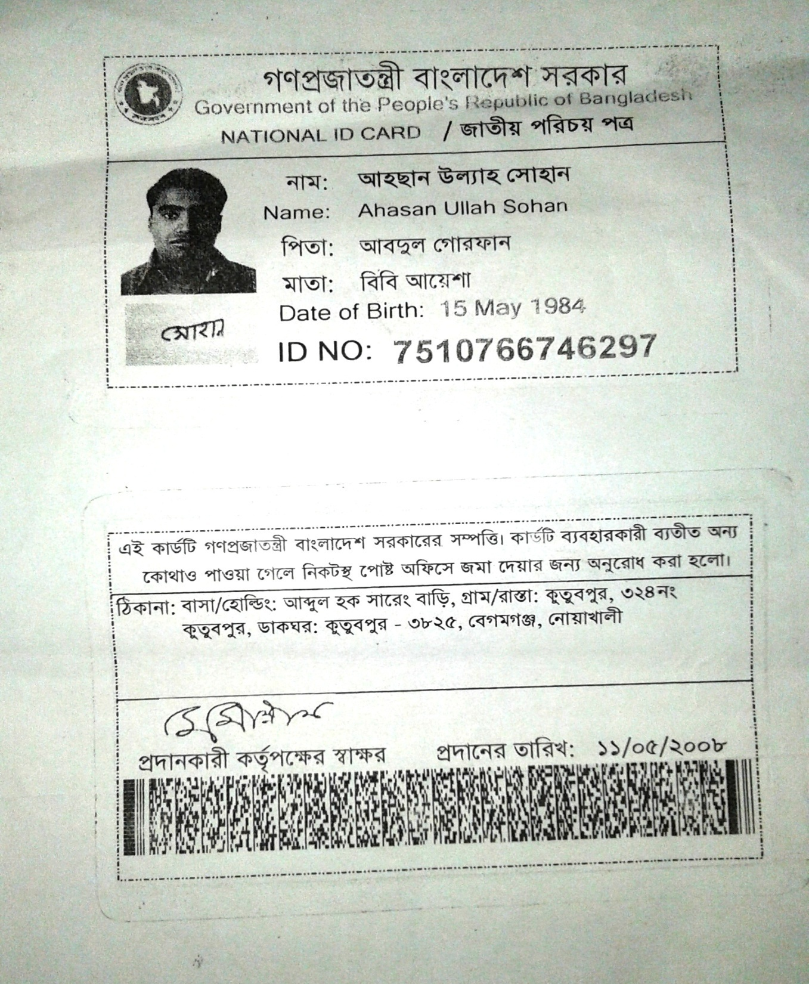

Slide 19
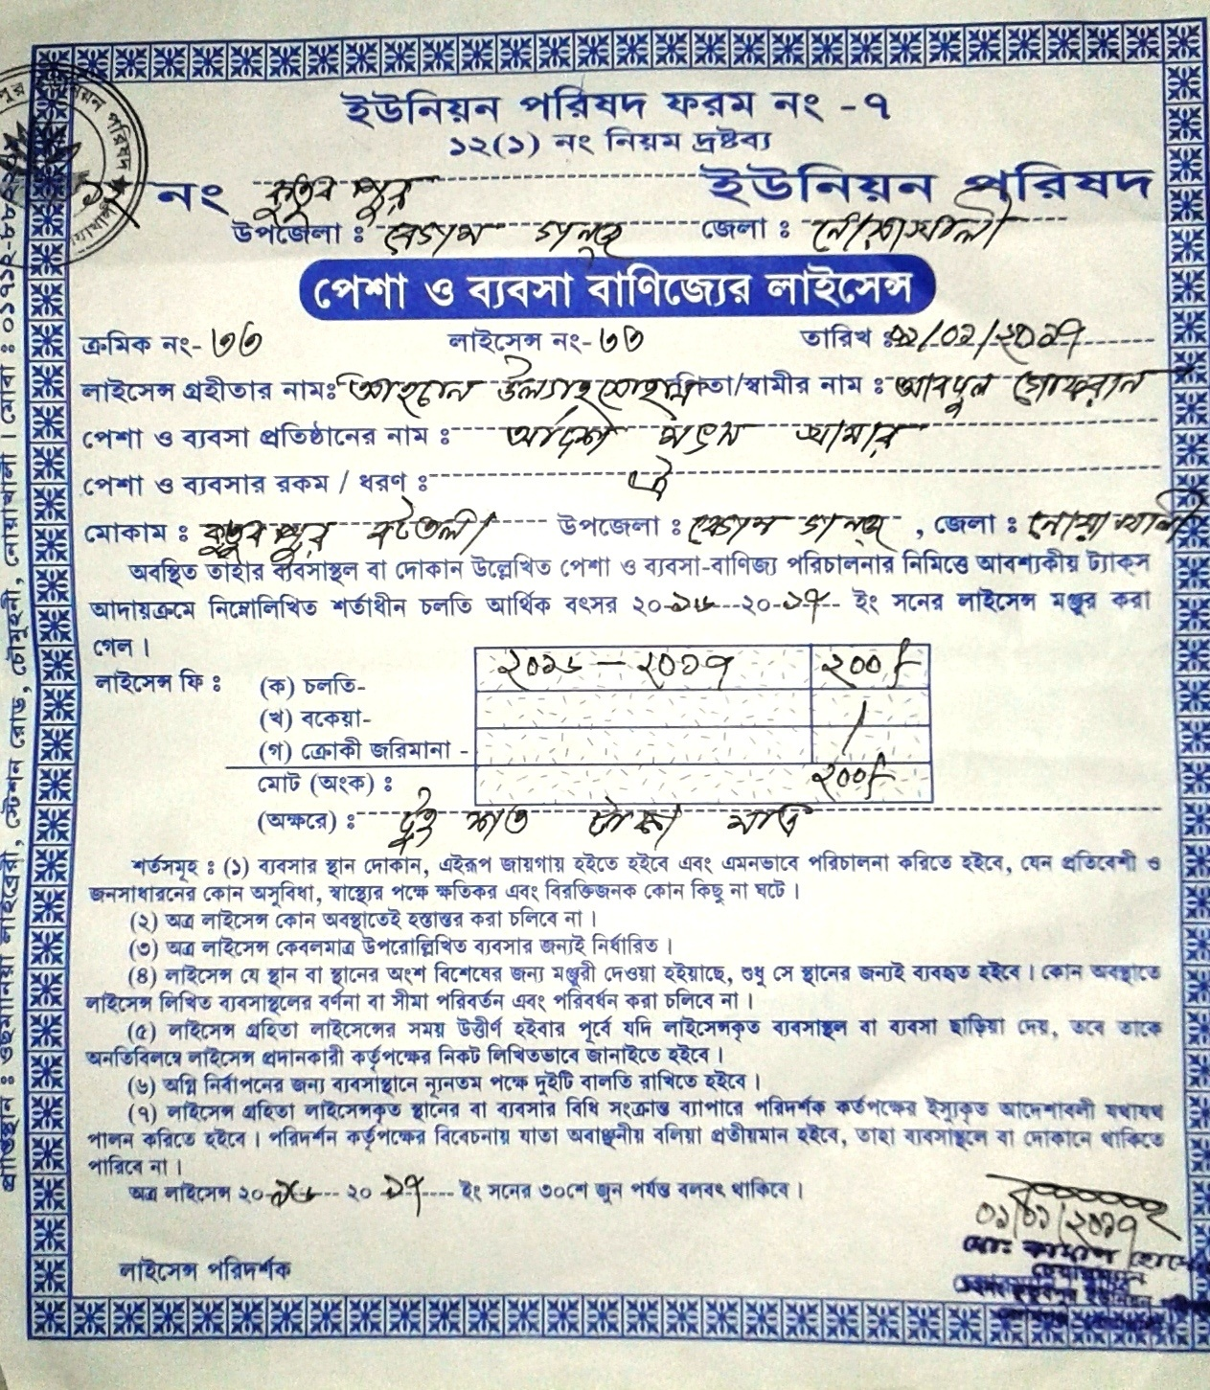

Slide 20
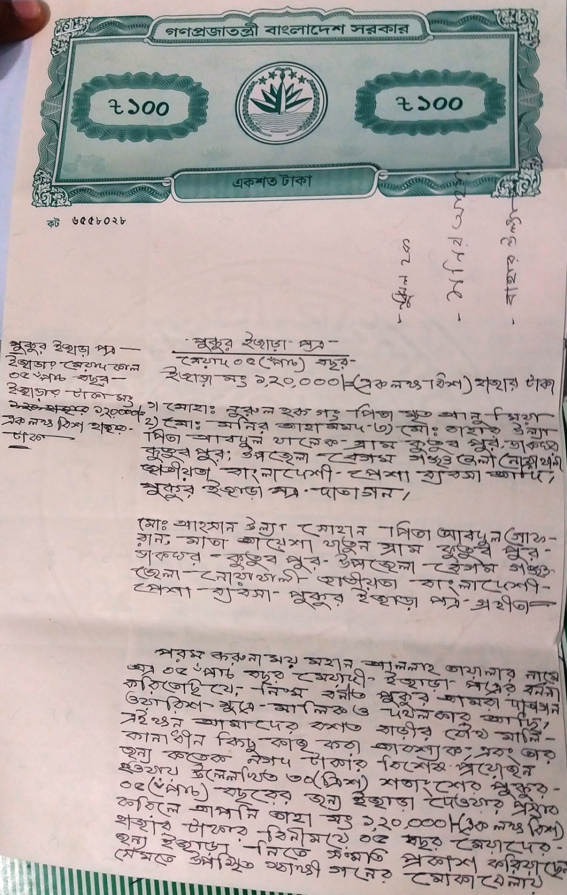
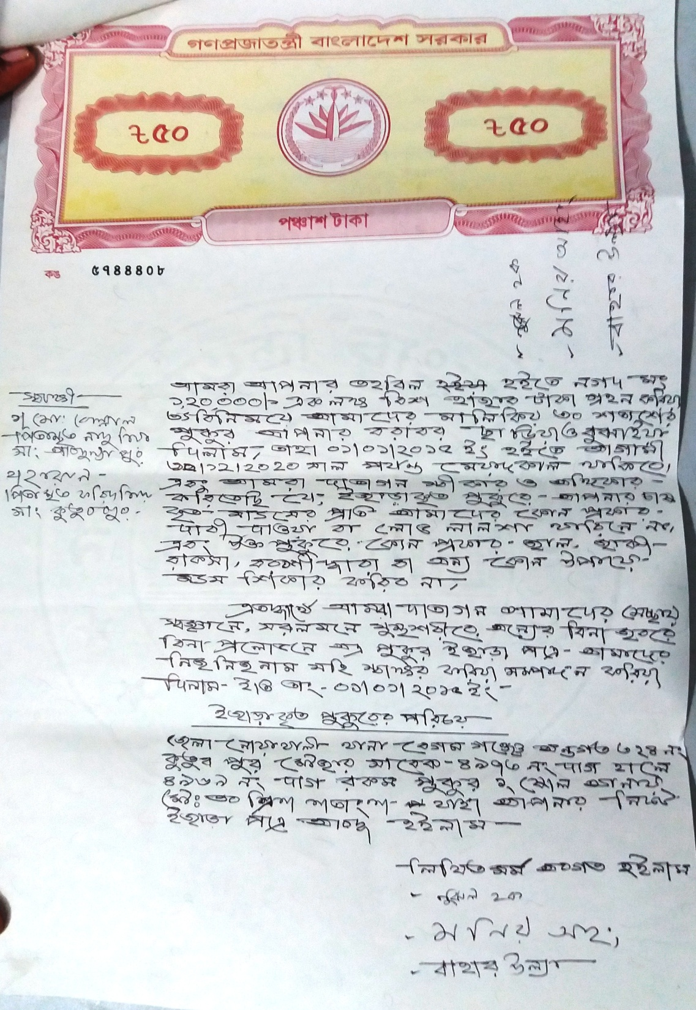

Slide 21

Presented at
SB Design Lab
On January, 2017
For more information
Grameen Trust
Phone No : 9017038
Ahasan Ullah Sohan
Cell No: - +8801814-896272

