Slide 1
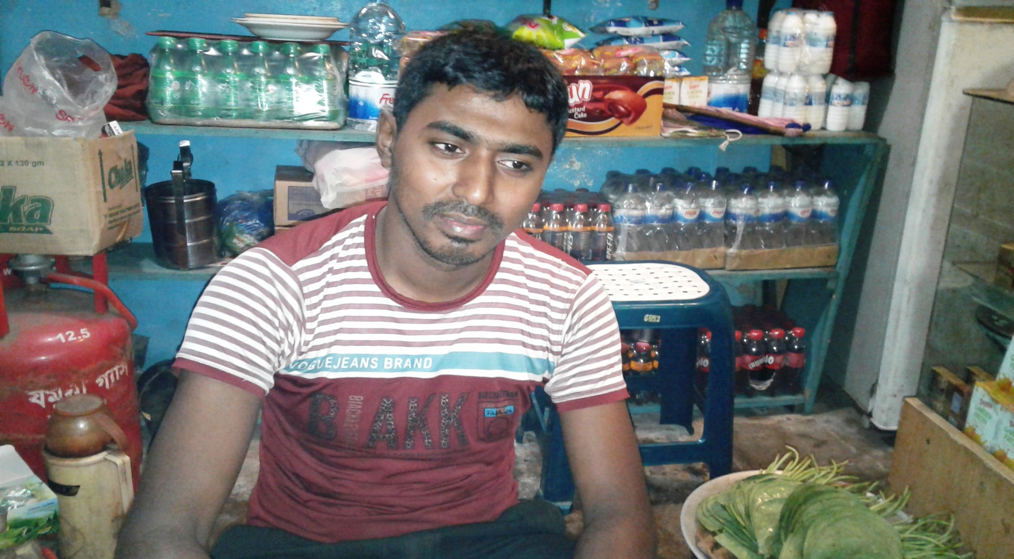

Emon Tea Store
Project by: Sahab Uddin
Identified by: Md. Billal Hossain
Verified By : Md. Zahidul Kabir
Noakhali Unit
Region -2
GRAMEEN TRUST

Slide 2
Brief Bio of the PROPOSED Nobin Udyokta
Name | : | Sahab Uddin
Permanent Address | : | Rosulpr, Bangla Bazar, Begumgonj, Noakhali-3822
Age | : | 10-Mar-1984 (33 Years)
Marital status | : | Married
Children | : | 02 Children
No. of siblings: | : | 02 Brothers, 04 Sisters
Parent’s and GB related Info (i) Who is GB member (ii) Mother’s name (iii) Father’s name (iv) GB member’s info Further Information: (v) Who pays GB loan installment (vi) Mobile lady (vii) Grameen Education Loan Any other loan like GCCN, GKF | : : : : : : : : | Mother Father Salma Begum Saydul Haque Branch: Jirtoli,Begumgonj, Centre :0 Group : 0, Loanee no.: 0, Member since: 2002To Drop out 2008 First loan: 5,000/=, Existing loan: 20,000, Outstanding: Nil. N/A N/A N/A. N/A N/A
Education | : | Class Six

Slide 3
Brief Bio of the PROPOSED Nobin Udyokta (cont…)
Present Occupation | : | Tea Store Collect raw materials from Chowmuhani Bazar. Local Consumer are the target customer group.
Initial Investment | : | 20,000/=
Trade License No |  | 232/2016-2017
Business Experience And Training Info | : : | 08 Years Received training from Chowmohani Bazar for 02years.
Other Own/Family Sources of Income | : | N/A
Other Own/Family Sources of Liabilities | : | N/A
NU Contact Info |  | +8801824-411795(This number will be registered in SBMS System for Daily SMS)
NU Project Source/Reference | : | Noakhali Unit

Slide 4
brief history of GB loan utilization by Family
NU’s mother has been a member of Grameen Bank from 2002 and drop out in 2008 (6 Years). At first she took a loan of Taka 5,000/- from Grameen Bank. His father used GB loan in his business and repaired their own houses from his income. NU also built their own houses from the income of GB loan. They bought some land also. NU’s mother gradually improved their life standard by using GB loan.

Slide 5
Proposed Nobin Udyokta business INFO
Business Name | : | Emon Tea Store
Address/ Location | : | Bangla Bazar, Begumgonj, Noakhali-3822
Total Investment in BDT | : | 1,70,000/-
Financing | : | Self BDT 1,00,000 (from existing business) 59% Required Investment BDT 70,000/-(as equity) 41%
Present salary/drawings from business (estimates) | : | 7,000/-
Proposed Salary | : | 7,000/-
Proposed Business % of present gross profit margin (ii) Estimated % of proposed gross profit margin (iii) Agreed grace period | : : : | 20% 20% 02 Months

Slide 6
Present & Proposed Investment Breakdown
Particulars | Existing Business (BDT) | Proposed (BDT) | Total (BDT)
Investments in different categories: | (1) | (2) | (1+2)
Present Stock Items: Advance- 40,000 Confectionary 20,000 Soft Drinks 20,000 Decoration 20,000 | 1,00,000 |  | 1,00,000
Proposed items: Confectionery Item 15,000 Soft Drinks 15,000 Fridge 30,000 Misti & Doi 10,000 |  | 70,000 | 70,000
Total Capital | 1,00,000 | 70,000 | 1,70,000

Slide 7
Present & Proposed Investment Breakdown
Present Stock Items
Product name | Amount
Advance | 40,000
Confectionery Item | 20,000
Decoration | 20,000
Soft Drinks | 20,000
Total Present Stock | 1,00,000
Proposed Items
Product Name | Unit | Amount
Confectionery Item |  | 15,000
Soft Drinks |  | 15,000
Fridge | 1 | 30,000
Misti & Doi |  | 10,000
Total Proposed Stock |  | 70,000

Slide 8
INFO ON EXISTING BUSINESS OPERATIONS
Particulars | Existing Business (BDT)
 | Daily | Monthly | Yearly
Sales (A) | 2,500 | 75,000 | 9,00,000
Less: Cost of sales (B) | 2,000 | 60,000 | 7,20,000
Gross Profit (C) [C=(A-B)] | 500 | 15,000 | 1,80,000
Less: Operating Costs
Electricity bill |  | 500 | 6,000
Generator bill |  | 200 | 2,400
Shop Rent |  | 2,000 | 24,000
Night Guard bill |  | 250 | 3,000
Mobile bill |  | 200 | 2,400
Present salary/Drawings- self |  | 7,000 | 84,000
Conveyance or Transport] |  | 800 | 9,600
Others (fees, Entertainment, TL renew) |  | 500 | 6,000
Non Cash Item:
Depreciation Expenses(20,000*10%) |  | 167 | 2,004
Total Operating Cost (F) |  | 11,617 | 1,39,404
Net Profit (E-F): |  | 3,383 | 40,596

Slide 9
Financial Projection of NU Business plan
Particulars | Year 1 (BDT) |  |  | Year 2 (BDT) |  |  | Year 3 (BDT)
 | Daily | Monthly | Yearly | Daily | Monthly | Yearly | Daily | Monthly | Yearly
Sales (A) | 2,800 | 84,000 | 10,08,000 | 3,000 | 90,000 | 10,80,000 | 3,200 | 96,000 | 11,52,000
Less: Cost of Sale (B) | 2,240 | 67,200 | 8,06,400 | 2,400 | 72,000 | 8,64,000 | 2,560 | 76,800 | 9,21,600
Gross Profit (A-B)=(C) | 560 | 16,800 | 2,01,600 | 600 | 18,000 | 2,16,000 | 640 | 19,200 | 2,30,400
Less: Operating Costs
Electricity bill |  | 500 | 6,000 |  | 500 | 6,000 |  | 500 | 6,000
Generator bill |  | 200 | 2,400 |  | 200 | 2,400 |  | 200 | 2,400
Shop Rent |  | 2,000 | 24,000 |  | 2,000 | 24,000 |  | 2,000 | 24,000
Night Guard bill |  | 250 | 3,000 |  | 250 | 3,000 |  | 250 | 3,000
Mobile bill |  | 200 | 2,400 |  | 200 | 2,400 |  | 200 | 2,400
Present salary/Drawings- self |  | 7,000 | 84,000 |  | 7,000 | 84,000 |  | 7,000 | 84,000
Conveyance or Transport |  | 800 | 9,600 |  | 800 | 9,600 |  | 800 | 9,600
Others (fees, Entertainment, TL renew) |  | 500 | 6,000 |  | 500 | 6,000 |  | 500 | 6,000
Non Cash Item:
Depreciation Expenses |  | 167 | 2,004 |  | 167 | 2,004 |  | 167 | 2,004
Total Operating Cost |  | 11,617 | 1,39,404 |  | 11,617 | 1,39,404 |  | 11,617 | 1,39,404
Net Profit (C-D) = (E) |  | 5,183 | 62,196 |  | 6,383 | 76,596 |  | 7,583 | 90,996
GT payback | 28,000 |  |  | 28,000 |  |  | 28,000
Retained Income: | 34,196 |  |  | 48,596 |  |  | 62,996

Slide 10
Cash flow projection on business plan (Rec. & Pay.)
Sl # | Particulars | Year 1 (BDT) | Year 2 (BDT) | Year 3 (BDT)
1.0 | Cash Inflow
1.1 | Investment Infusion by Investor | 70,000
1.2 | Net Profit | 62,196 | 76,596 | 90,996
1.3 | Depreciation (Non cash item) | 2,004 | 2,004 | 2,004
1.4 | Opening Balance of Cash Surplus |  | 36,200 | 86,800
 | Total Cash Inflow | 1,34,200 | 1,14,800 | 1,79800
2.0 | Cash Outflow
2.1 | Purchase of Product | 70,000
2.2 | Payment of GB Loan
2.3 | Investment Pay Back Including ownership Tr. Fee | 28,000 | 28,000 | 28,000
 | Total Cash Outflow | 98,000 | 28,000 | 28,000
3.0 | Net Cash Surplus | 36,200 | 86,800 | 1,15,800

Slide 11
SWOT Analysis
STRENGTH Skilled & experienced Well known in locality. Quality services. | WEAKNESS Less Capital
OPPORTUNITIES Shop position is in the center point of business area. Beside main road. | THREATS Fire . Theft.

Slide 12
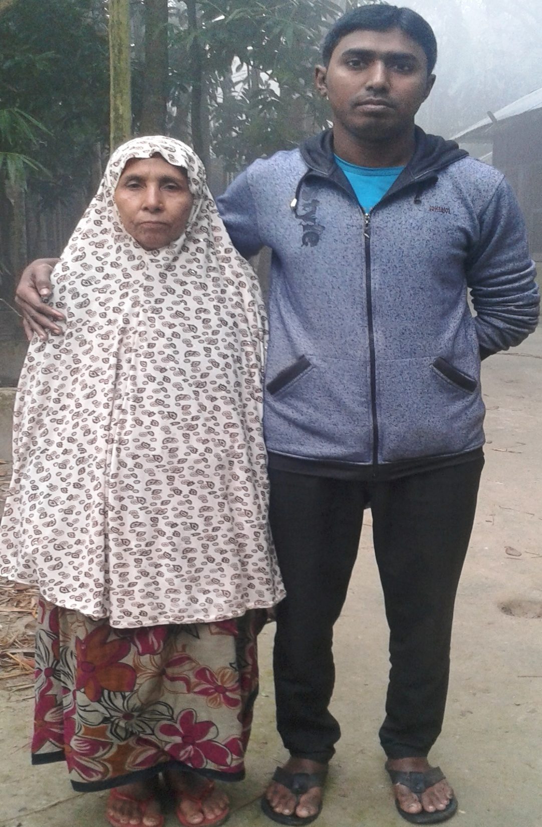

Slide 13
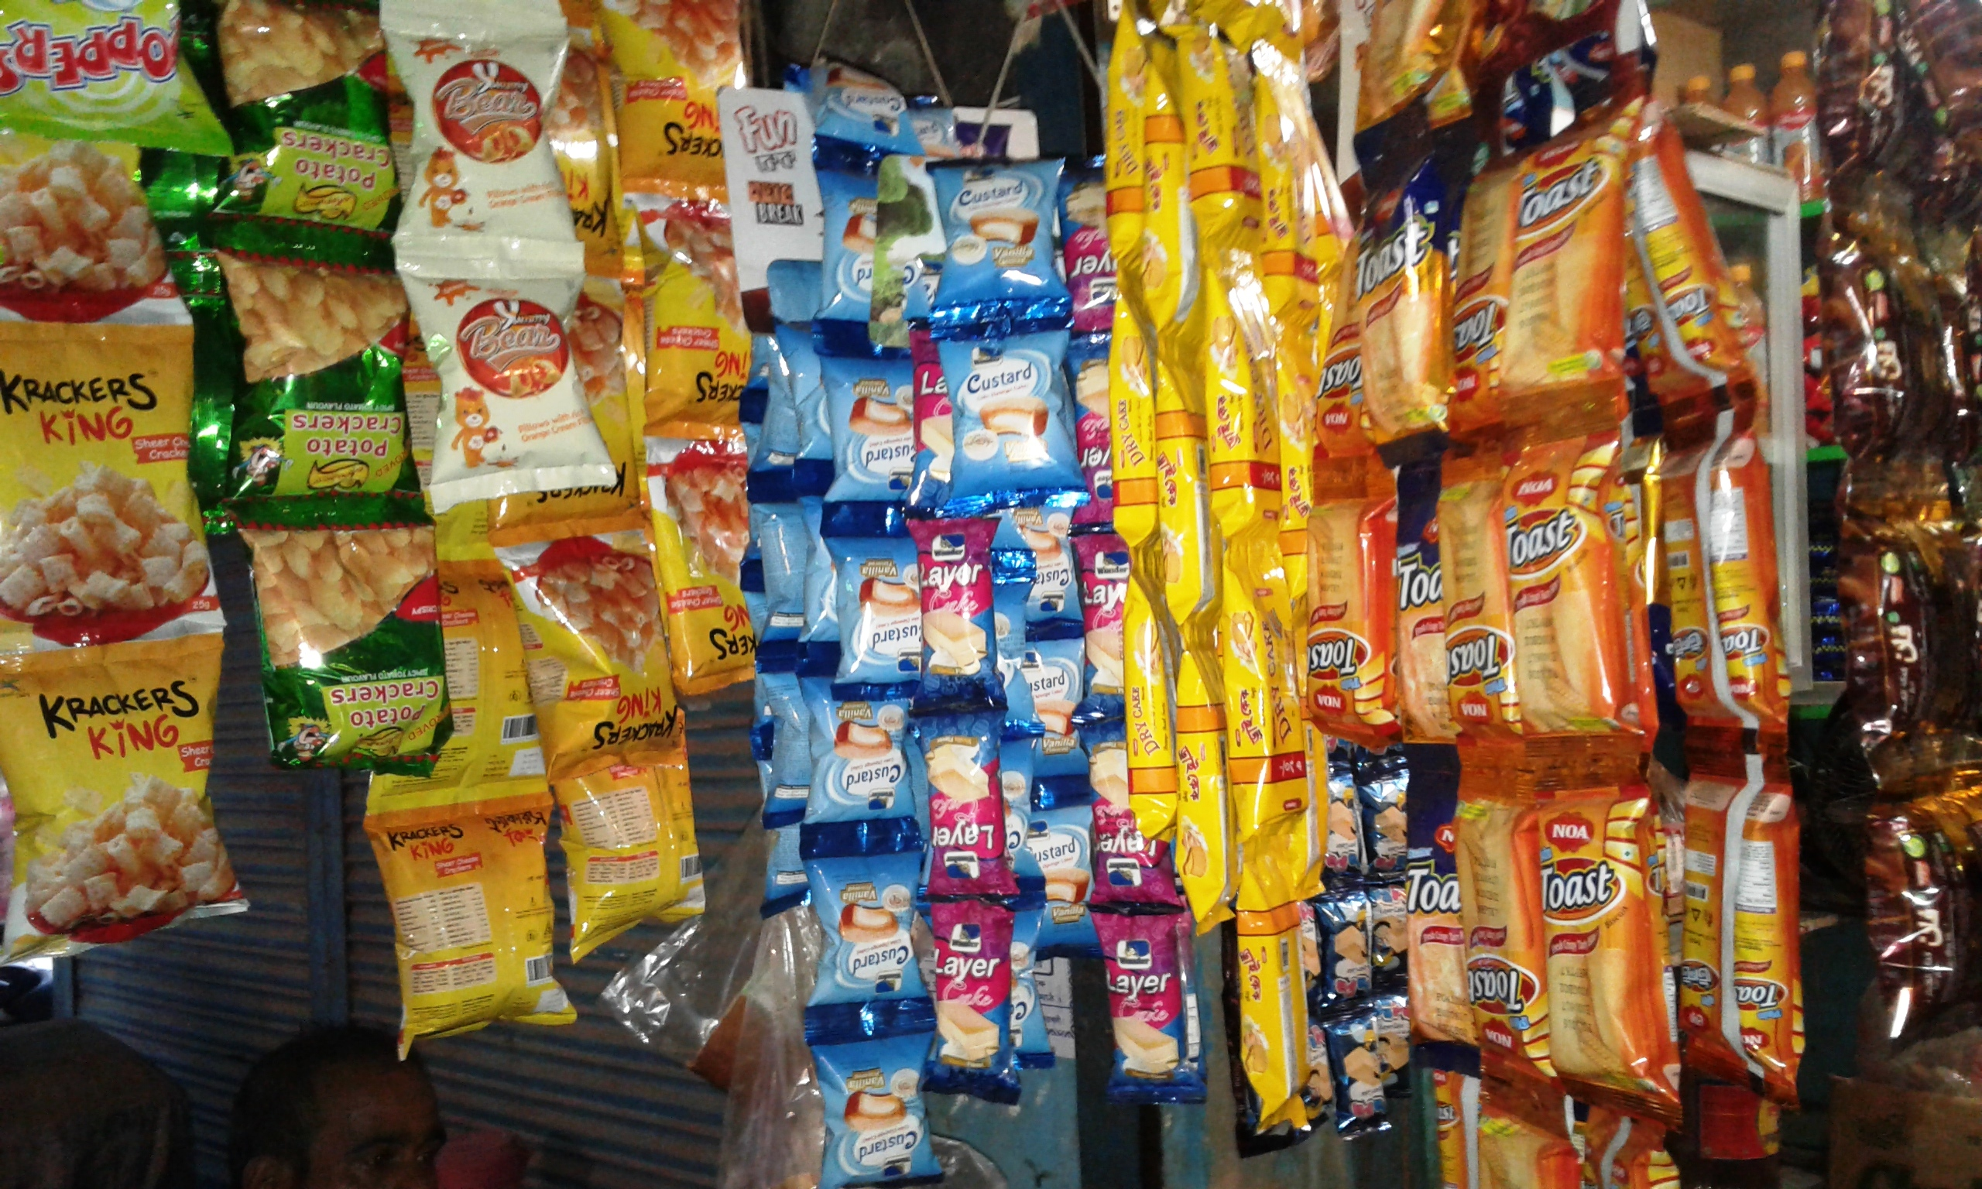

Slide 14
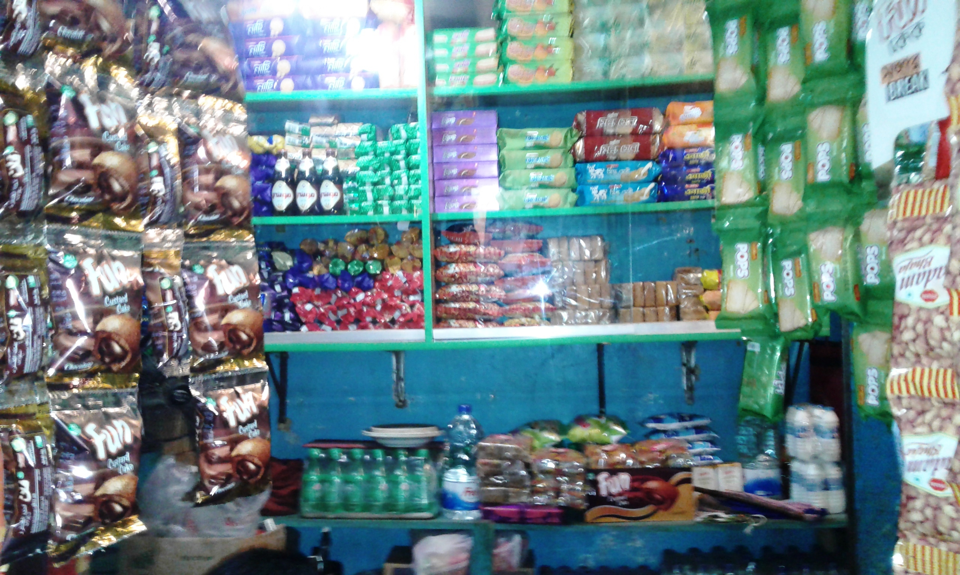

Slide 15
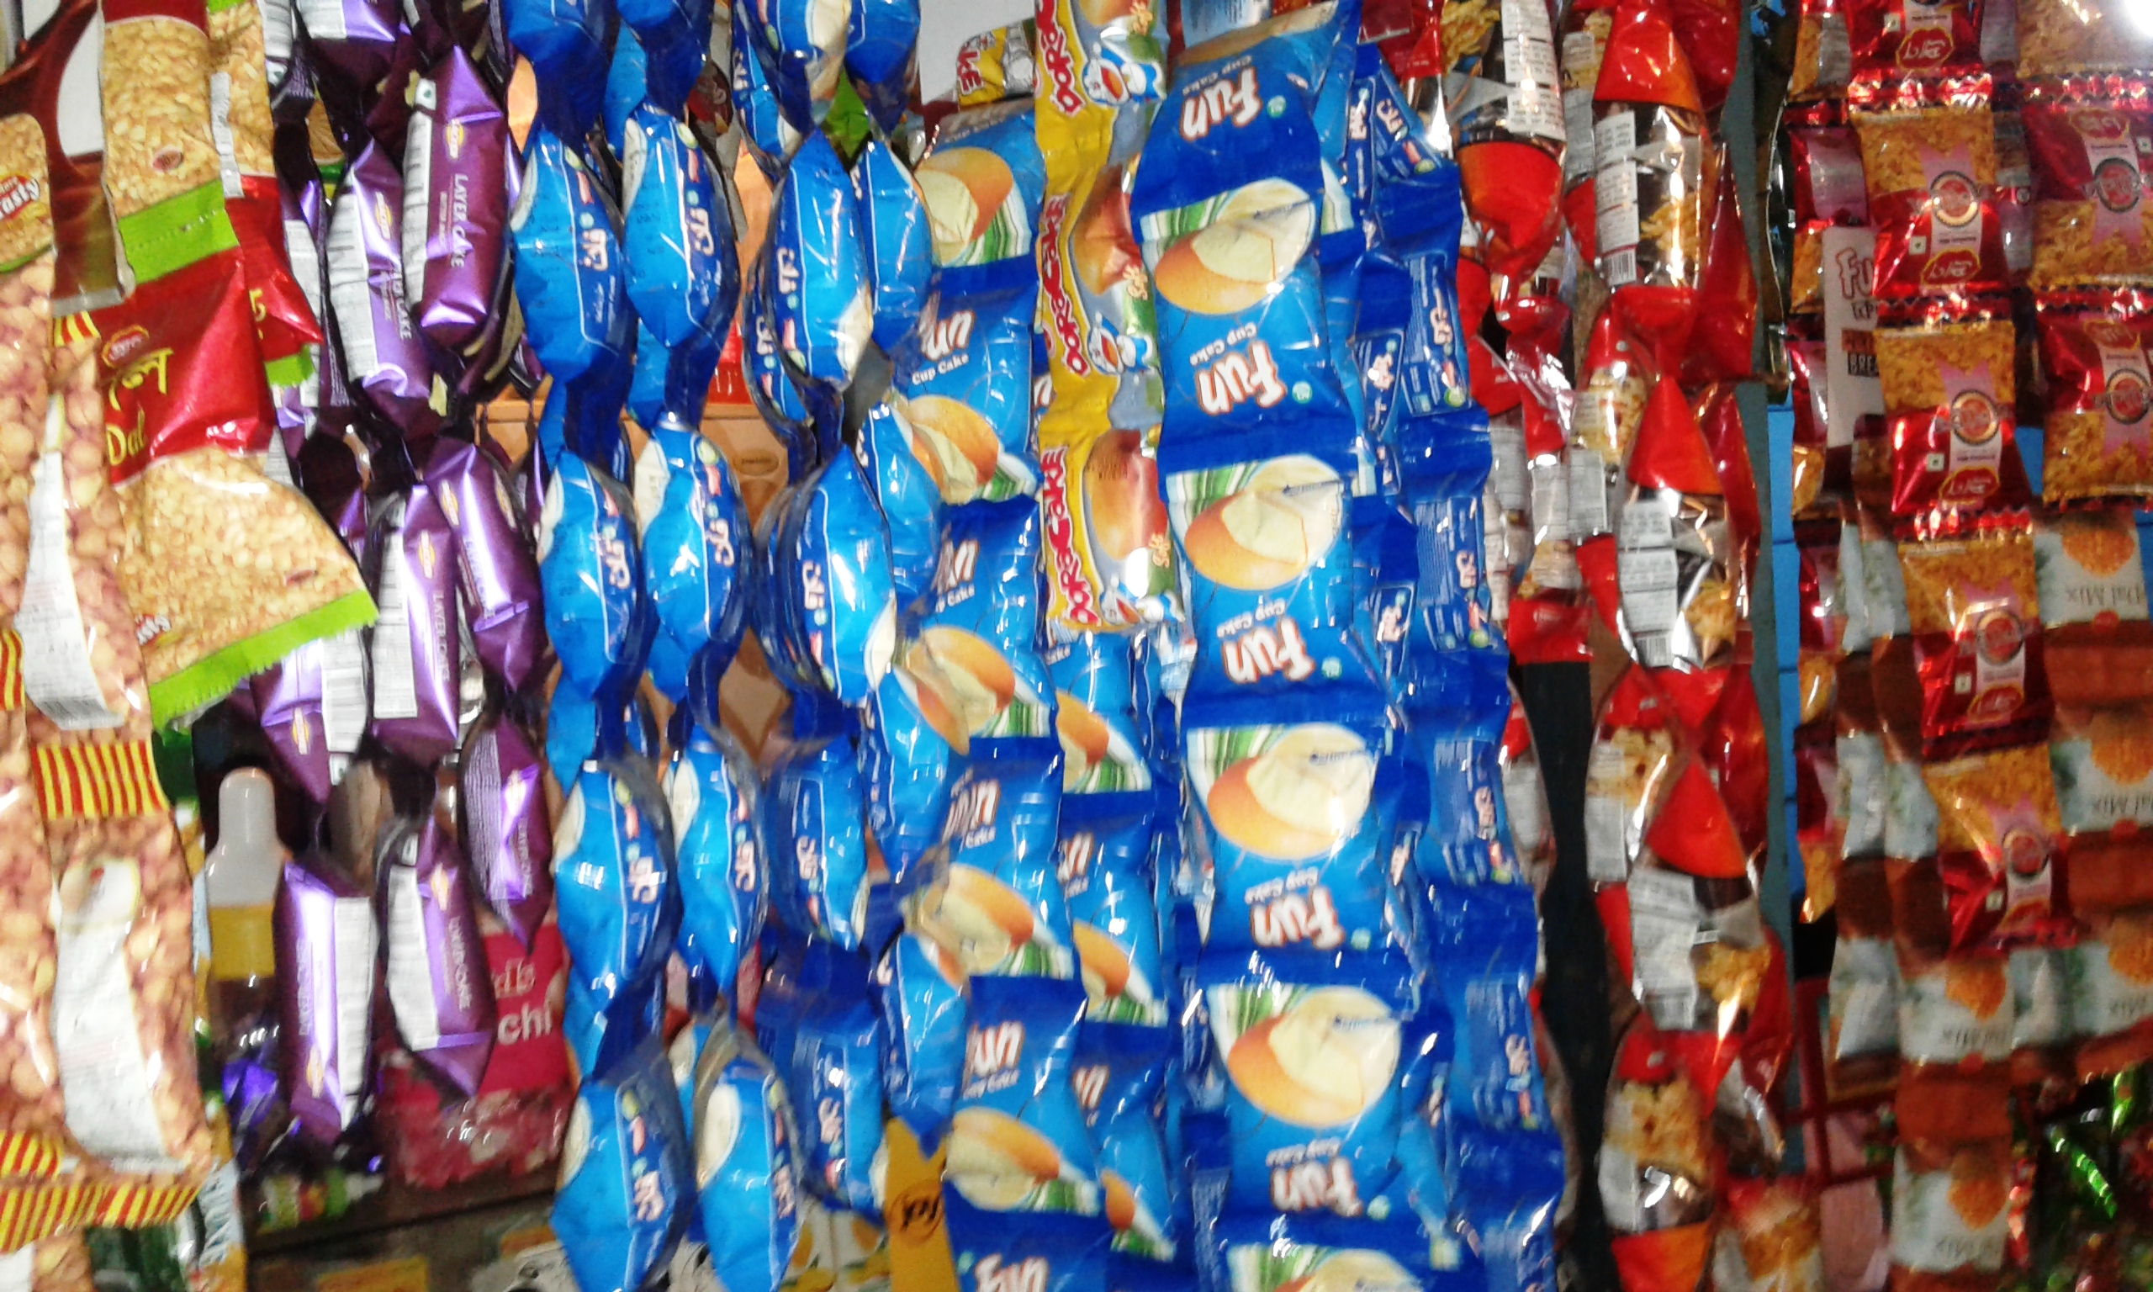

Slide 16
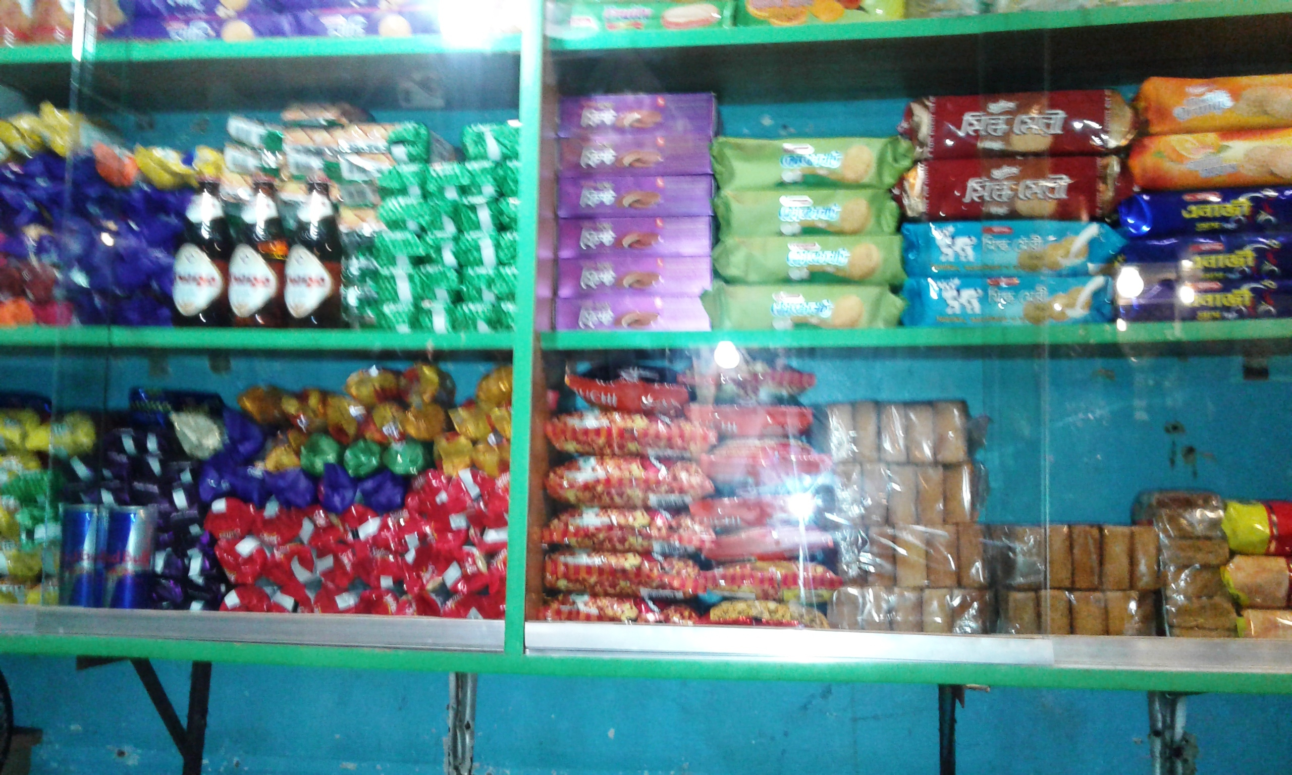

Slide 17
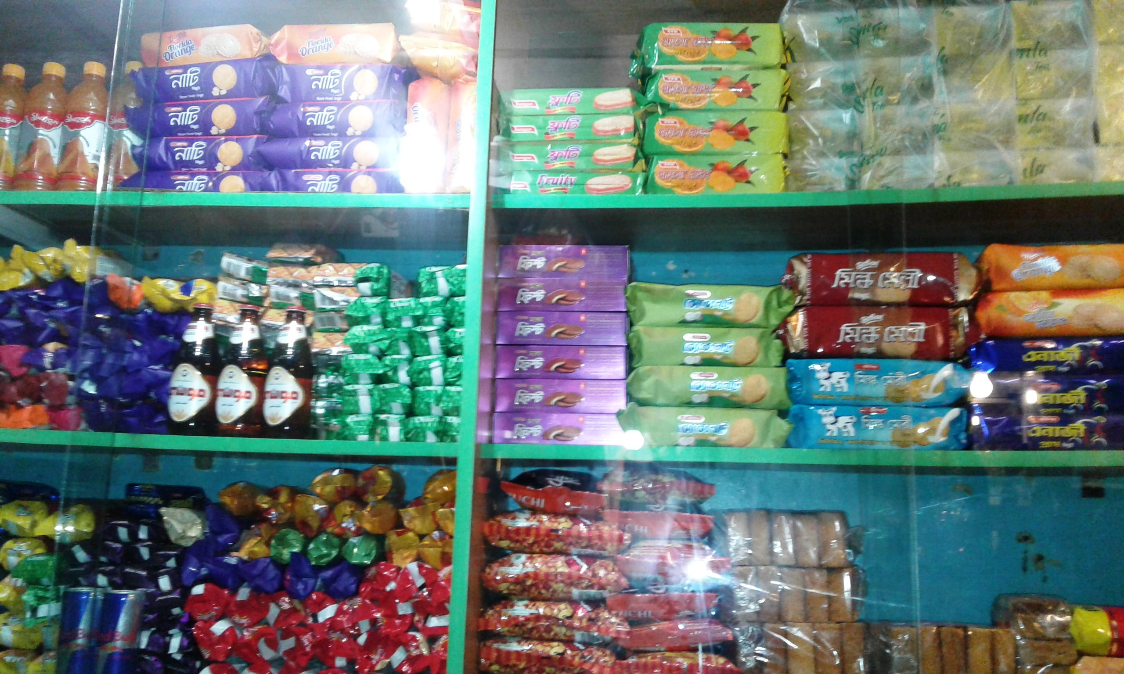

Slide 18
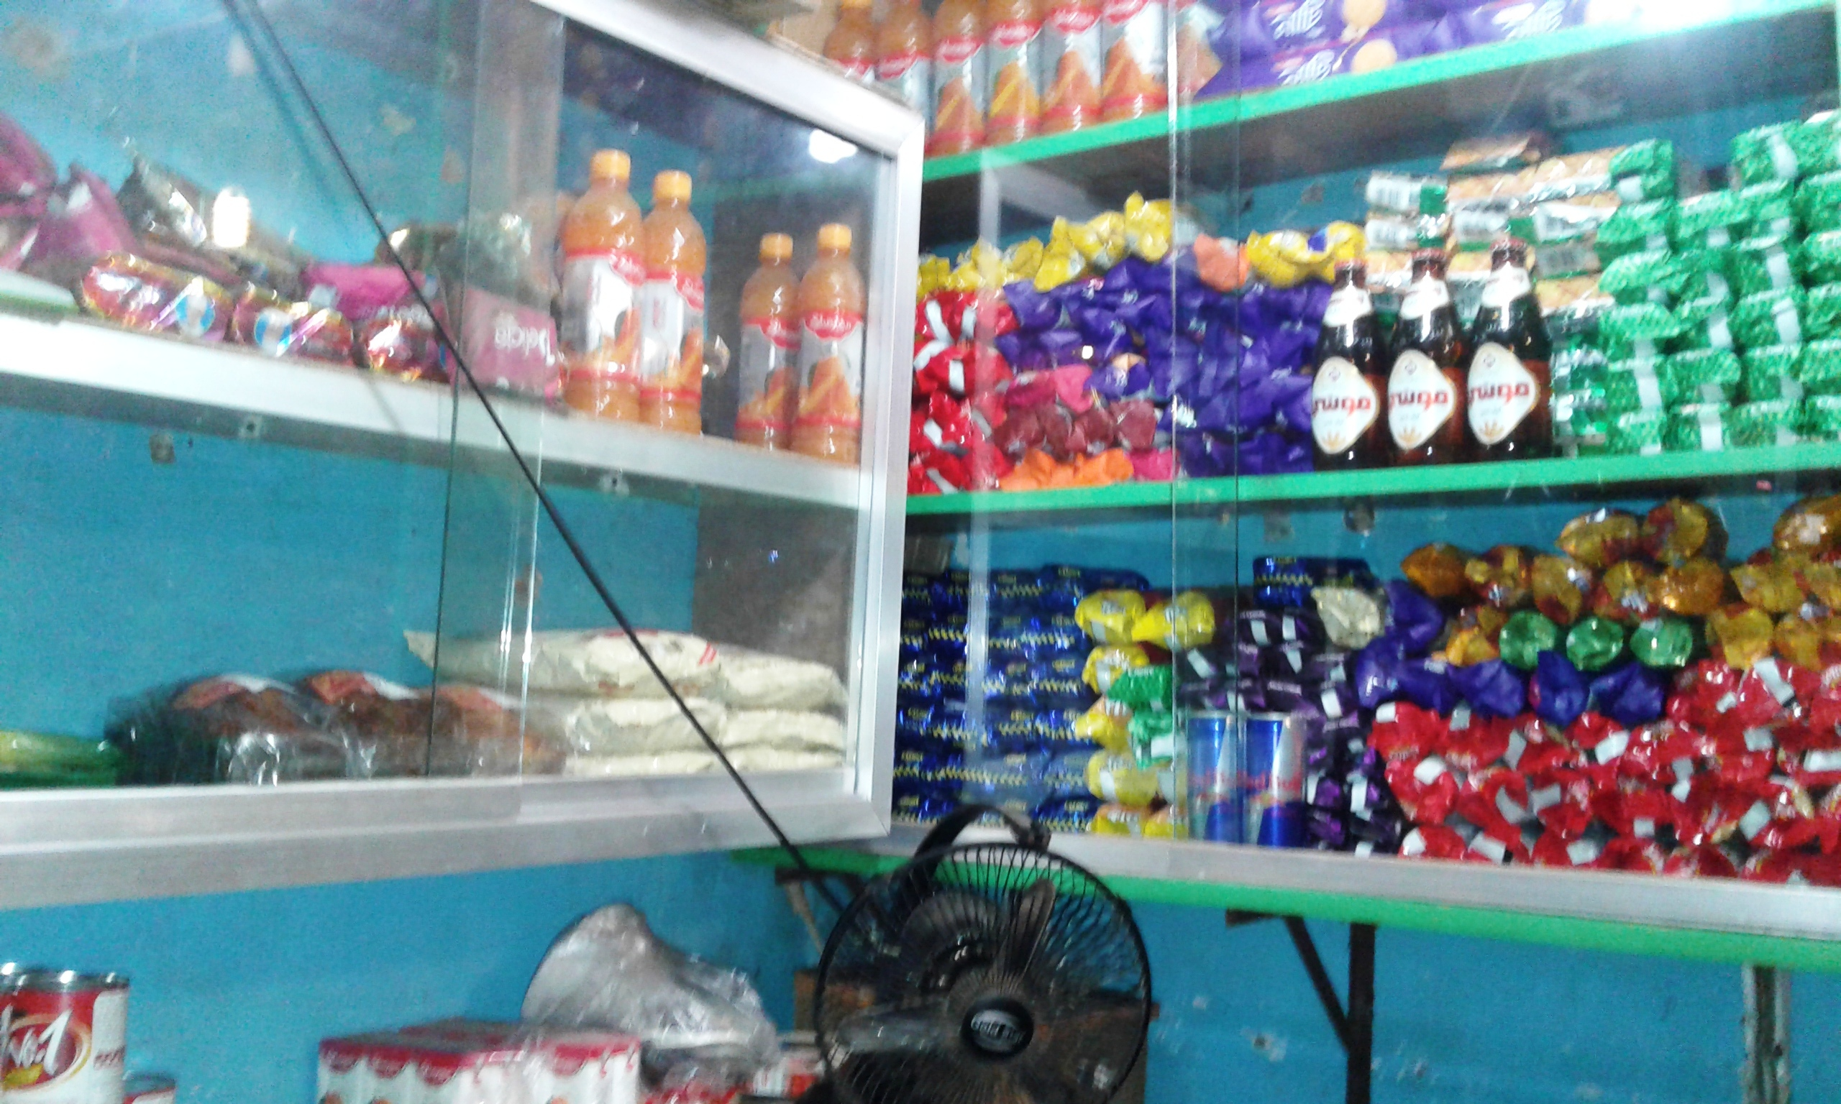

Slide 19
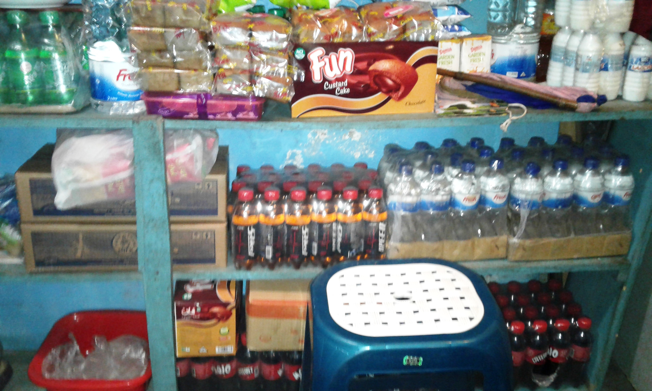

Slide 20
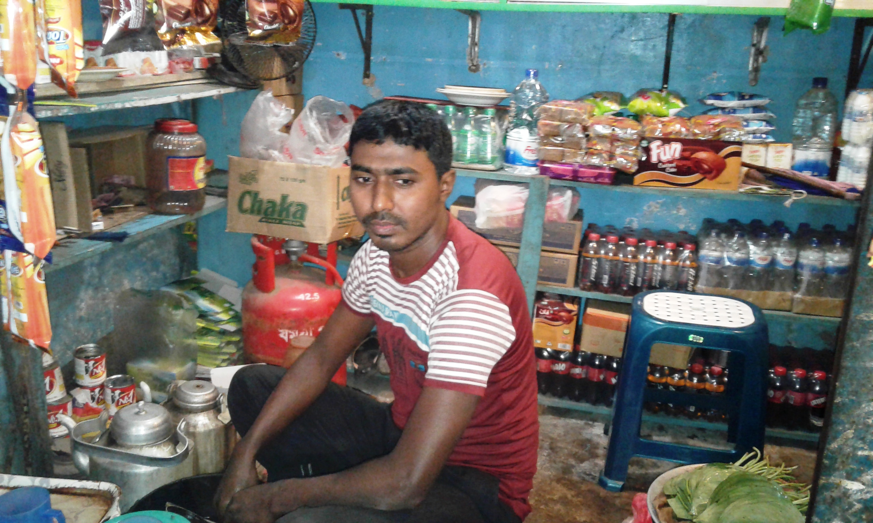

Slide 21
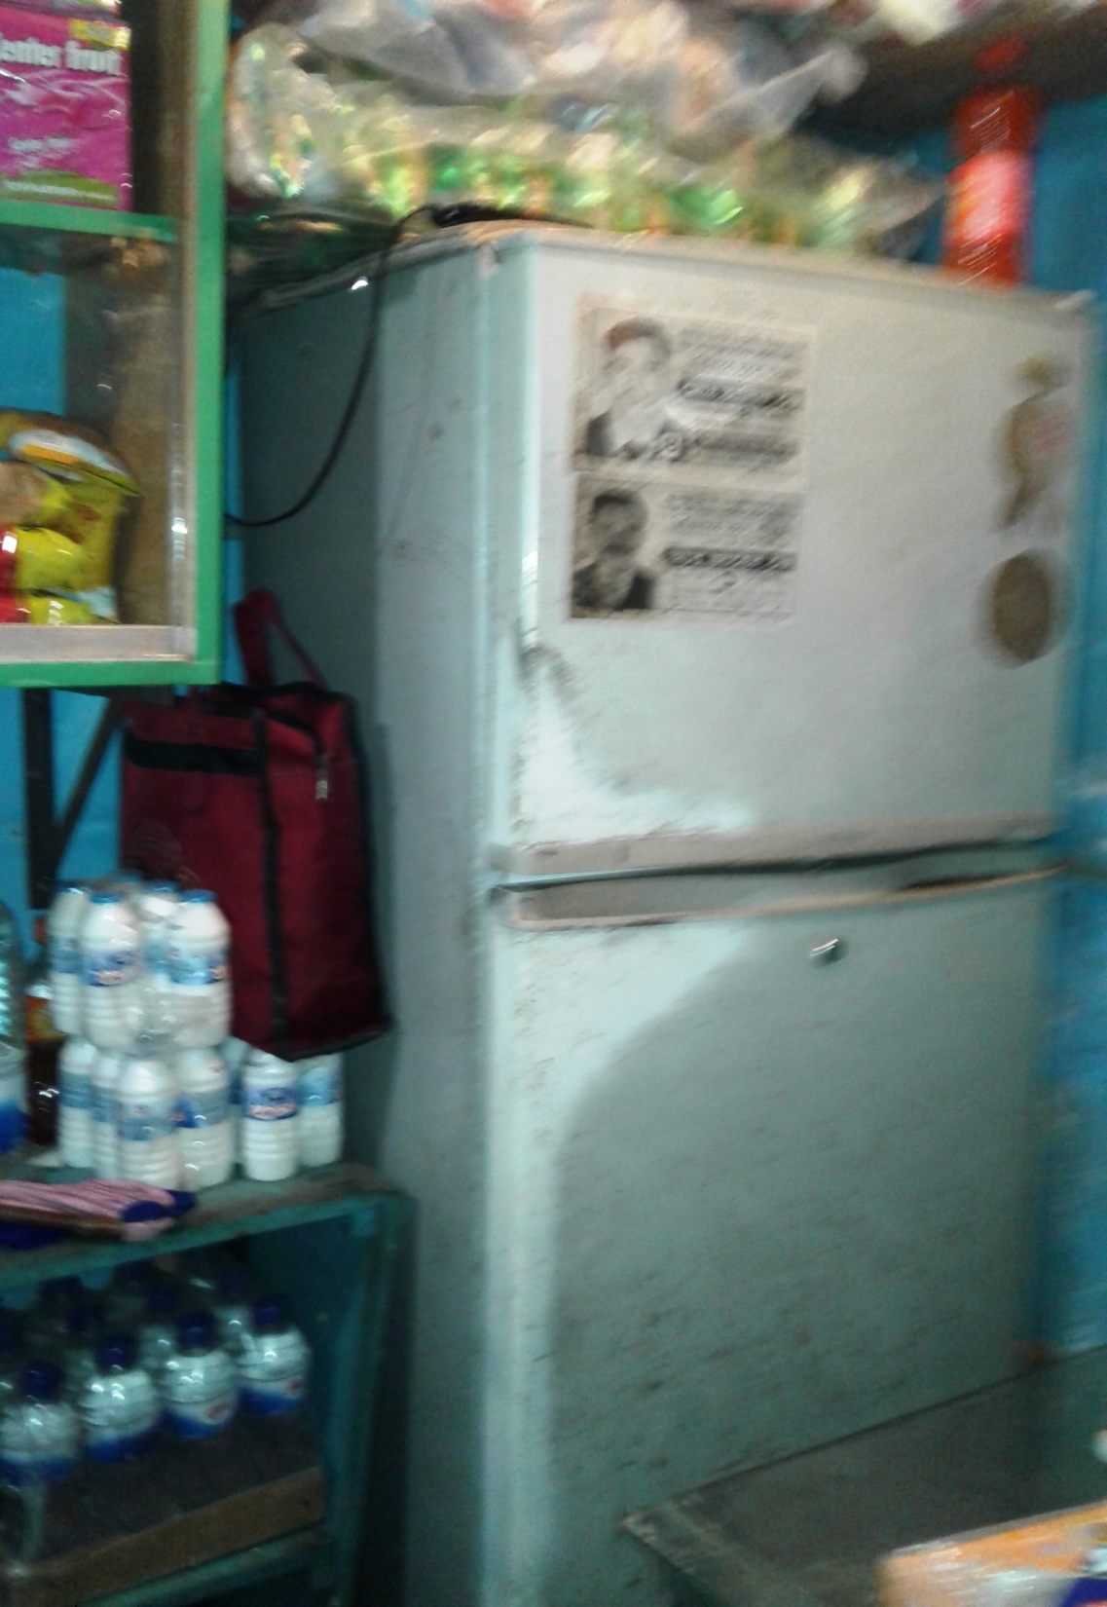

Slide 22
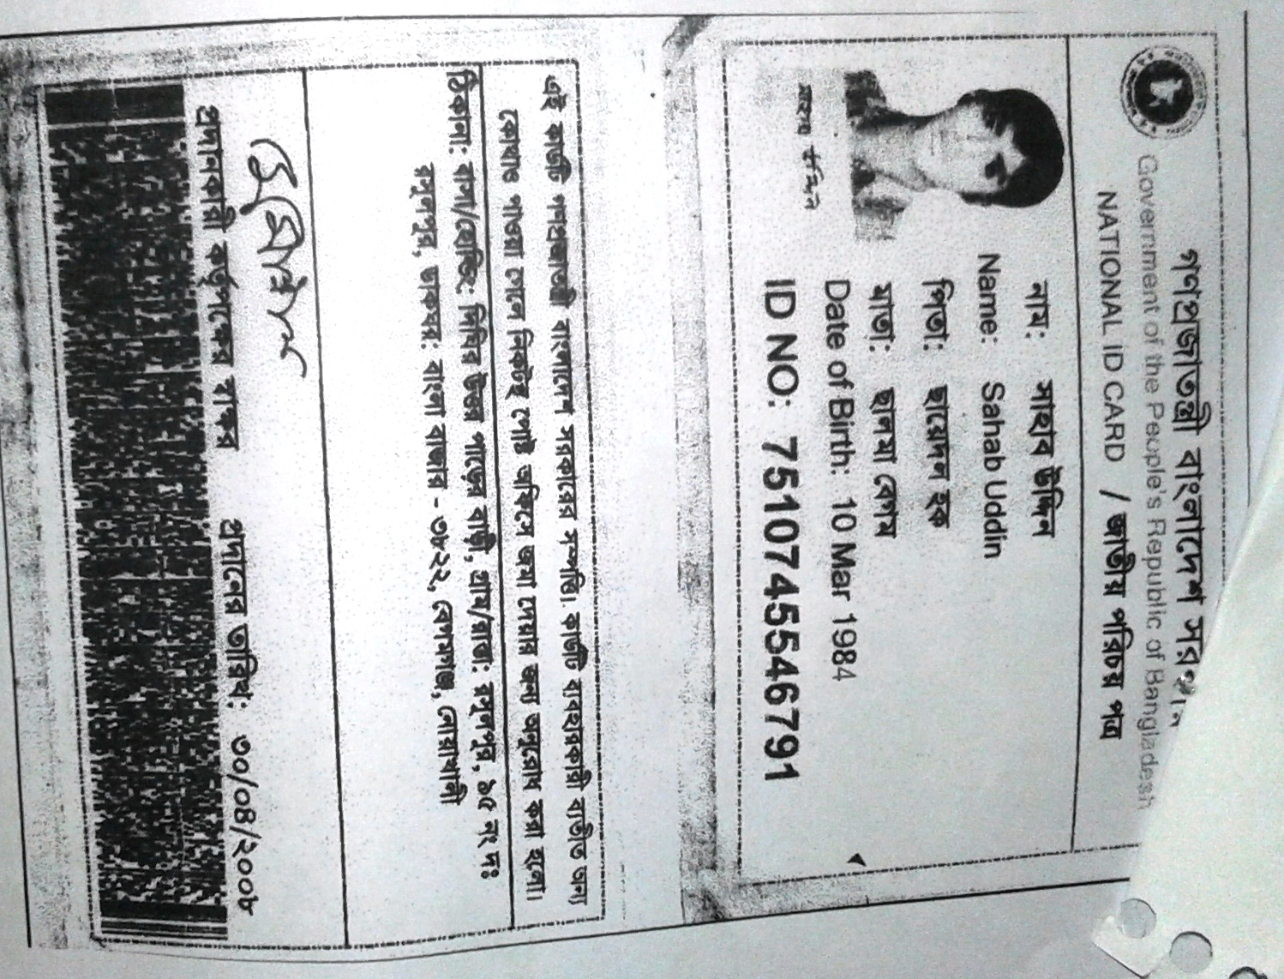

Slide 23
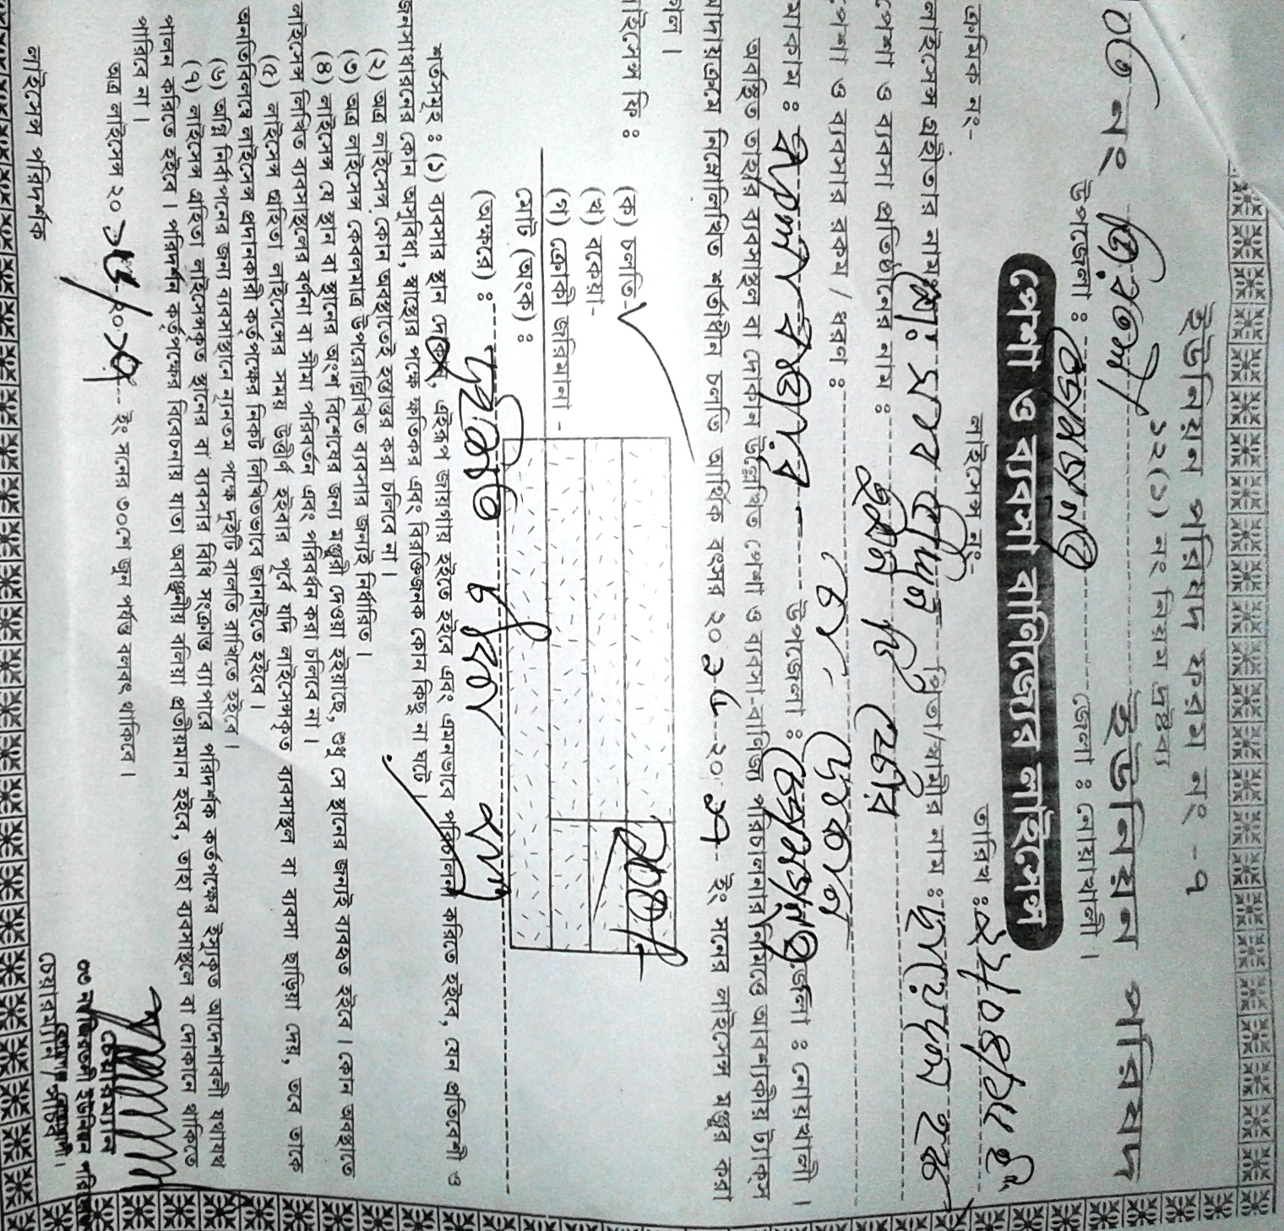

Slide 24
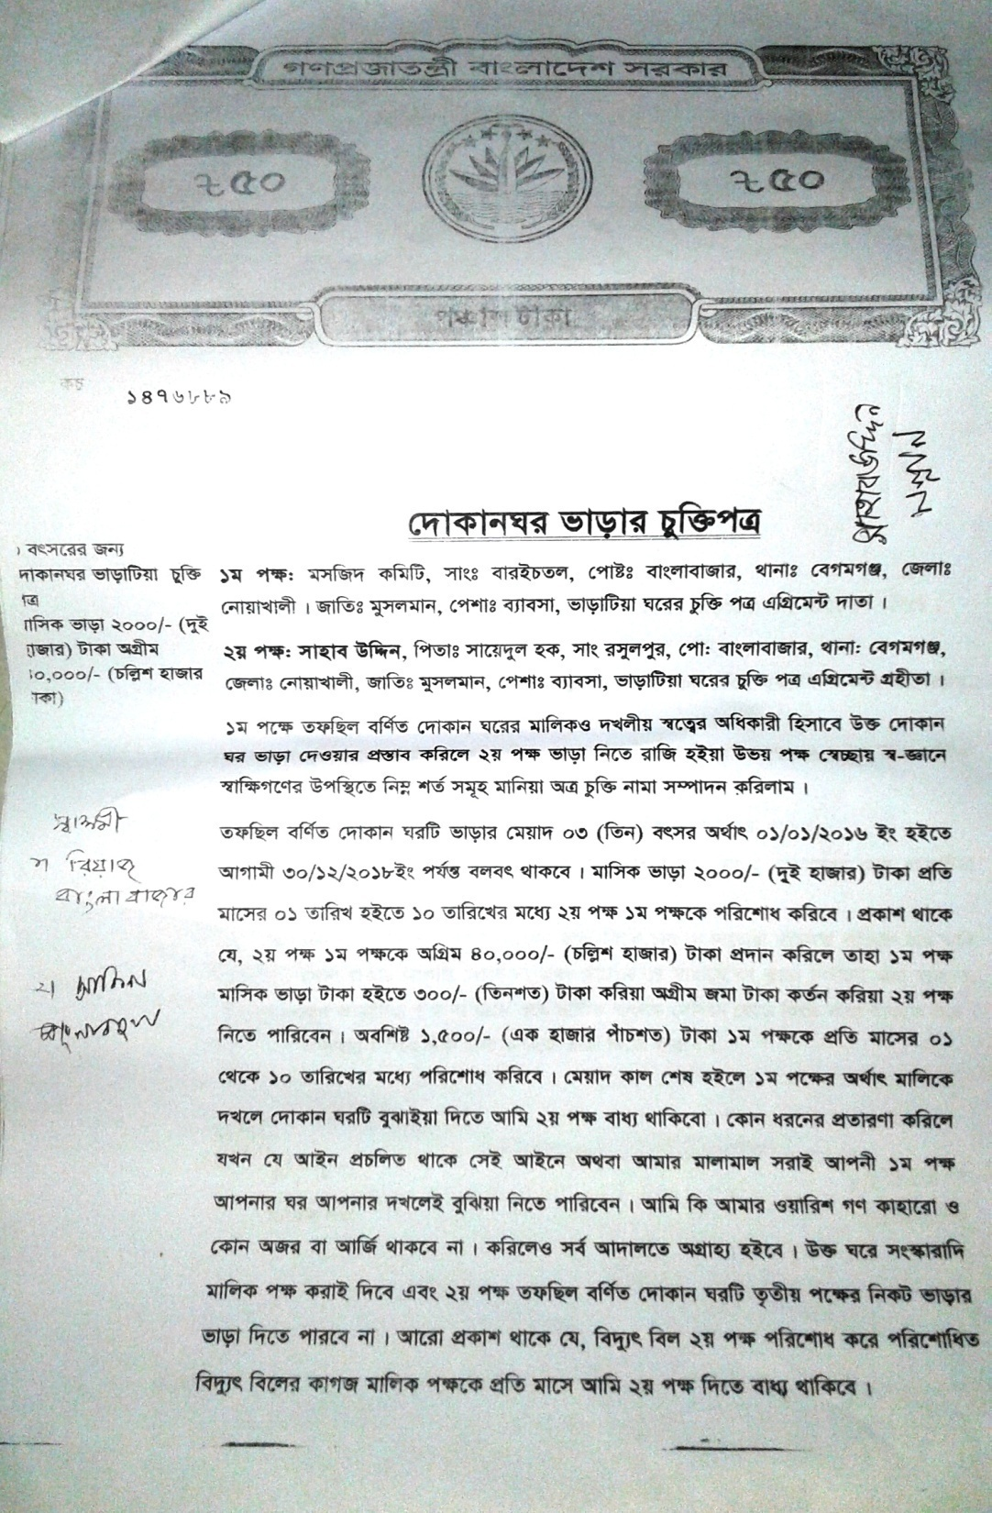
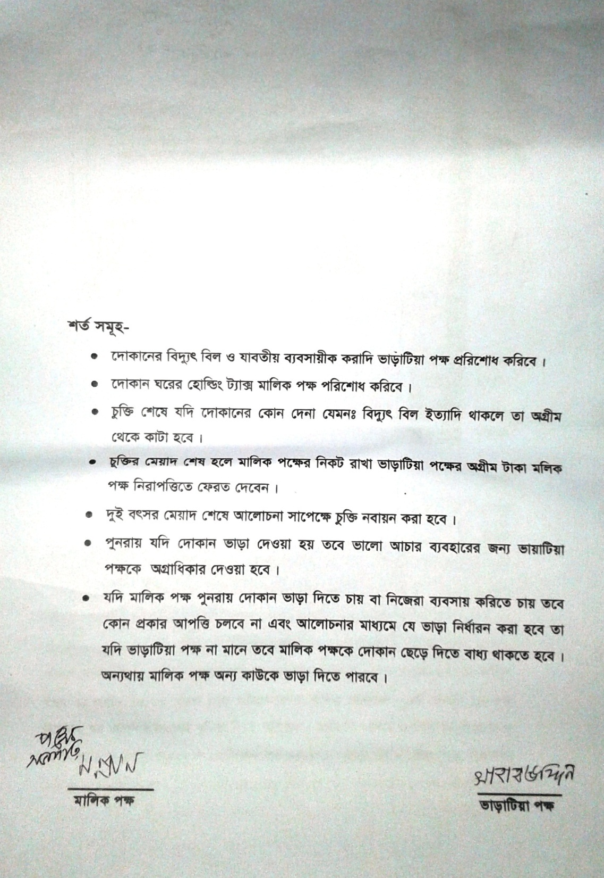

Slide 25

Presented at
SB Internal Design Lab
On January, 2017
For more information
Grameen Trust
Phone No : 9017038
Sahab Uddin
Cell No: - 01824-411795

