Slide 1
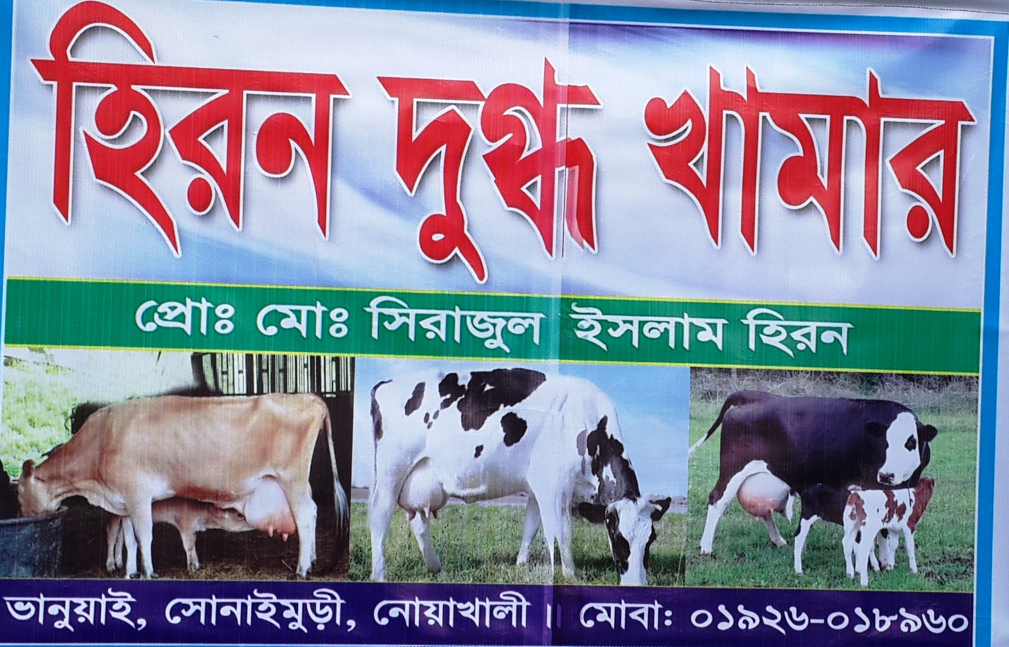

Heron Dugdho Khamar
Clear Shop picture with Sign Board
Project by: Serazul Islam
Identified by: Ala Uddin
Verified By: Mir Hossain Chowdhury
Sonaimuri Unit
Region -2
GRAMEEN TRUST

Slide 2
Brief Bio of the PROPOSED Nobin Udyokta
Name | : | Serazul Islam
Permanent Address | : | Vill: Banuiya, Post:Sonaimuri , P.S: Sonaimuri, District: Noakhali.
Age | : | 23/02/1990 (27 Years)
Marital status | : | Unmarried
Children | : | N/A
No. of siblings: | : | Two Brothers, Four Sisters.
Parent’s and GB related Info (i) Who is GB member (ii) Mother’s name (iii) Father’s name (iv) GB member’s info Further Information: (v) Who pays GB loan installment (vi) Mobile lady (vii) Grameen Education Loan Any other loan like GCCN, GKF | : : : : : : : | Mother Yes Father Shirin Begum Babul Branch: Deoty Centre: 12/m Group no: 03 Loanee no.: 8012, Member since: 2005, First loan: 20,000/-, Existing loan: N/A, Outstanding: N/A N/A N/A N/A N/A
Education | : | Five

Slide 3
Brief Bio of the PROPOSED Nobin Udyokta (cont…)
Present Occupation | : | Dairy Farm
Initial Investment | : | 200,000/-
Trade License/ Drug License |  | 28-16/17
Business Experience And Training Info | : | 06 years
Other Own/Family Sources of Income | : | One brother is doing business.
Other Own/Family Sources of Liabilities | : | N/A
NU Contact Info |  | 01926018960
NU Project Source/Reference | : | Sonaimuri Unit, Noakhali.

Slide 4
brief history of GB loan utilization by Family
NU’s Mother has been a member of Grameen Bank since 2005 (11 years). At first she took a loan of Tk. 20,000/- from GB. NU’s mother gradually improved their living standard by using GB loan.

Slide 5
Proposed Nobin Udyokta business INFO
Business Name | : | Heron Dugdho Khamar
Address/ Location | : | Banuiya Sonaimuri, Noakhali.
Total Investment in BDT | : | 3,80,000/-
Financing | : | Self BDT 3,00,000 (from existing business) -79% Required Investment BDT 80,000/-(as equity) -21%
Present salary/drawings from business (estimates) | : | 8,000/-
Proposed Salary | : | 8,000/-
Proposed Business % of present gross profit margin (ii) Estimated % of proposed gross profit margin (iii) Agreed grace period | : : : | 40% 40% 2 months

Slide 6
Present & Proposed Investment Breakdown
Particulars | Existing Business (BDT) | Proposed (BDT) | Total (BDT)
Investments in different categories: | (1) | (2) | (1+2)
Present Stock Items: Miæ (Mvfx) Miæi ev”Pv | 240,000 60,000 |  | 3,00,000
Proposed items: |  | 80,000 | 80,000
Total Capital |  |  | 3,80,000

Slide 7
Present & Proposed Investment Breakdown
Present Stock items
Product name | Unit (Quantity) | Amount
Miæ (Mvfx) | 3*80,000 | 240,000
Miæi ev”Pv | 2*30,000 | 60,000
Total Present Stock |  | 300,000
Proposed items
Product Name | Unit | Amount
Miæ (Mvfx) | 1*80000 | 80,000
Total Proposed Stock |  | 80,000

Slide 8
INFO ON EXISTING BUSINESS OPERATIONS
Particulars | Existing Business (BDT)
 | Daily | Monthly | Yearly
Sales (A) | 1,500 | 45,000 | 5,40,000
Less: Cost of sales (B) | 900 | 27,000 | 3,24,000
Gross Profit C=(A-B) | 600 | 18,000 | 2,16,000
Less: Operating Costs
Mobile bill |  | 300 | 3,600
Present salary/Drawings- self |  | 8,000 | 96,000
Conveyance or Transport] |  | 200 | 2,400
Others (fees, Entertainment, TL renew) |  | 200 | 2,400
Total Operating Cost (D) |  | 8,700 | 1,04,400
Net Profit (C-D): |  | 9,300 | 1,11,600

Slide 9
Financial Projection of NU Business plan
Particulars | Year 1 (BDT) |  |  | Year 2 (BDT) |  |  | Year 3 (BDT)
 | Daily | Monthly | Yearly | Daily | Monthly | Yearly | Daily | Monthly | Yearly
Sales (A) | 2,000 | 60,000 | 7,20,000 | 2,500 | 75,000 | 9,00,000 | 3,000 | 90,000 | 10,80,000
Less: Cost of Sale (B) | 1,200 | 36,000 | 4,32,000 | 1,500 | 45,000 | 5,40,000 | 1,800 | 54,000 | 6,48,000
Gross Profit (A-B)=(C) | 800 | 24,000 | 2,88,000 | 1,000 | 30,000 | 3,60,000 | 1,200 | 36,000 | 4,32,000
Less: Operating Costs
Mobile bill |  | 300 | 3,600 |  | 350 | 4,200 |  | 400 | 4,800
Present salary/Drawings- self |  | 8,000 | 96,000 |  | 8,000 | 96,000 |  | 8,000 | 96,000
Conveyance or Transport |  | 200 | 2,400 |  | 300 | 3,600 |  | 400 | 4,800
Others (fees, Entertainment, TL renew) |  | 200 | 2,400 |  | 200 | 2,400 |  | 200 | 2,400
Total Operating Cost (D) |  | 8,700 | 1,04,400 |  | 8,850 | 1,06,200 |  | 9,000 | 1,08,000
Net Profit (C-D) = (E) |  | 15,300 | 1,83,600 |  | 21,150 | 2,53,800 |  | 27,000 | 3,24,000
GT payback | 32,000 |  |  | 32000 |  |  | 32,000
Retained Income: | 1,51,600 |  |  | 2,03,800 |  |  | 2,92,000

Slide 10
Cash flow projection on business plan (Rec. & Pay.)
Sl . No. # | Particulars | Year 1 (BDT) | Year 2 (BDT) | Year 3 (BDT)
1.0 | Cash Inflow
1.1 | Investment Infusion by Investor | 80,000
1.2 | Net Profit | 1,83,600 | 2,53,800 | 3,24,000
1.4 | Opening Balance of Cash Surplus |  | 1,51600 | 3,73,400
 | Total Cash Inflow | 2,63,600 | 405400 | 6,97,400
2.0 | Cash Outflow
2.1 | Purchase of Product | 80000
2.2 | Payment of GB Loan
2.3 | Investment Pay Back (Including Ownership Tr. Fee) | 32,000 | 32,000 | 32000
 | Total Cash Outflow | 112000 | 32000 | 32000
3.0 | Net Cash Surplus | 1,51,600 | 3,73,400 | 6,65,400

Slide 11
SWOT Analysis
STRENGTH Skill and experienced Quality service and product Seven days open in a week 16 hours shop open | WEAKNESS Lack of investment
OPPORTUNITIY More customers within the area. Increasing demand. | THREATS Political Unrest Theft

Slide 12
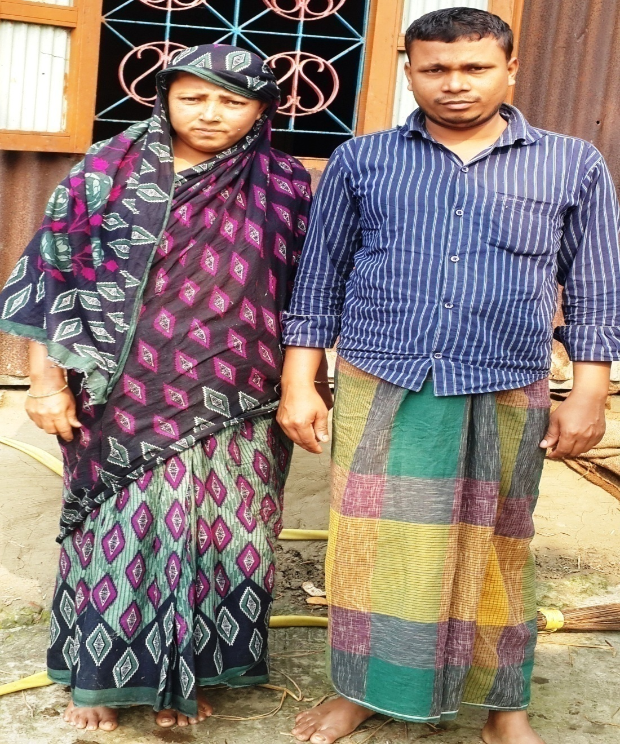

Slide 13
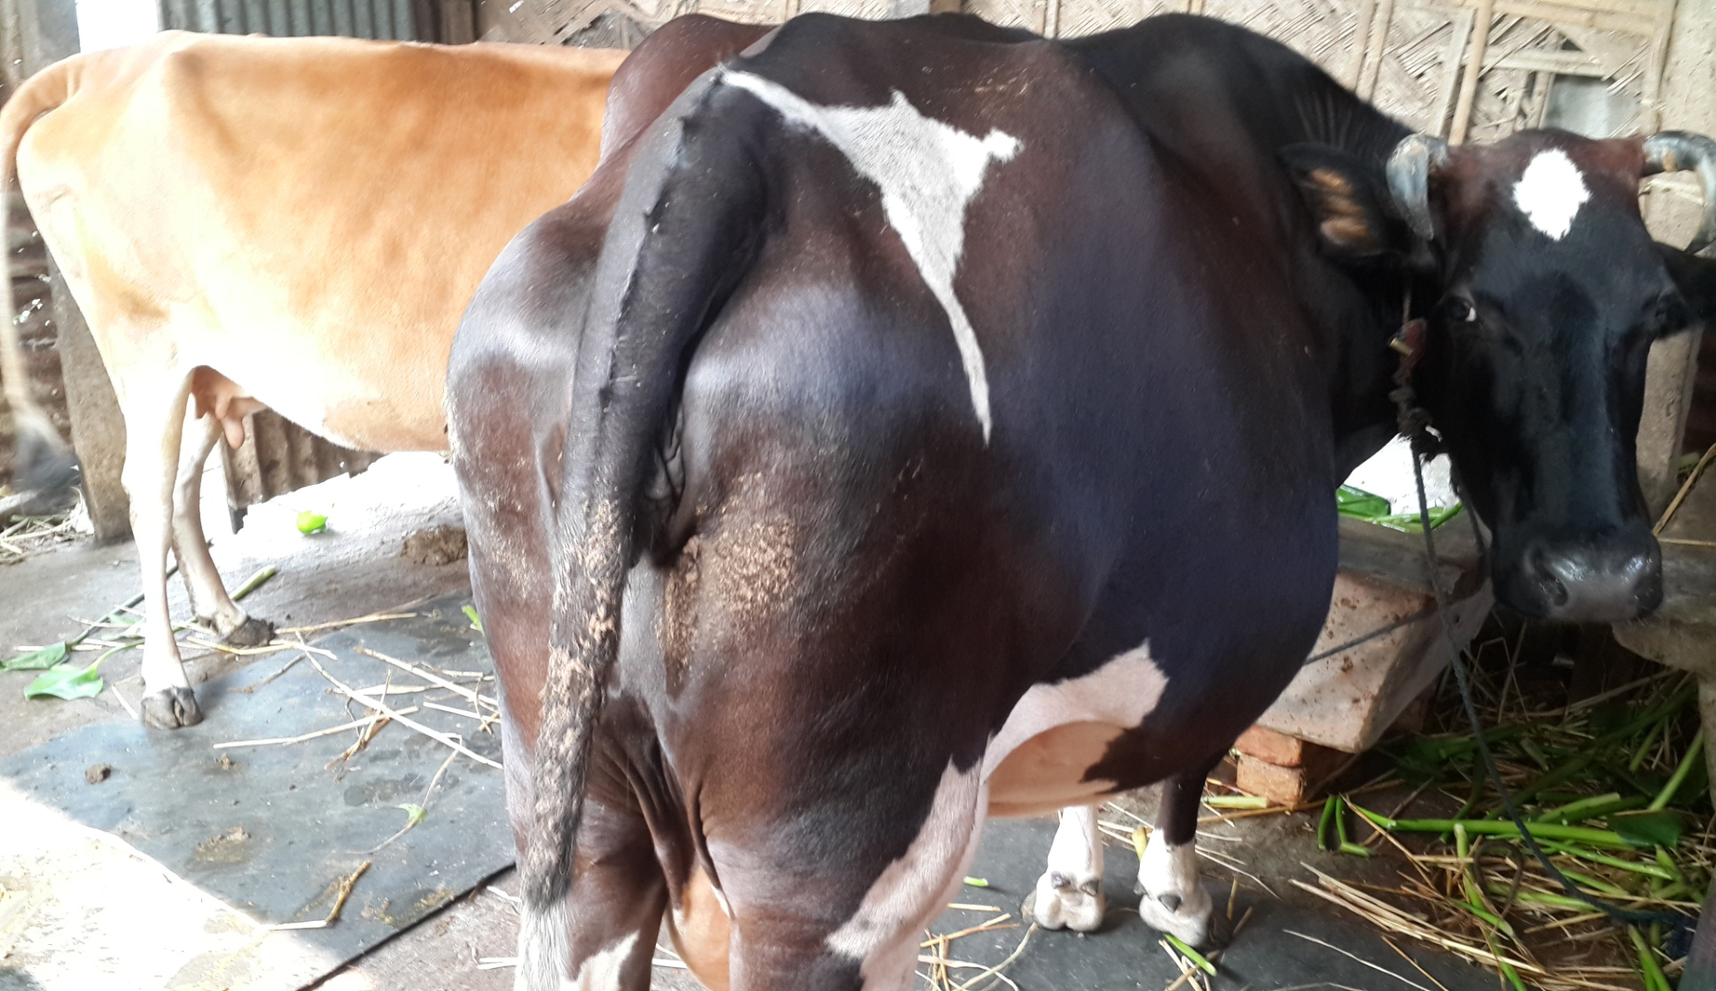

Slide 14
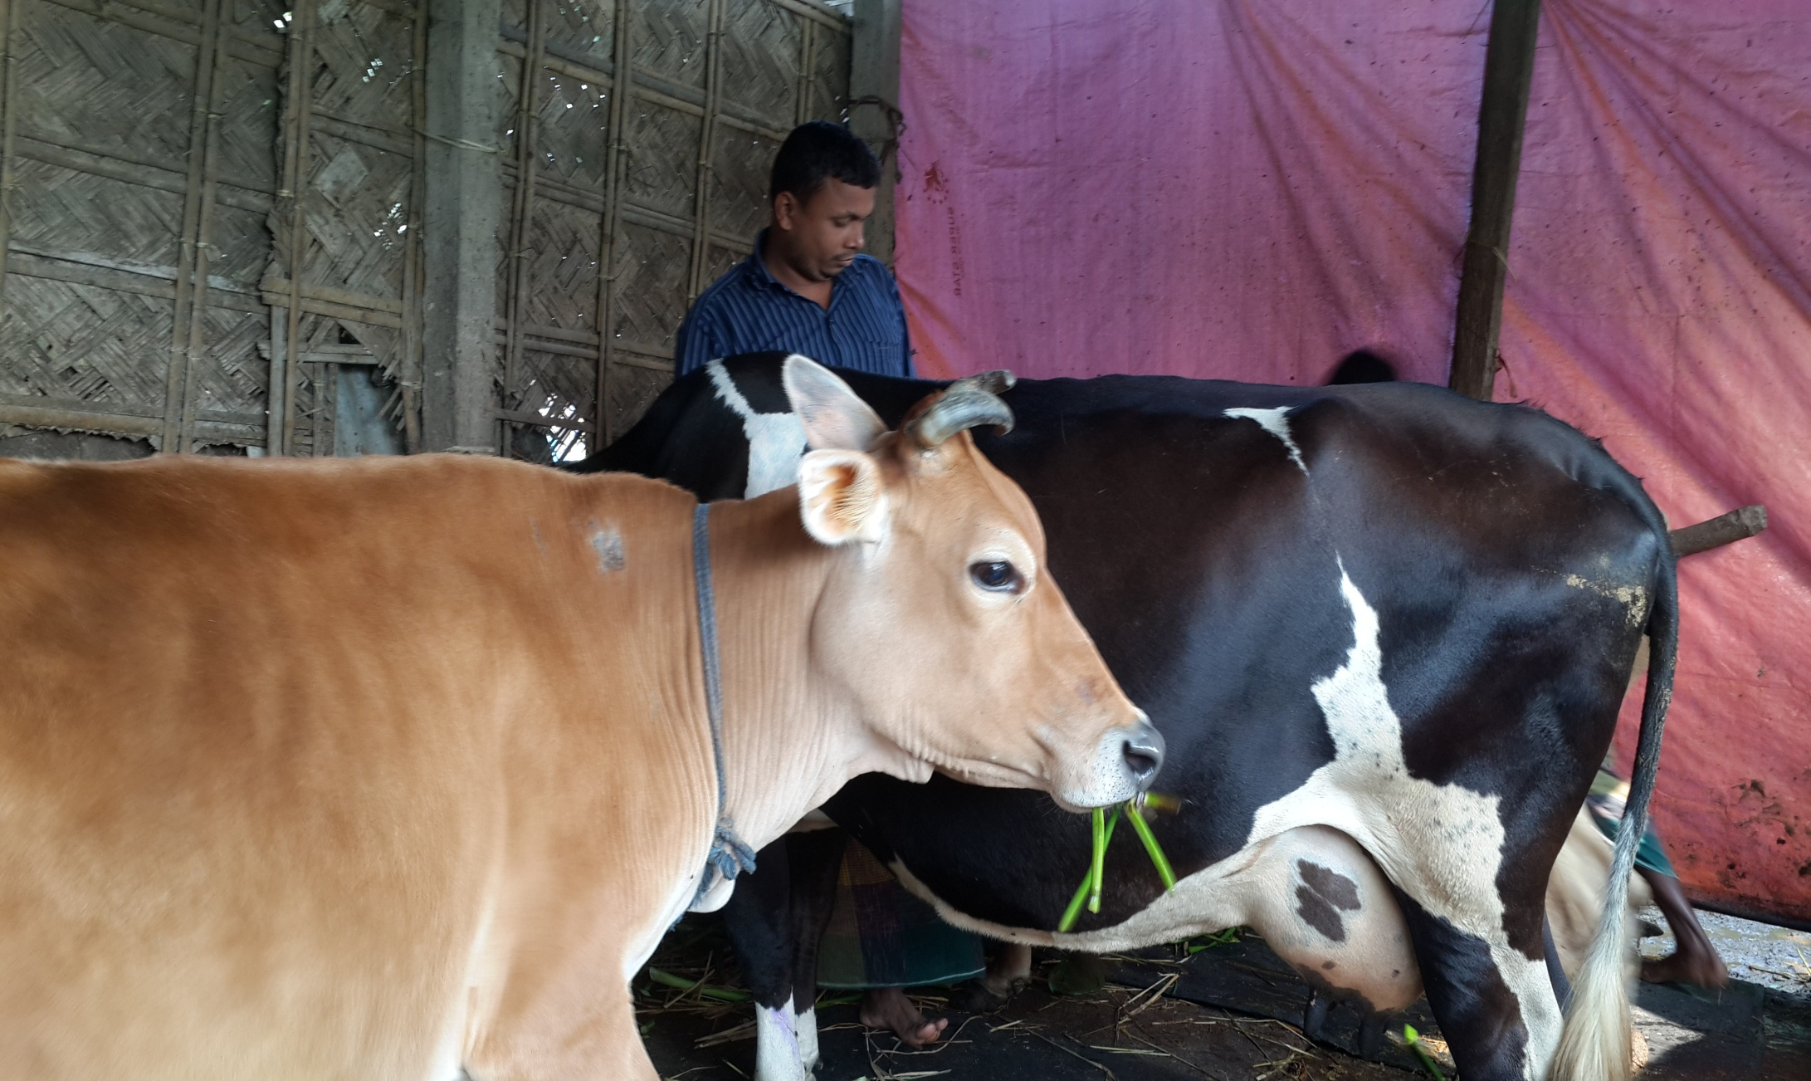

Slide 15
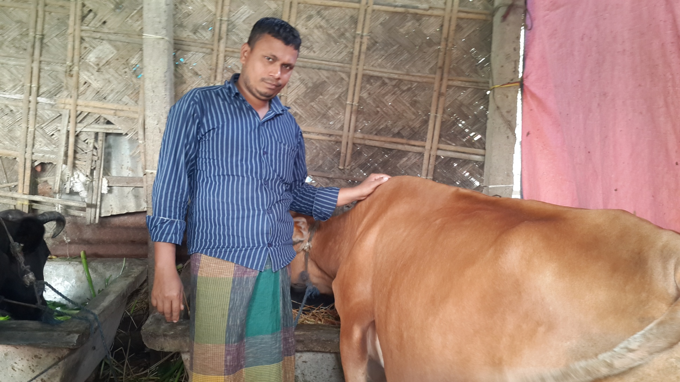

Slide 16
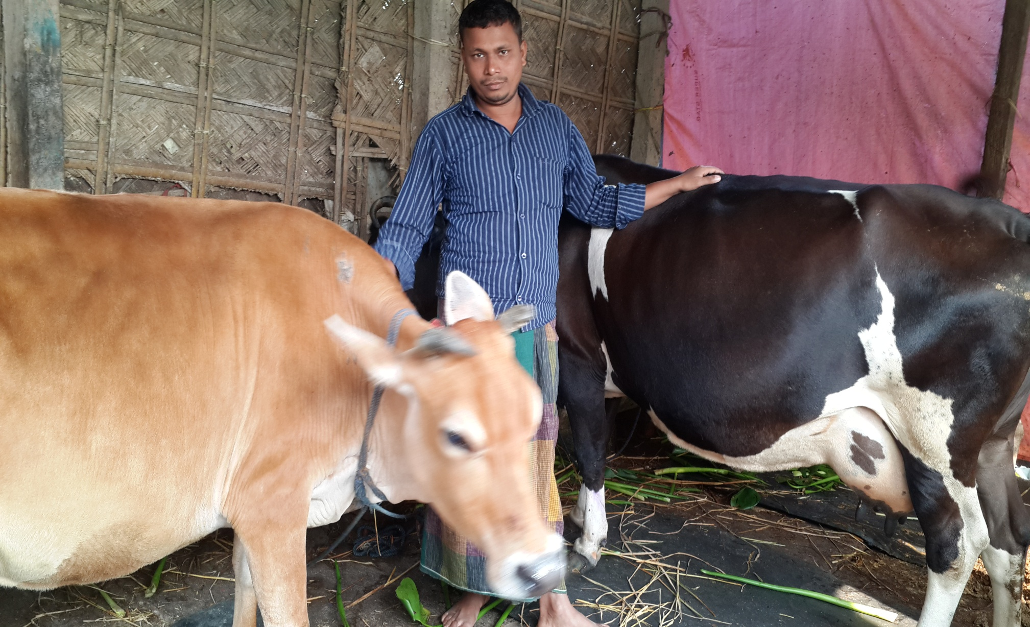

Slide 17
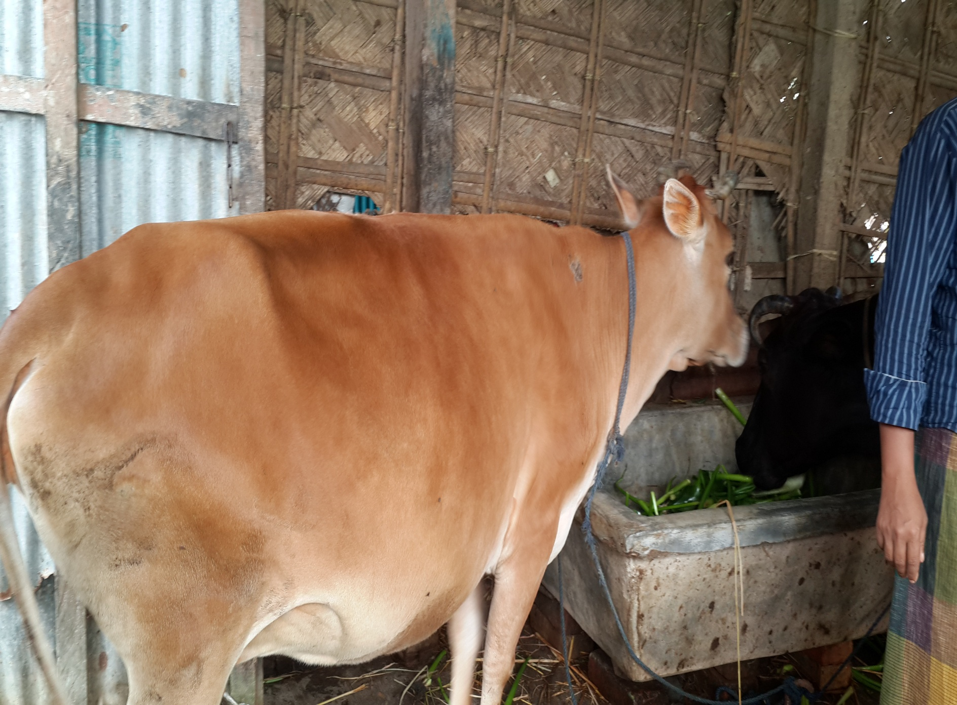

Slide 18
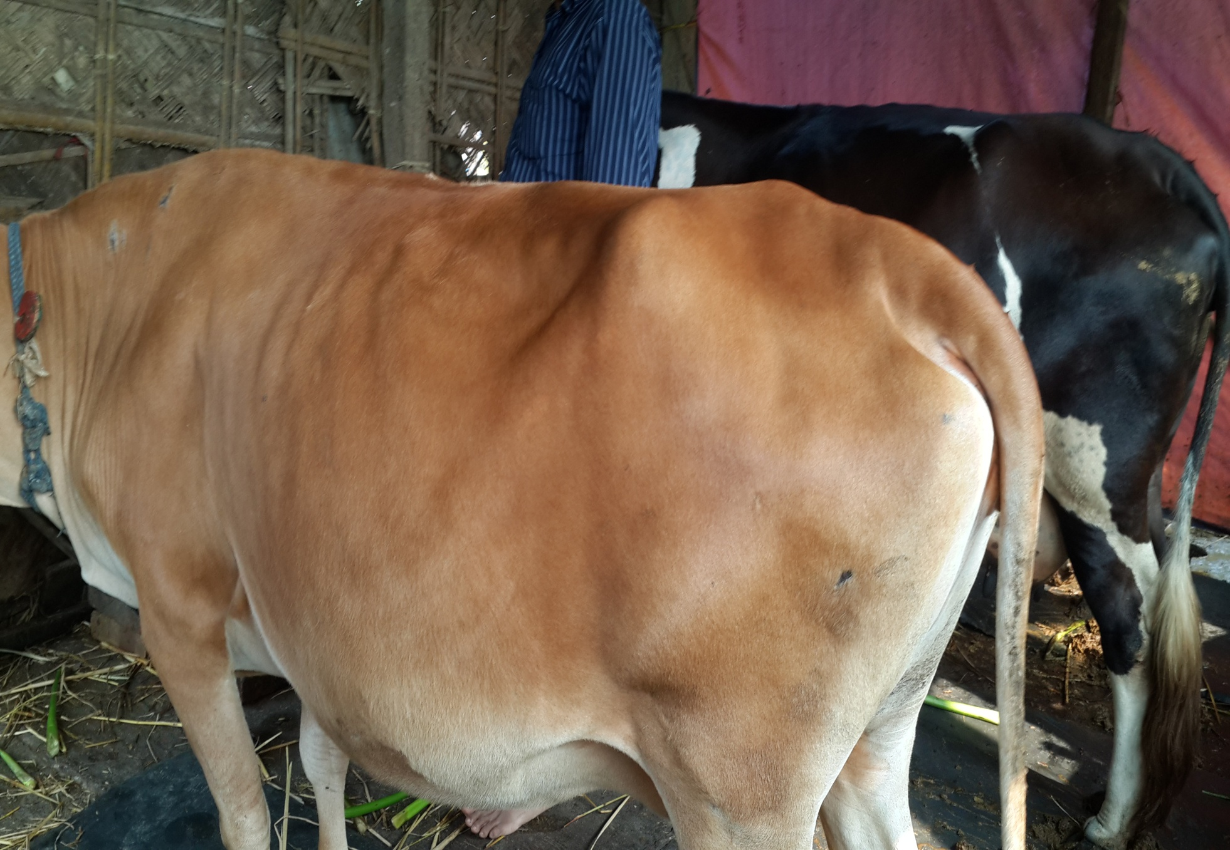
Clear Picture of NID (Both Side)

Slide 19
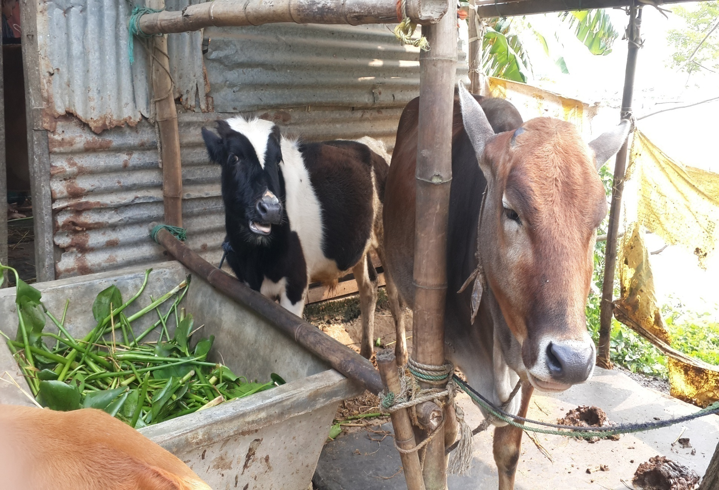
Clear Picture of Trade License

Slide 20
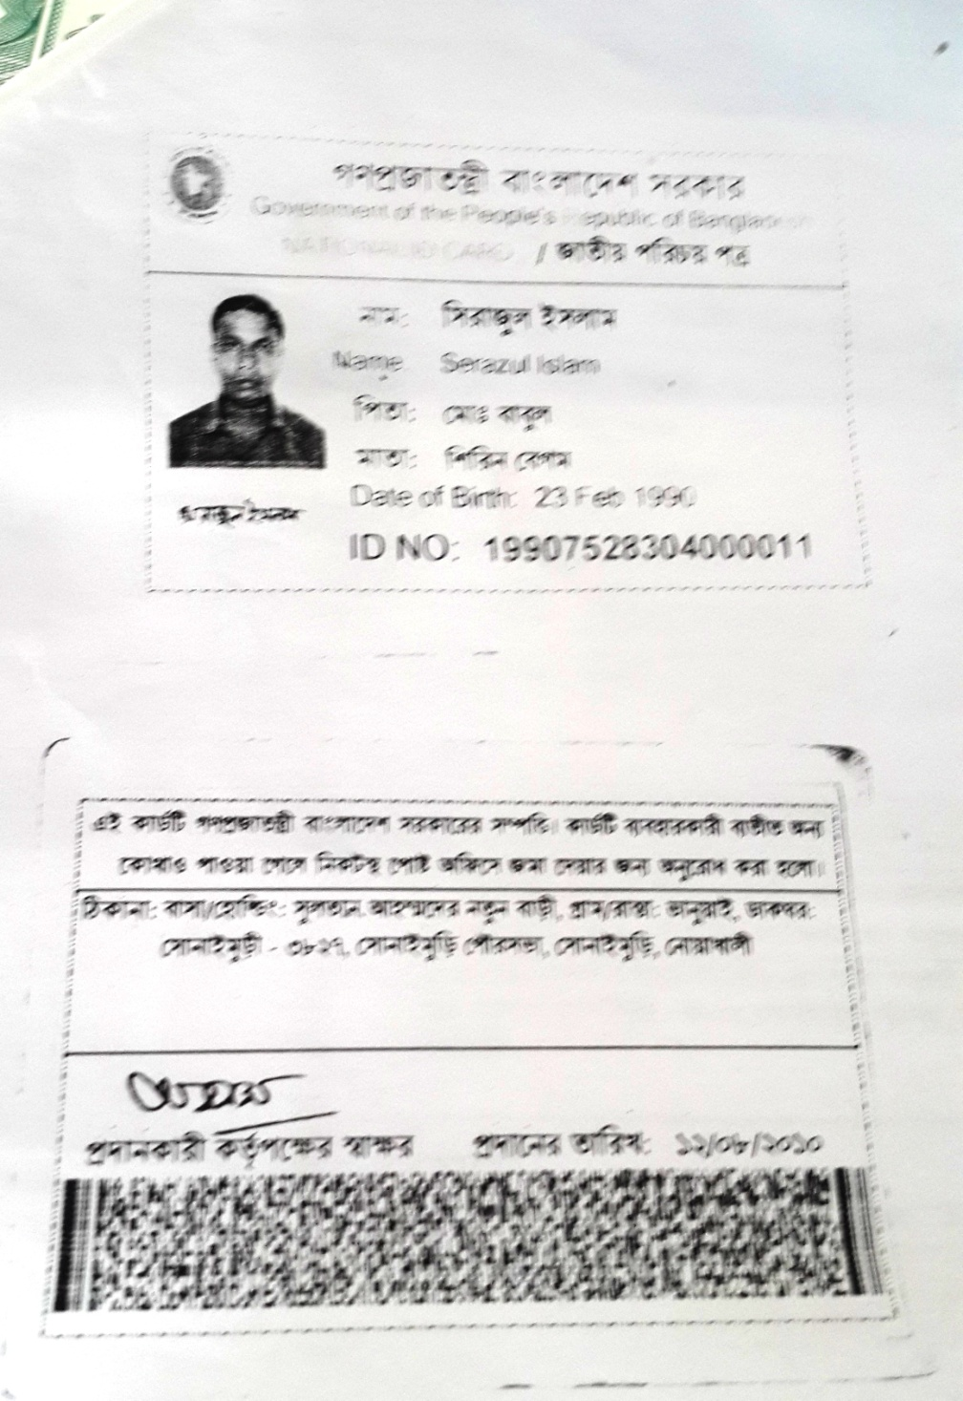
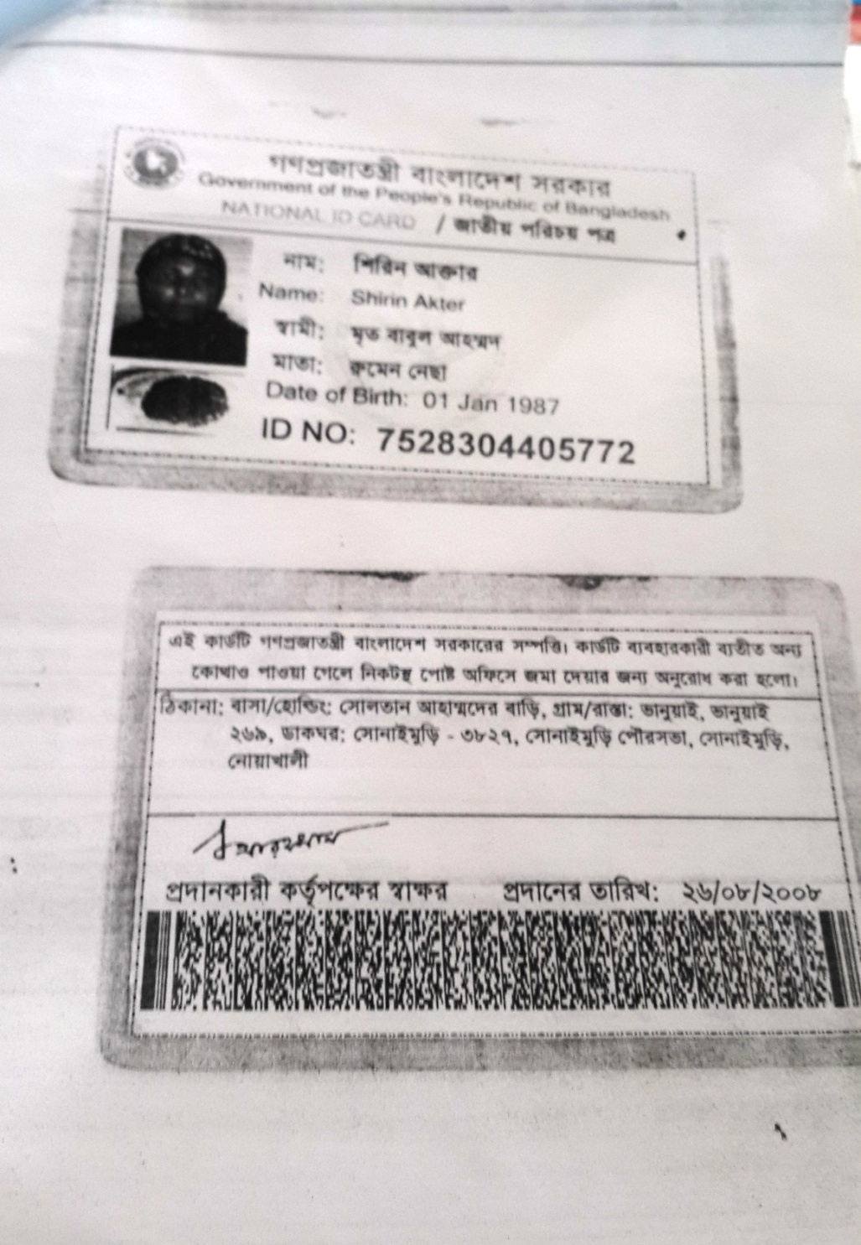

Slide 21

Presented at
SB Design Lab
On January 2017
For more information
Grameen Trust
Phone No : 9017038
Md. Serazul Islam
Cell No:

