Slide 1
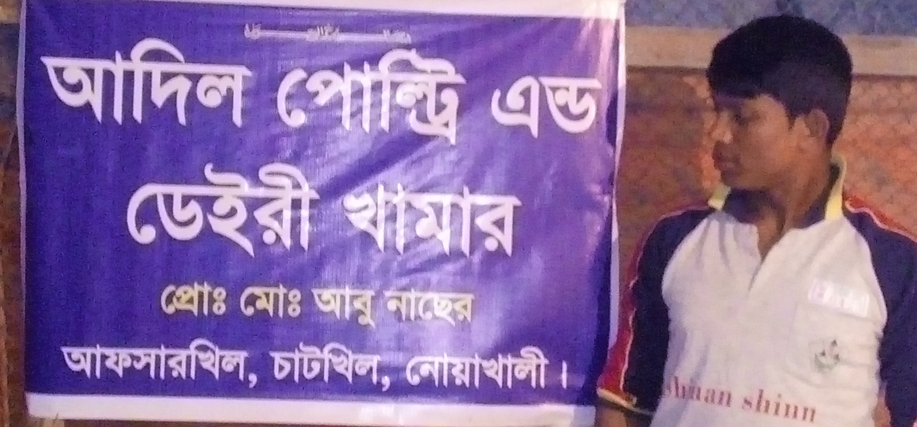

Adil Poultry Khamar
Clear Shop picture with Sign Board
Project by: Mohammad Abu Naser
Identified by: Ala Uddin
Verified By: Mir Hossain Chwdhury
Sonaimuri Unit
Region -2
GRAMEEN TRUST

Slide 2
Brief Bio of the PROPOSED Nobin Udyokta
Name | : | Md. Mohammad Abu Naser
Permanent Address | : | Vill: Afsar Khil post: Taltola Bazer, P.S: Chatkhil, District: Noakhali.
Age | : | February 20, 1983 (33 Years)
Marital status | : | Married
Children | : | Nil
No. of siblings: | : | 04 Brothers, Three Sisters.
Parent’s and GB related Info (i) Who is GB member (ii) Mother’s name (iii) Father’s name (iv) GB member’s info Further Information: (v) Who pays GB loan installment (vi) Mobile lady (vii) Grameen Education Loan Any other loan like GCCN, GKF | : : : : : : : | Mother Yes Father Bebe Hazera Abdul Haque Branch: Joyag, Centre: 27/m Group no: 05 Loanee no.: 4984 Member since: 2005, First loan: 5,000/-, Existing loan:N/A, Outstanding: N/A N/A N/A N/A N/A
Education | : | Eight

Slide 3
Brief Bio of the PROPOSED Nobin Udyokta (cont…)
Present Occupation | : | Poultry Farm
Initial Investment | : | 250,000/-
Trade License/ Drug License |  | 369
Business Experience And Training Info. | : | 10 years
Other Own/Family Sources of Income | : | One brother is doing business & one brother is staying in abroad.
Other Own/Family Sources of Liabilities | : | N/A
NU Contact Info |  | 01833647033
NU Project Source/Reference |  | Sonaimuri Unit, Noakhali.

Slide 4
brief history of GB loan utilization by Family
NU’s Mother has been a member of Grameen Bank since 2005 (6 years). At first she took a loan of Tk. 5,000/- from GB. NU’s mother gradually improved their living standard by using GB loan.

Slide 5
Proposed Nobin Udyokta business INFO
Business Name | : | Adil Poultry Khamar
Address/ Location | : | Afsar Khill Chatkhil
Total Investment in BDT | : | 4,66,400/-
Financing | : | Self BDT 3,86,400 (from existing business) 83% Required Investment BDT 80,000/-(as equity) 17%
Present salary/drawings from business (estimates) | : | 8,000/-
Proposed Salary | : | 8,000/-
Proposed Business % of present gross profit margin (ii) Estimated % of proposed gross profit margin (iii) Agreed grace period | : : : | 15% 15% 2 months

Slide 6
Present & Proposed Investment Breakdown
Particulars | Existing Business (BDT) | Proposed (BDT) | Total (BDT)
Investments in different categories: | (1) | (2) | (1+2)
Present Stock Items: gyiMx gyiMxi Lvevi wWsMv Jla | 2,50,000 1,20,000 6,400 10,000 |  | 3,86,400
Proposed items: |  | 80,000 | 80,000
Total Capital |  |  | 4,66,400

Slide 7
Present & Proposed Investment Breakdown
Present Stock items3366
Product name | Unit (Quantity) | Amount
gyiMx | 1,550*160 | 250000
gyiMxi Lvevi | 60*2,000 | 1,20000
wWsMv |  | 6,400
Jla |  | 10,000
Total Present Stock |  | 3,86,400
Proposed items
Product Name | Unit | Amount
gyiMxi ev”Pv | 1,000*50 | 50,000
gyiMxi Lvevi | 15*2,000 | 30,000
Total Proposed Stock |  | 80,000

Slide 8
INFO ON EXISTING BUSINESS OPERATIONS
Particulars | Existing Business (BDT)
 | Monthly | Yearly
Sales (A) | 2,50,000 | 30,00,000
Less: Cost of sales (B) | 2,12,500 | 25,50,000
Gross Profit C=(A-B) | 37,500 | 4,50,000
Less: Operating Costs
Electricity bill | 1,000 | 12,000
Shop Rent | 5,000 | 60,000
Mobile bill | 200 | 2,400
Present salary/Drawings- self | 8,000 | 96,000
Employee Salary | 5,000 | 60,000
Conveyance or Transport] | 200 | 2,400
Others (fees, Entertainment, TL renew) | 200 | 2,400
Non Cash Item:
Depreciation Expenses (10%) | 53 | 640
Total Operating Cost (D) | 19,653 | 2,35,840
Net Profit (C-D): | 17,847 | 2,14,160

Slide 9
Financial Projection of NU Business plan
Particulars | Year 1 (BDT) |  | Year 2 (BDT) |  | Year 3 (BDT)
 | Monthly | Yearly | Monthly | Yearly | Monthly | Yearly
Sales (A) | 2,60,000 | 31,20,000 | 2,70,000 | 32,40,000 | 2,80,000 | 33,60,000
Less: Cost of Sale (B) | 2,21,000 | 26,52,000 | 2,29,500 | 27,54,000 | 2,38,000 | 28,56,000
Gross Profit (A-B)=(C) | 39,000 | 4,68,000 | 40,500 | 4,86,000 | 42,000 | 5,04,000
Less: Operating Costs
Electricity bill | 1,000 | 12,000 | 1,100 | 13,200 | 1,200 | 14,400
Employee Salary | 5,000 | 60,000 | 5,000 | 60,000 | 5,000 | 60,000
Mobile bill | 200 | 2,400 | 300 | 3,600 | 400 | 4,800
Present salary/Drawings- self | 8,000 | 96,000 | 8,000 | 96,000 | 8,000 | 96,000
Conveyance or Transport | 200 | 2,400 | 300 | 3,600 | 400 | 4,800
Others (fees, Entertainment, TL renew) | 200 | 2,400 | 200 | 2,400 | 200 | 2,400
Non Cash Item:
Depreciation Expenses (10%) | 53 | 640 | 53 | 640 | 53 | 640
Total Operating Cost (D) | 14,653 | 1,75,840 | 14,953 | 1,79,240 | 15,253 | 1,83,040
Net Profit (C-D) = (E) | 24,347 | 2,92,160 | 25,547 | 3,06,760 | 26,747 | 3,20,960
GT payback | 32,000 |  | 32,000 |  | 32 ,000
Retained Income: | 260160 |  | 274760 |  | 2,88960

Slide 10
Cash flow projection on business plan (Rec. & Pay.)
Sl . No. # | Particulars | Year 1 (BDT) | Year 2 (BDT) | Year 3 (BDT)
1.0 | Cash Inflow
1.1 | Investment Infusion by Investor | 80,000
1.2 | Net Profit | 2,92,160 | 3,06,760 | 3,20,960
1.3 | Depreciation (Non cash item) | 640 | 640 | 640
1.4 | Opening Balance of Cash Surplus |  | 2,60,800 | 5,36,200
 | Total Cash Inflow | 3,72,800 | 5,68,200 | 8,57,800
2.0 | Cash Outflow
2.1 | Purchase of Product | 80,000
2.2 | Payment of GB Loan
2.3 | Investment Pay Back (Including Ownership Tr. Fee) | 32,000 | 32,000 | 32,000
 | Total Cash Outflow | 1,12,000 | 32,000 | 32,000
3.0 | Net Cash Surplus | 2,60,800 | 5,36,200 | 8,25,800

Slide 11
SWOT Analysis
STRENGTH Skilled and experienced. Quality service and product Seven days open in a week 16 hours shop open | WEAKNESS Lack of investment
OPPORTUNITIY More customers within the area. Increasing demand. | THREATS Political Unrest Theft

Slide 12
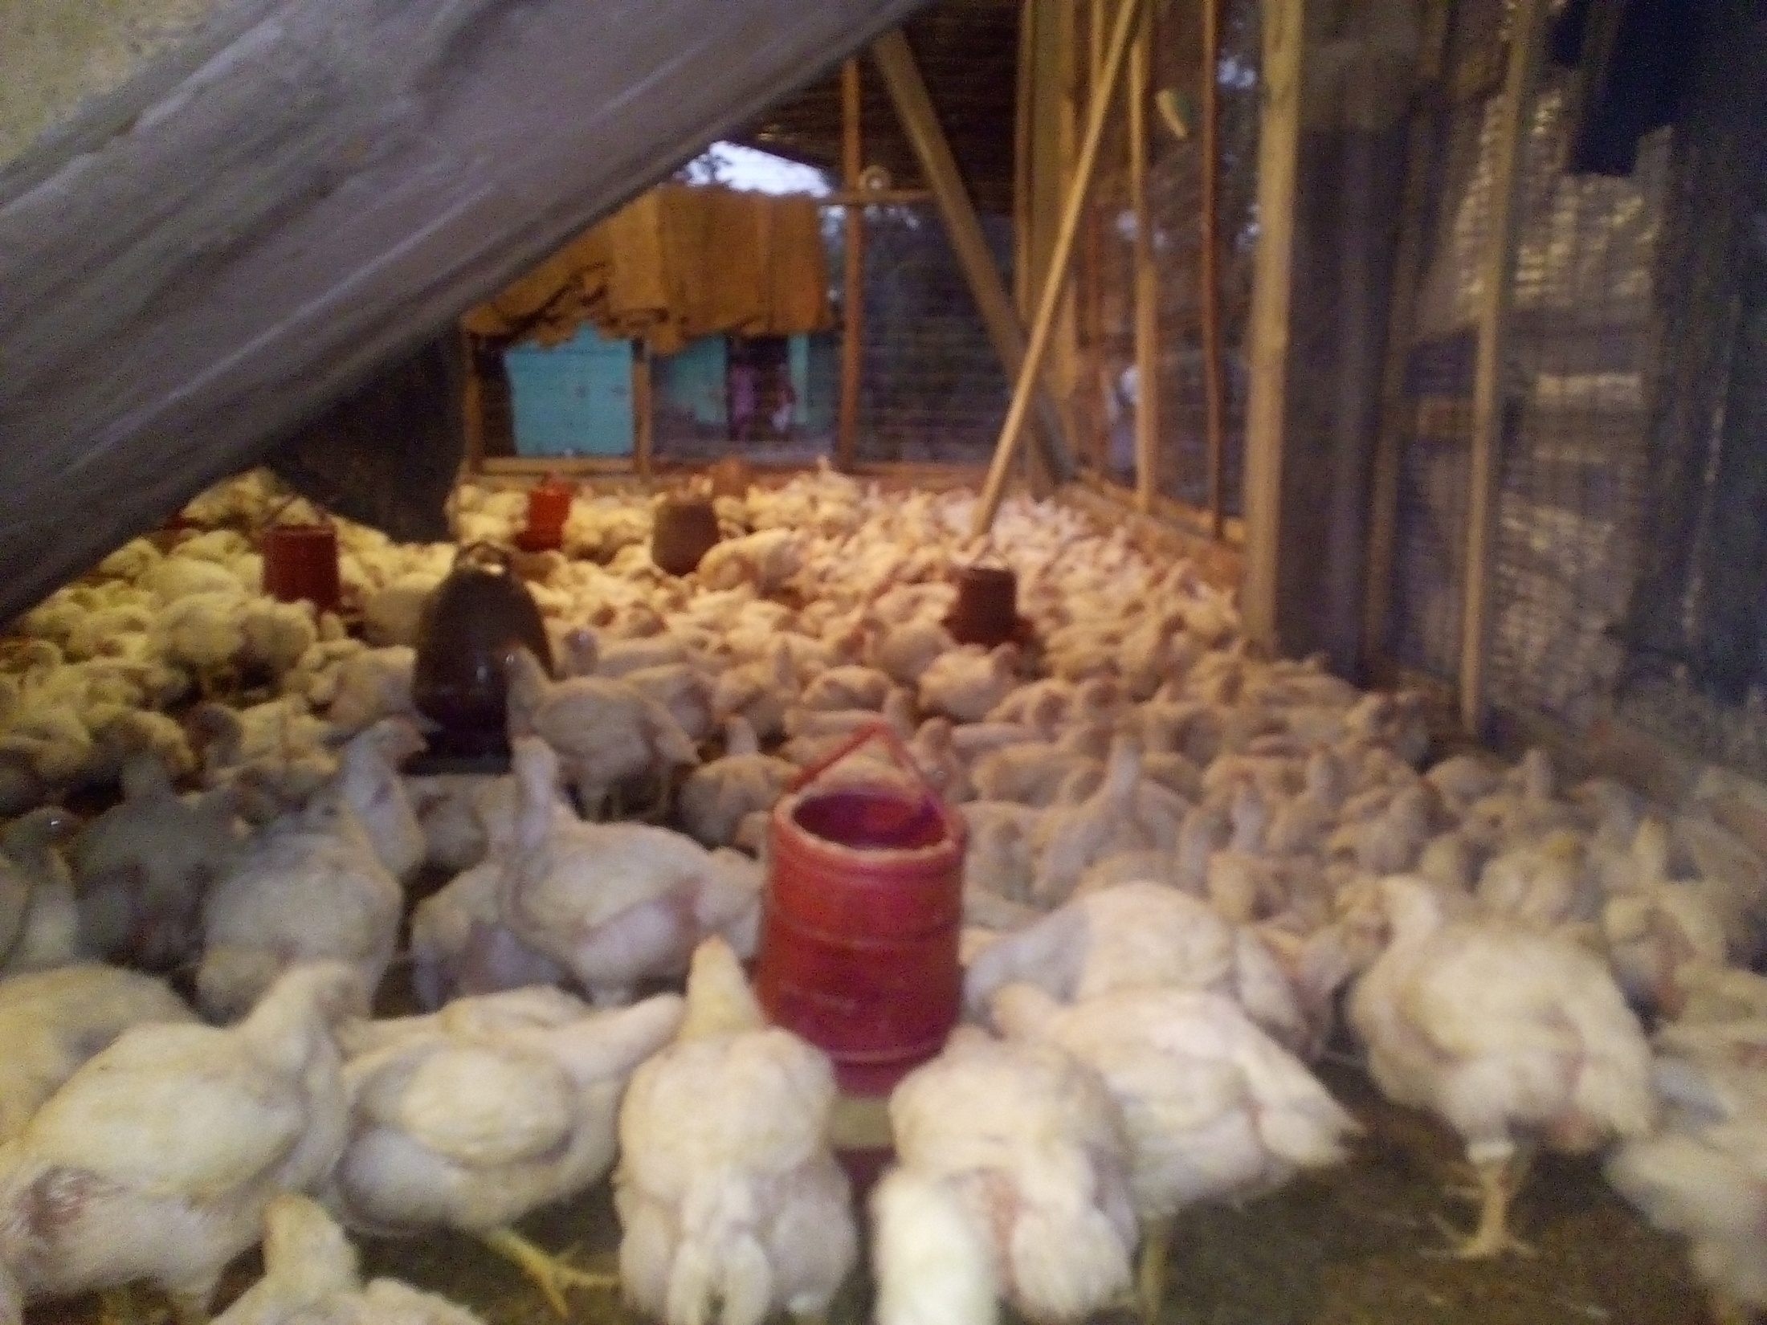

Slide 13
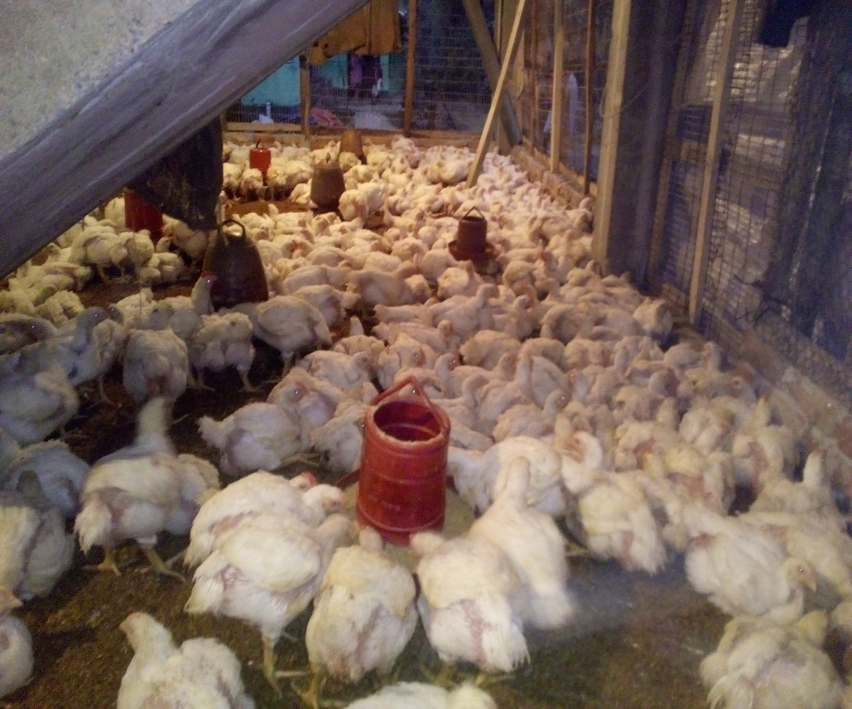

Slide 14
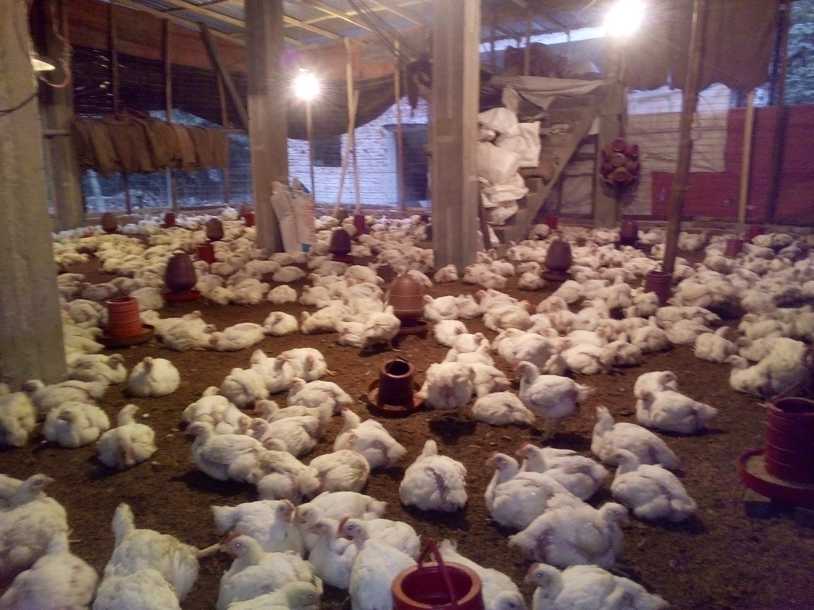

Slide 15
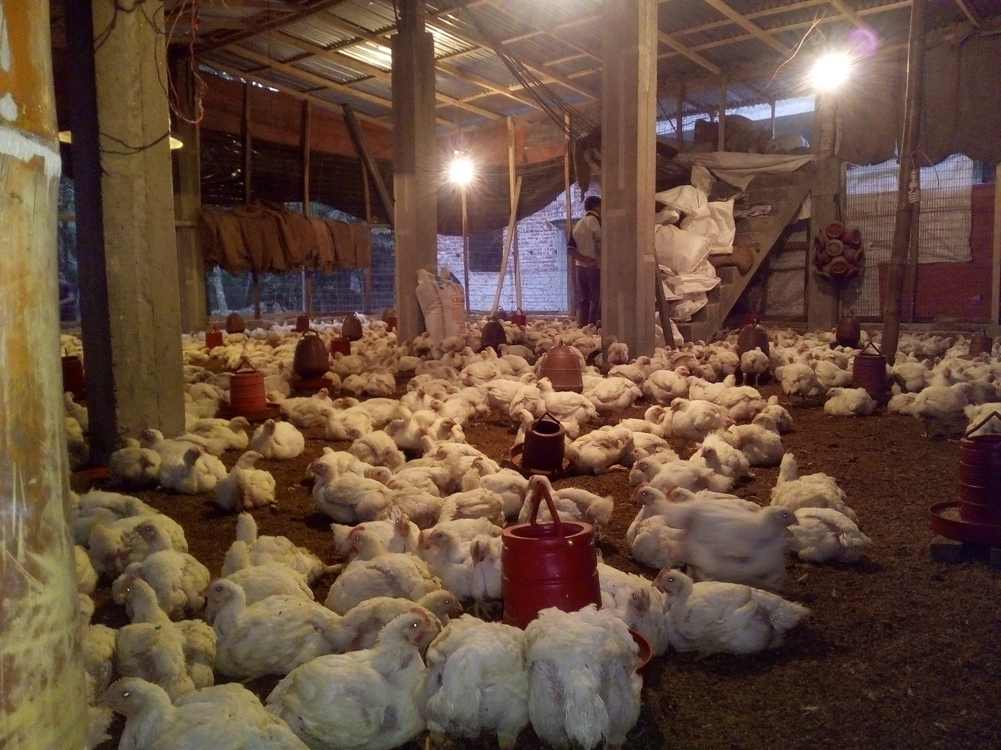

Slide 16
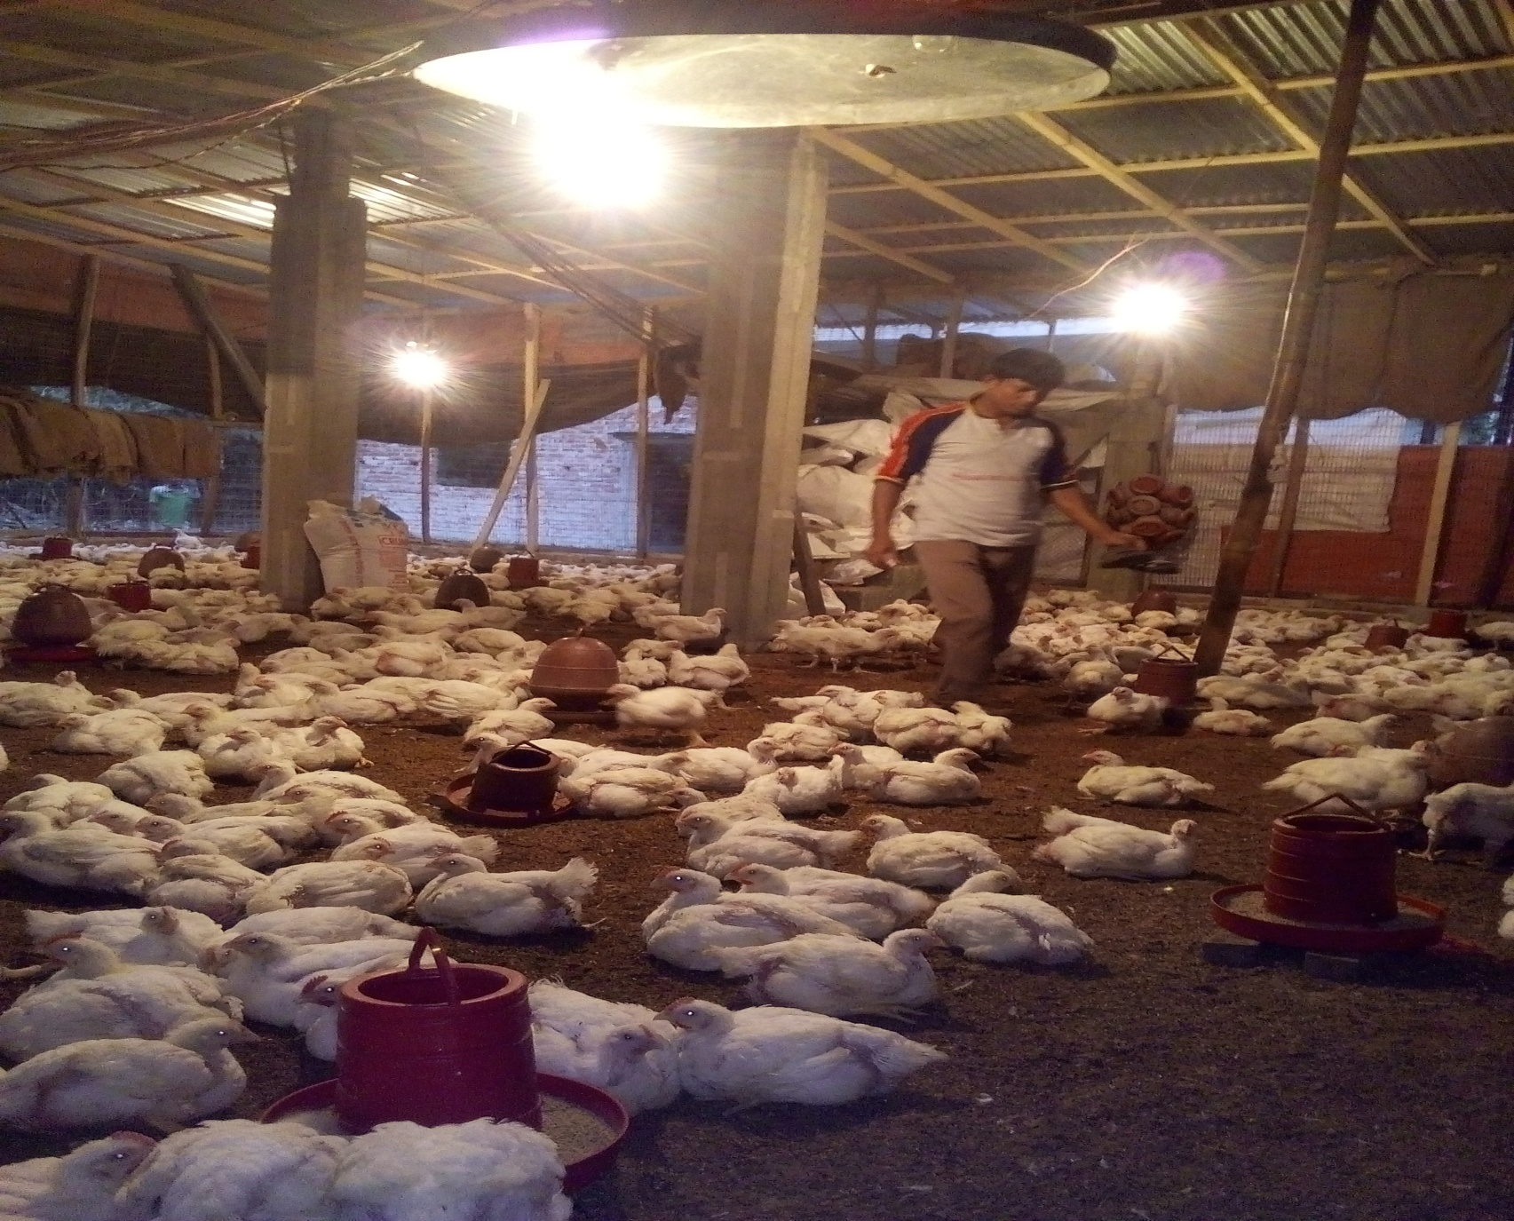

Slide 17
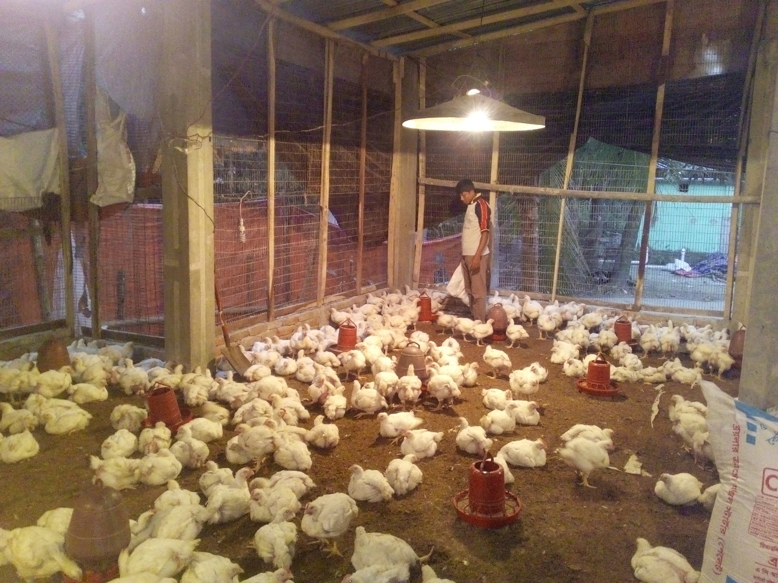
Clear Picture of NID (Both Side)

Slide 18
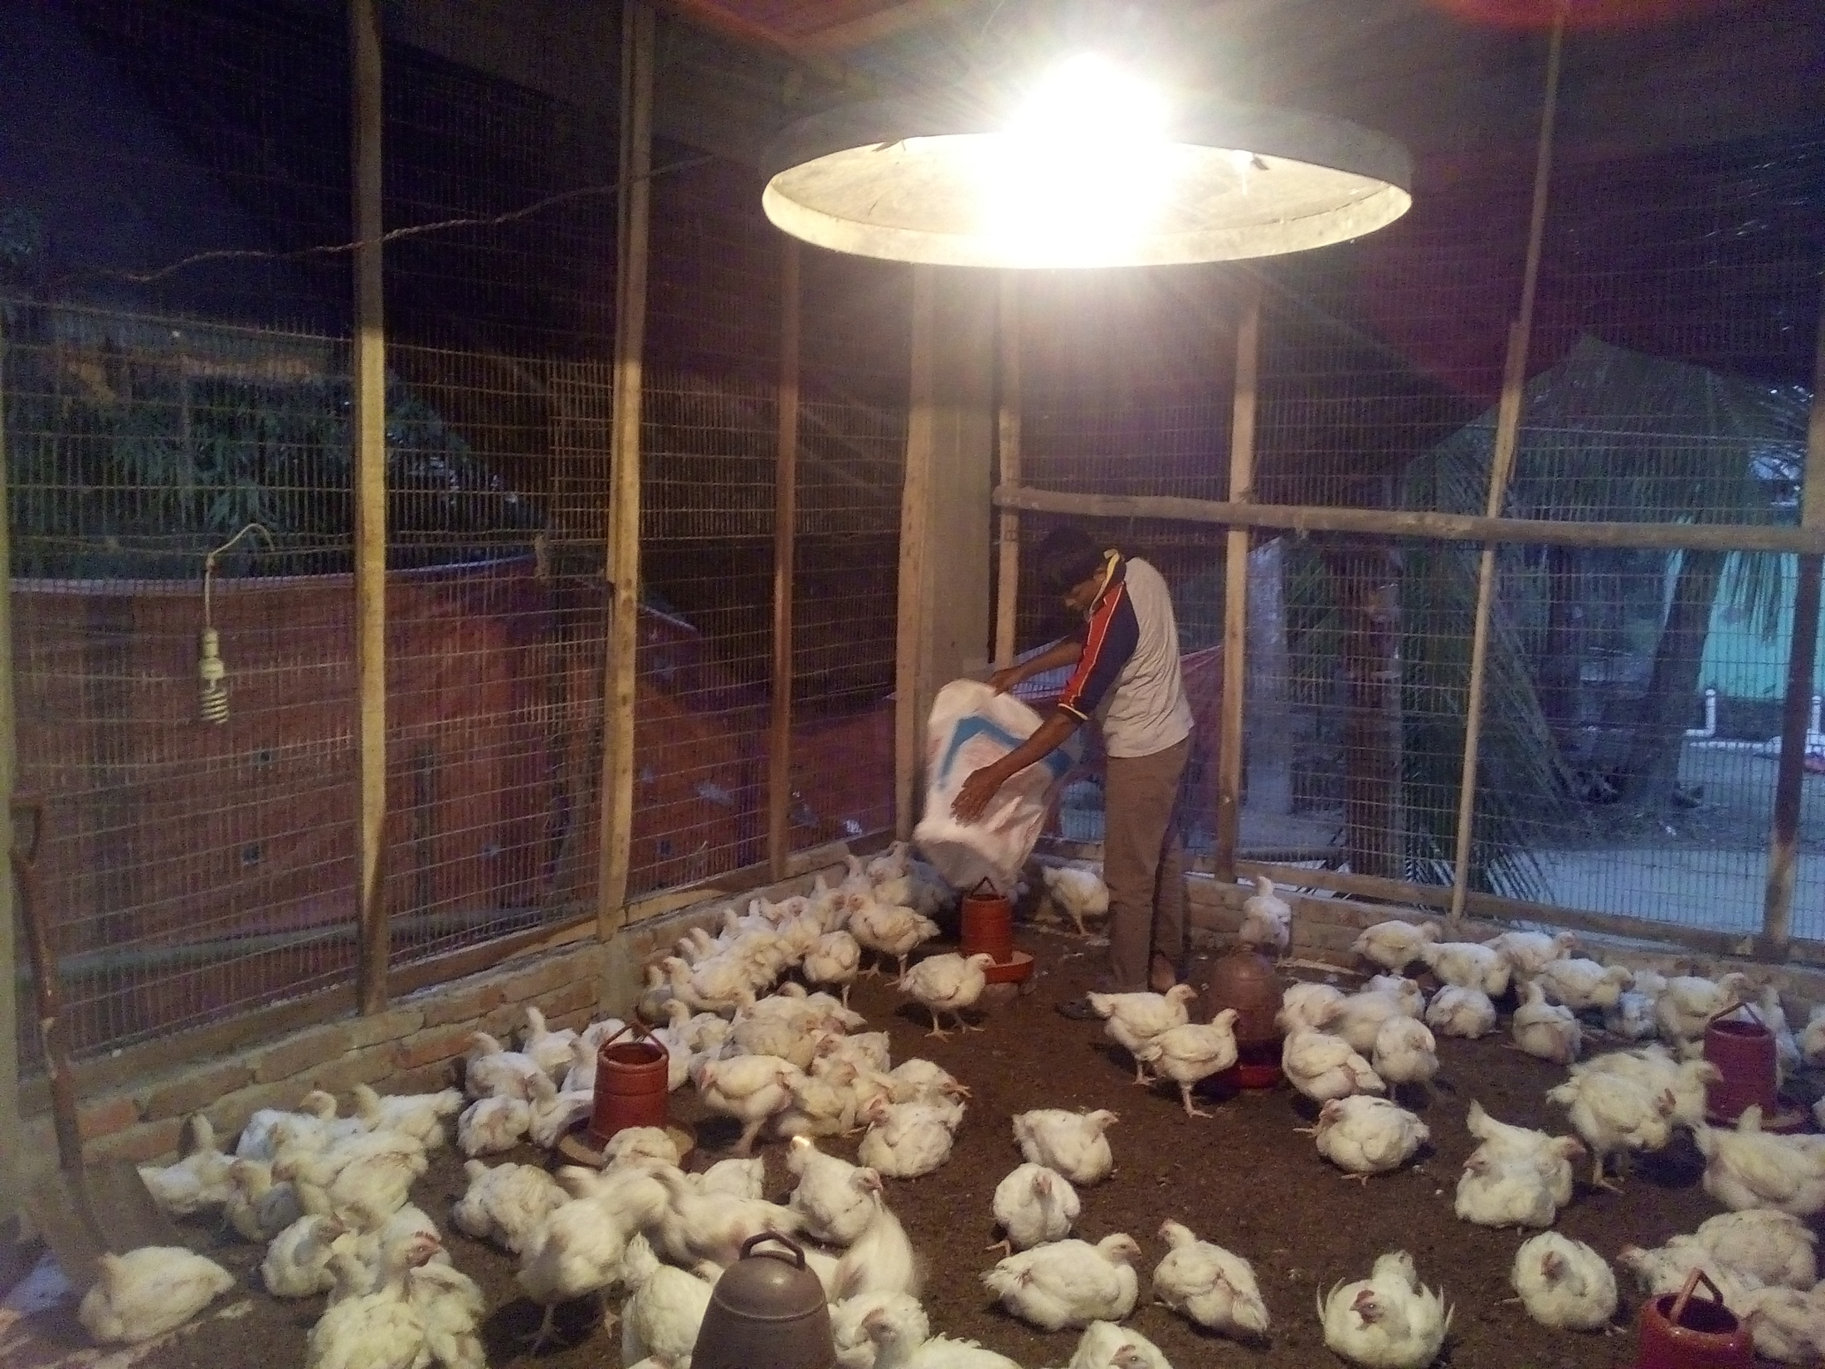
Clear Picture of Trade License

Slide 19
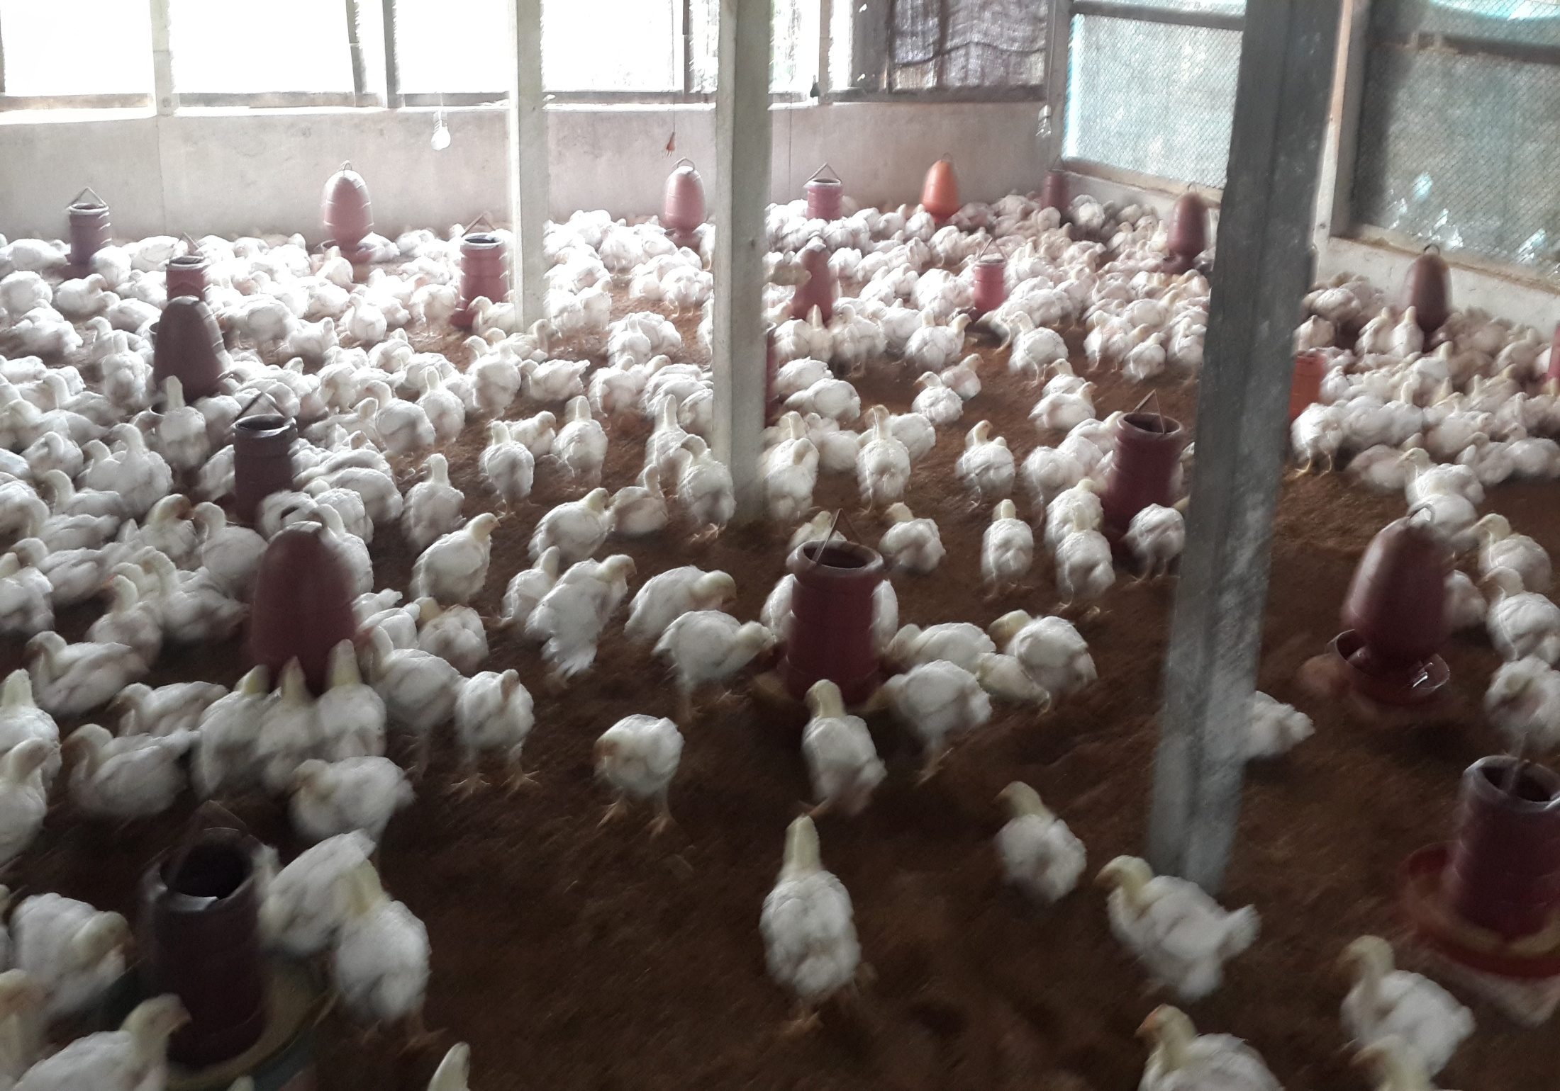

Slide 20
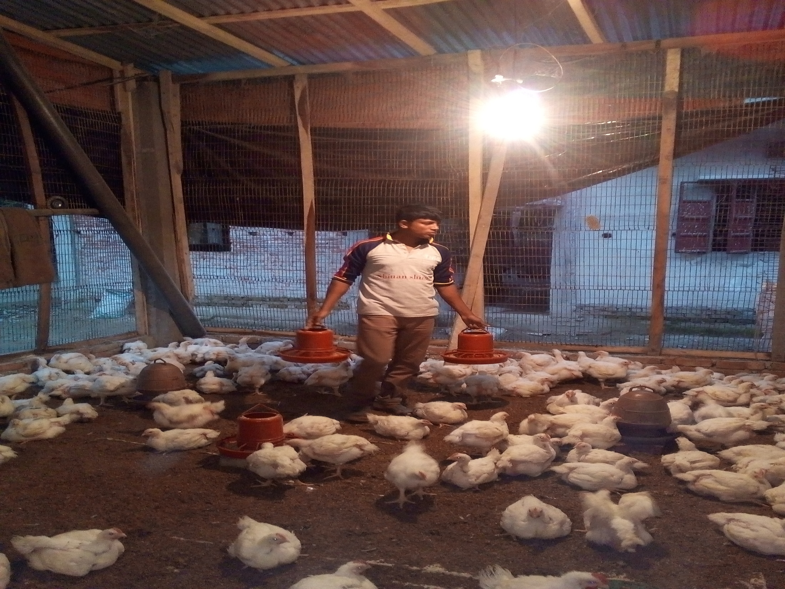

Slide 21
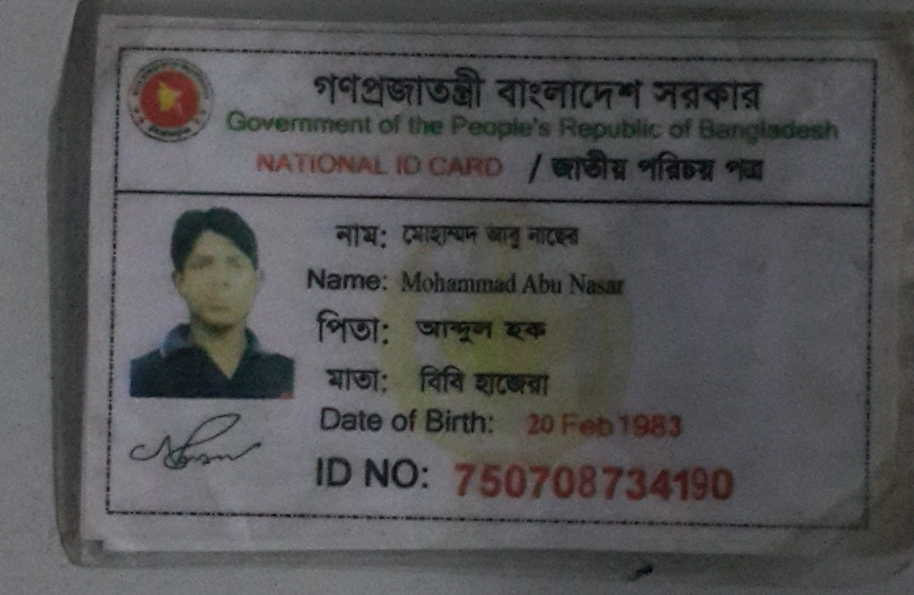
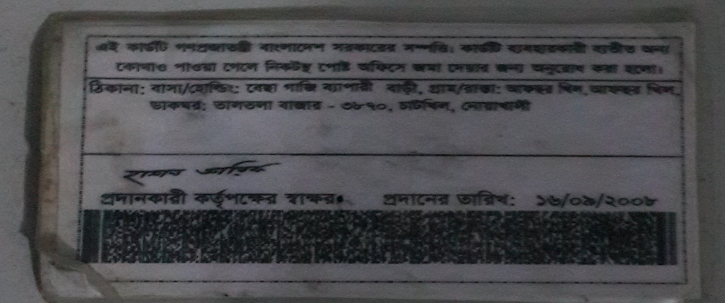

Slide 22
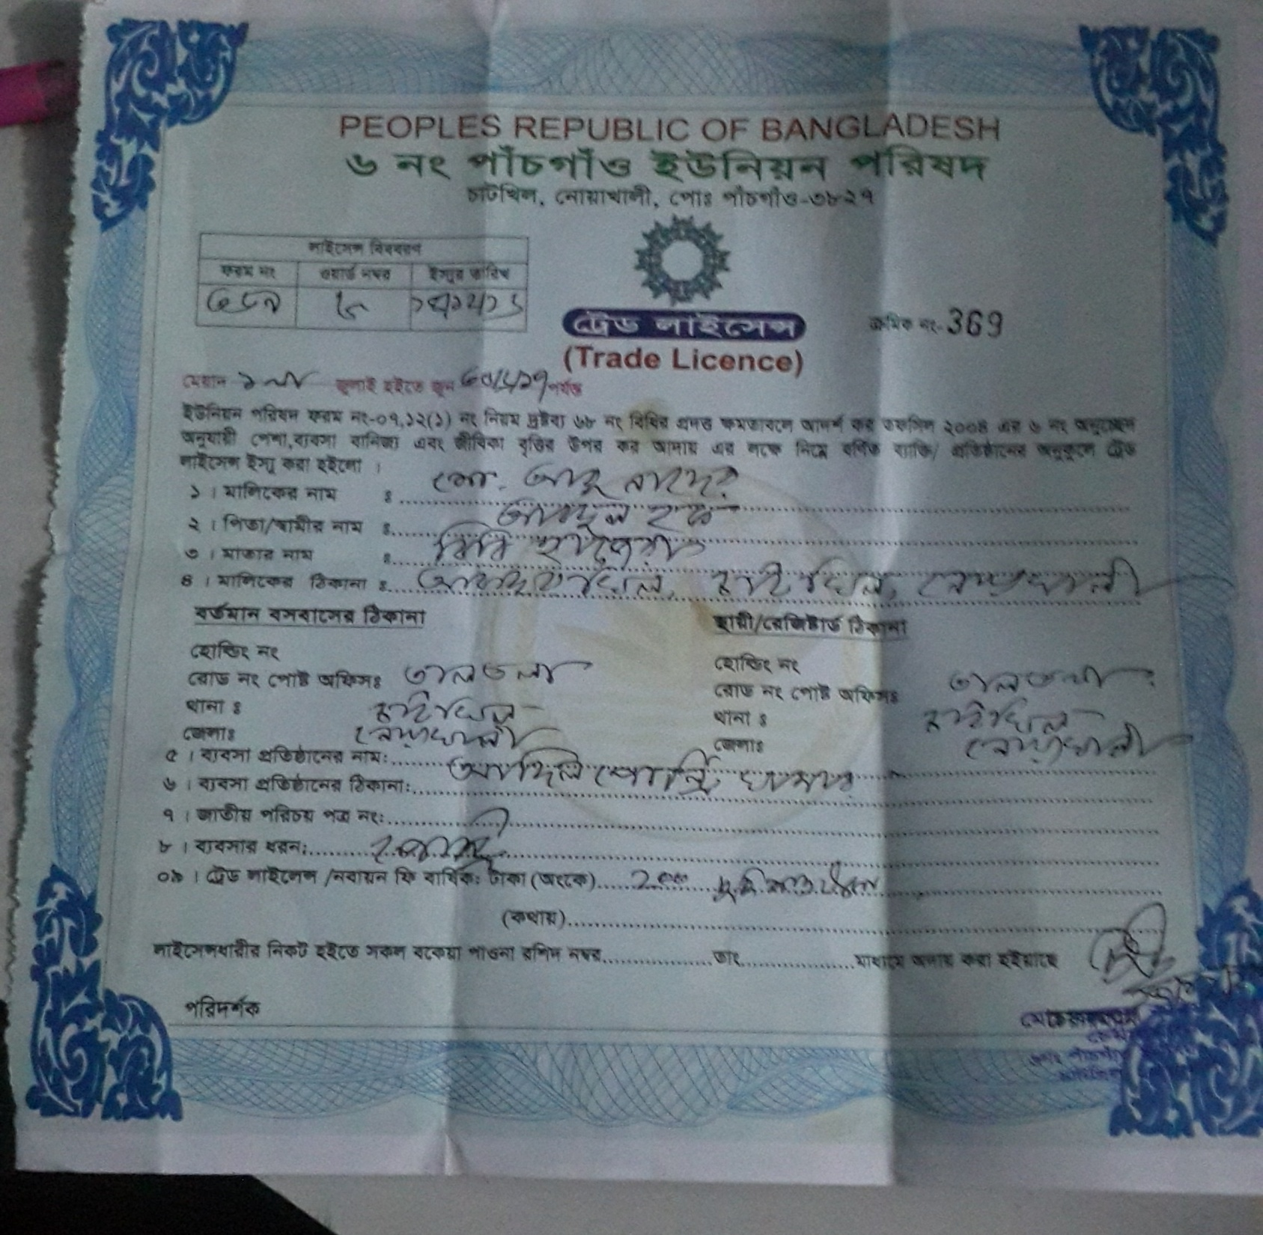

Slide 23

Presented at
SB Design Lab
On January 2017 at GT
For more information
Grameen Trust
Phone No : 9017038
Mohammoad Abu Naser
Cell No: 01753468235

